Slide 1

BDNF in the NAc:
Essential Role in Chronic Social Stress-Induced Depression
Optogenetics in the Nucleus Accumbens
April 29, 2016
Brenna Bray

Slide 2
Outline
Background
Krishnan et al., 2007: Molecular Adaptations Underlying Vulnerability & Resistance to Social Defeat (BDNF & “Pro-depressant NAc DA”)
Tye et al., 2013: Dopamine neurons modulate neural encoding and expression of depression-related behavior (“Antidepressant NAc DA”)
Koo et al., 2016: Essential Role of Mesolimbic BDNF in Chronic Social Stress-Induced Depressive Behaviors
  CSDS: ↑ VTA→NAc activity→ ↑ NAc BDNF → ↓ D1 MSN activity → social avoidance

Slide 3
Notes:
DA signaling in the Mesolimbic Reward System (VTA to Nac)
Neural substrates of the rewarding properties (food, mating behaviors, and addictive drugs)
Motivate social behaviors
Social interactions engage reward pathways (Krishnan et al., 2007)
Mediate responses to social defeat (Krishnan et al., 2007):
↑ VTA DA neurons in CSDS-vulnerable mice
↑ VTA BDNF in CSDS-vulnerable mice
↑ TrkB receptor signaling in NAc
Dipesh Chaudhury’s 2013 article “rapid regulation of depression-related behaviors by control of midbrain dopamine neurons” – out of MH Han’s lab in collaboration with Eric Nestler – which adapted from Krishnan 2007 a Subthreshold social defeat paradigm – that also produced susceptible and resiliant “depression-related” phenotypes and incorporates optigenetic techniques.

Slide 4
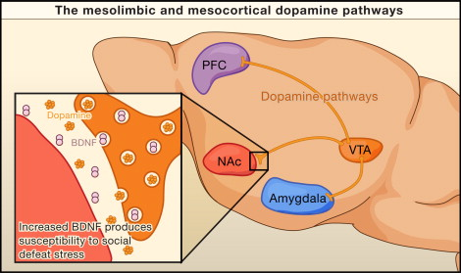
Mesolimbic Dopamine Reward System (VTA→Nac)
Neural substrates of natural & drug rewards
Motivate social behaviors:
  Engaged by social interactions (Krishnan et al., 2007)
Mediate social defeat responses (Krishnan et al., 2007):
  ↑ # VTA DA neurons in CSDS-vulnerable mice
  ↑ VTA BDNF in CSDS-vulnerable mice
  ↑ TrkB receptor signaling in NAc
Hyman, SE. (2007) Cell. 131(2): 232-4.
Notes:
DA signaling in the Mesolimbic Reward System (VTA to Nac)
Neural substrates of the rewarding properties (food, mating behaviors, and addictive drugs)
Motivate social behaviors
Social interactions engage reward pathways (Krishnan et al., 2007)
Mediate responses to social defeat (Krishnan et al., 2007):
↑ VTA DA neurons in CSDS-vulnerable mice
↑ VTA BDNF in CSDS-vulnerable mice
↑ TrkB receptor signaling in NAc
Dipesh Chaudhury’s 2013 article “rapid regulation of depression-related behaviors by control of midbrain dopamine neurons” – out of MH Han’s lab in collaboration with Eric Nestler – which adapted from Krishnan 2007 a Subthreshold social defeat paradigm – that also produced susceptible and resiliant “depression-related” phenotypes and incorporates optigenetic techniques.

Slide 5
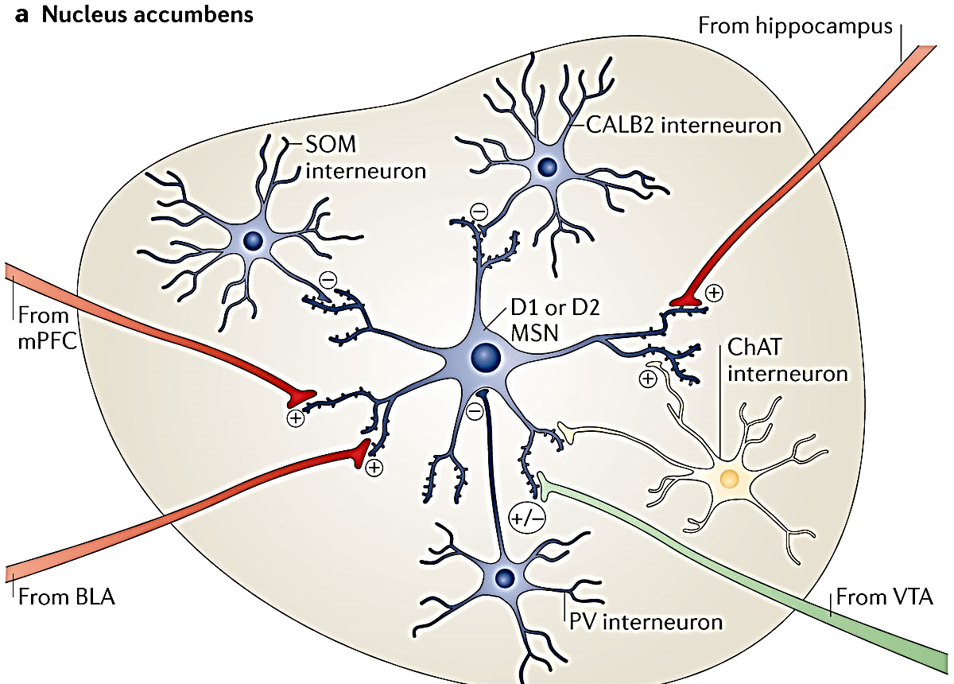
Dopaminergic Signalling in the NAc
NAcC: 95% GABAergic MSNs
Project to GP, ScN
D1R (Gs, +): ↑ reward
Direct Pathway
Excite targets, promote behaviors
↑ cocaine reward-context associations
D2R (Gi, -): aversion, ↓ cocaine reward
Indirect Pathway
Inhibit targets & associated behaviors
Russo & Nestler. (2013). Nature Reviews Neurosci 14, 609-625
Notes:
In NAc, ~40% MSNs express D1 & D2Rs, but most = in NAc Shell

Slide 6
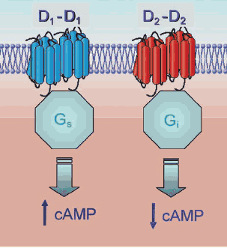
Dopaminergic Signalling in the NAc
NAcC: 95% GABAergic MSNs
Project to GP, ScN
D1R (Gs, +): ↑ reward
Direct Pathway
Excite targets, promote behaviors
↑ cocaine reward-context associations
D2R (Gi, -): aversion, ↓ cocaine reward
Indirect Pathway
Inhibit targets & associated behaviors
Whitten, L. (2009). NIDANotes; https://www.drugabuse.gov/news-events/nida-notes/2009/10/receptor-complexes-link-dopamine-to-long-term-neuronal-effects
Notes:
In NAc, ~40% MSNs express D1 & D2Rs, but most = in NAc Shell

Slide 7
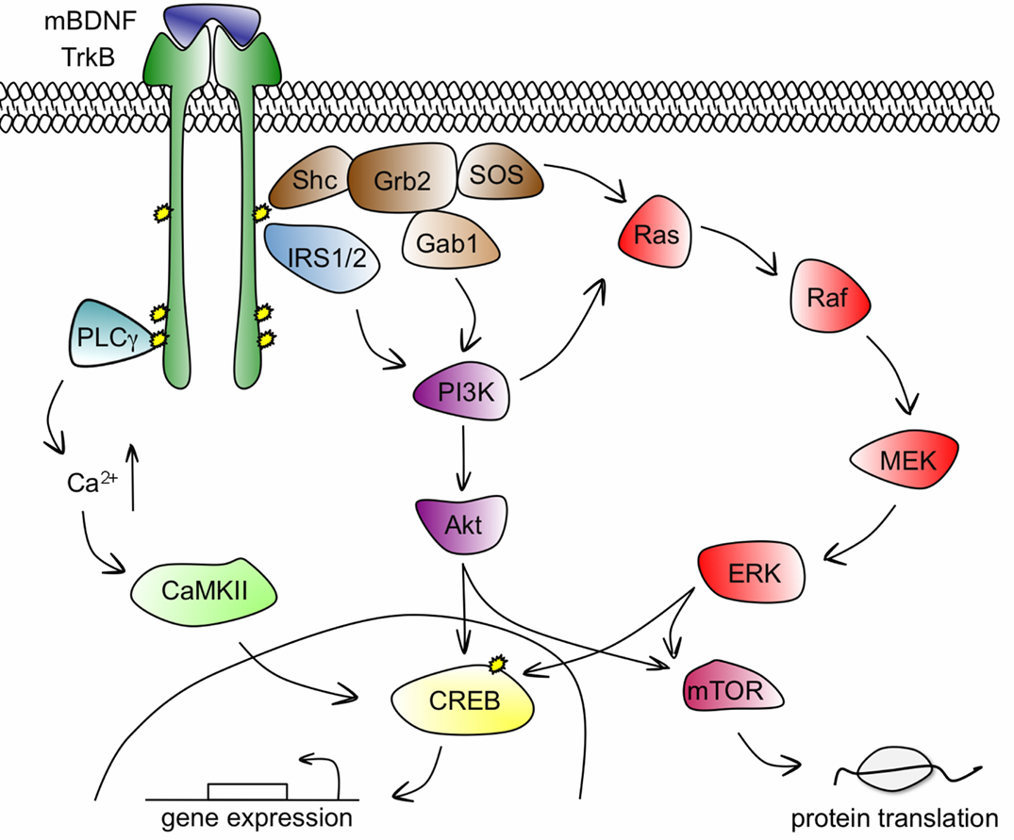
BDNF-TrkB Signaling
BDNF: Important growth factor in brain:
  increases dendritic spine growth (via pERK)
  Pro-depressant in NAc
Chronic Stress up-regulates NAc BDNF:
Stress → ↑ Cort, CRF → ↑ BDNF transcription →
↑ NAc BDNF→ pERK → ↑ spine density
GR controls BDNF expression (Suri & Vaidya 2013)
    Steroids Δ TrkB Signaling & spine density
    Ex: GR activation alters ERK signaling
  CRFR gates BDNF Up-regulation (Walsch 2014)
Cunha, Brambilla, & Thomas. (2010). Front Mol. Neurosci.
Bennett & Lagopoulos. (2014). Progress in Neurobiology 112: 80-99.

Slide 8
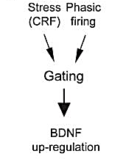
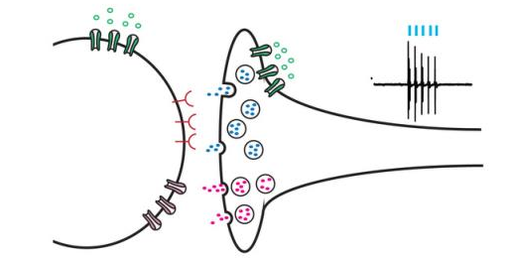
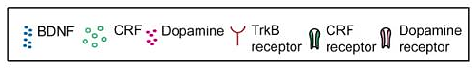
CSDS-Induced Up-Regulation of VTA-NAc Circuitry (and BDNF)
a
b
NAc
MSN
VTA DA Neuron
Stress gates up-regulation of NAc BDNF signaling by working together with phasic firing of VTA→NAc DA neurons as well as pre- and post-synaptic CRF actions in NAc.
BDNF & CRF interact to promote stress vulnerability: Stress-induced CRF signaling in NAc activates presynaptic CRF receptors on VTA DA terminals and works together with arriving phasic spikes to release BDNF. BDNF then activates TrkB receptors on NAc MSNs to promote vulnerability.
Walsh et al. (2014). Stress and CRF gate neural activation of BDNF in the mesolimbic reward pathway. Nat Neurosci, 17(1), 27-29.
Notes:
Together, these findings implicate CRF, acting in the Nac, in gating the ability of phasic firing, in the context of stress, to increase BDNF signaling in the NAc.

Slide 9
Krishnan et al. (2007). Cell 131, 391-404.
Notes:
DA signaling in the Mesolimbic Reward System (VTA to Nac)
Neural substrates of the rewarding properties (food, mating behaviors, and addictive drugs)
Motivate social behaviors
Social interactions engage reward pathways (Krishnan et al., 2007)
Mediate responses to social defeat (Krishnan et al., 2007):
↑ VTA DA neurons in CSDS-vulnerable mice
↑ VTA BDNF in CSDS-vulnerable mice
↑ TrkB receptor signaling in NAc
Dipesh Chaudhury’s 2013 article “rapid regulation of depression-related behaviors by control of midbrain dopamine neurons” – out of MH Han’s lab in collaboration with Eric Nestler – which adapted from Krishnan 2007 a Subthreshold social defeat paradigm – that also produced susceptible and resiliant “depression-related” phenotypes and incorporates optigenetic techniques.

Slide 10
Resilience:
“the process of adapting well in the face of adversity”
(Charney, 2004)
Krishnan et al. (2007). Cell.
Notes:
A simplified schematic of the major dopaminergic, glutamatergic and GABAergic connections to and from the ventral tegmental area (VTA) and nucleus accumbens (NAc) in the rodent brain. The primary reward circuit includes dopaminergic projections from the VTA to the NAc, which release dopamine in response to reward-related stimuli (and in some cases, aversion-related stimuli). There are also GABAergic projections from the NAc to the VTA; projections through the direct pathway (mediated by D1-type medium spiny neurons (MSNs)) directly innervate the VTA, whereas projections through the indirect pathway (mediated by D2-type MSNs) innervate the VTA via intervening GABAergic neurons in the ventral pallidum (not shown). The NAc also contains numerous types of interneurons (Fig. 2). The NAc receives dense innervation from glutamatergic monosynaptic circuits from the medial prefrontal cortex (mPFC), hippocampus (Hipp) and amygdala (Amy), as well as other regions. The VTA receives such inputs from the lateral dorsal tegmentum (LDTg), lateral habenula (LHb) and lateral hypothalamus (LH), as well as both GABAergic and glutamatergic connections from the extended amygdala (not shown). These various glutamatergic inputs control aspects of reward-related perception and memory. The dashed lines indicate internal inhibitory projections. The glutamatergic circuit from the LH to the VTA is also mediated by orexin (not shown). Greater details of these monosynaptic circuits for NAc and VTA are shown in Fig. 2. RTMg, rostromedial tegmentum.

Slide 11
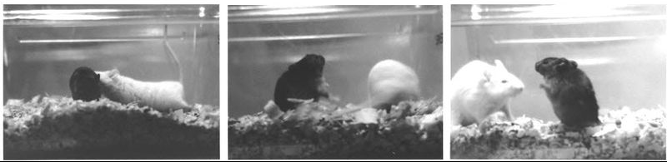
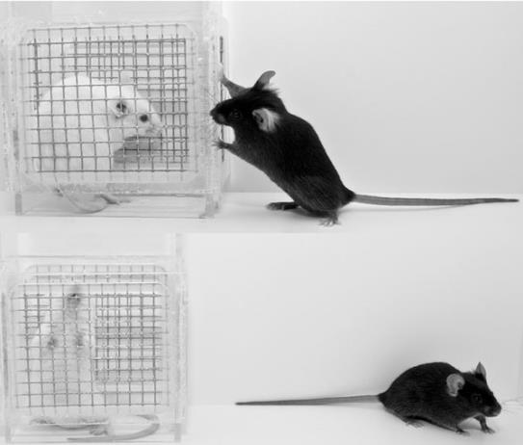
Social Defeat Stress → Depression (humans & rodents)
Resident-Intruder model of social defeat
http://schaechter.asmblog.org/schaechter/2012/08/the-road-to-microbial-endocrinology.html
Chronic Social Defeat Stress (Krishnan et al., 2007):
CSDS: 10 d x 10 min interaction w aggressive CD1
Single housing immediately after each defeat
Social Interaction Test: 24h after last defeat
Segregates vulnerable & resilient phenotypes
Social Interaction Testing
www.sfn.org, obtained 3/1/2014
Notes:
Chronic Social Defeat Stress Induces Depression in Humans and Rodents
Dipesh Chaudhury’s 2013 article “rapid regulation of depression-related behaviors by control of midbrain dopamine neurons” – out of MH Han’s lab in collaboration with Eric Nestler – which adapted from Krishnan 2007 a Subthreshold social defeat paradigm – that also produced susceptible and resiliant “depression-related” phenotypes and incorporates optigenetic techniques.

Slide 12
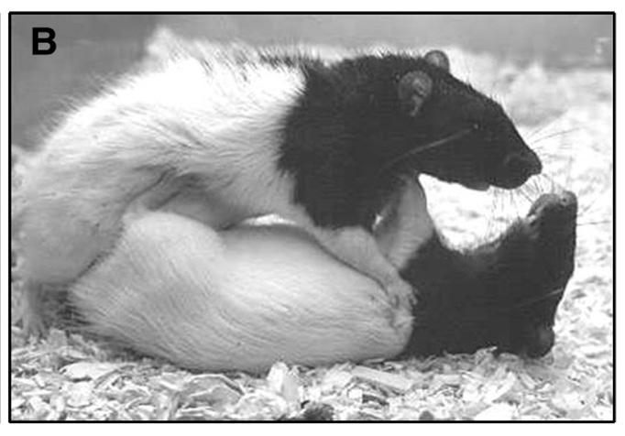
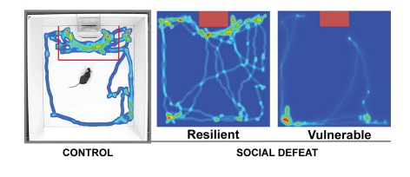
Two-Trial Social Interaction Testing (day 11)
Trial 1, (“target absent”): Free exploration in open field arena w empty wire mesh cage (2.5min)
Trial 2, (“target present”): 2.5 min exploration with unfamiliar CD1 aggressor in the cage
Interaction Ratio (IR): (Time spent in interaction zone w target-present / time w target absent) * 100
  Vulnerable (IR<100); resilient (IR≥100)
Red=most time spent
Left: Miczek, et al., 2008. http://dx.doi.org/10.1016/j.pharmthera.2008.07.006; Right: Jochems et al., 2015. http://dx.doi.org/10.1016/j.biopsych.2014.07.036.
Notes:
Male CD1 retired breeders (selected on basis of reliable expression of aggressive behaviors) used to physically defeat experimental C57BL/6 mice for 5 min each day, followed by housing (of experimental mice) for remainder of the time (“24h”) in protected sensory contact with the CD1 aggressor through Plexiglas partition.
Controls housed in similar partitioned cages with another C57BL/6 mouse and handled daily
Day 11: two-trial social interaction test. Trial 1: 2.5min “target absent” trial (free exploration in dimly lit open field arena containing empty wire mesh cage). Trial 2:2.5m “target present” exploration of same arena with unfamiliar CD1 aggressor in the cage.
Interaction ratios (IR): percentage of time spent in interaction zone (red box) in target-present (relative to target-absent) condition. Vulnerable (IR<100); resilient (IR>/=100), per Krishnan et al., 2007).

Slide 13
Two-Trial Social Interaction Testing (day 11)
Trial 1, (“target absent”): Free exploration in open field arena w empty wire mesh cage (2.5min)
Trial 2, (“target present”): 2.5 min exploration with unfamiliar CD1 aggressor in the cage
Interaction Ratio (IR): (Time spent in interaction zone w target-present / time w target absent) * 100
  Vulnerable (IR<100); resilient (IR≥100)
Red=most time spent
Left: Krishnan et al., 2007; Right: Jochems et al., 2015. http://dx.doi.org/10.1016/j.biopsych.2014.07.036.
Notes:
Male CD1 retired breeders (selected on basis of reliable expression of aggressive behaviors) used to physically defeat experimental C57BL/6 mice for 5 min each day, followed by housing (of experimental mice) for remainder of the time (“24h”) in protected sensory contact with the CD1 aggressor through Plexiglas partition.
Controls housed in similar partitioned cages with another C57BL/6 mouse and handled daily
Day 11: two-trial social interaction test. Trial 1: 2.5min “target absent” trial (free exploration in dimly lit open field arena containing empty wire mesh cage). Trial 2:2.5m “target present” exploration of same arena with unfamiliar CD1 aggressor in the cage.
Interaction ratios (IR): percentage of time spent in interaction zone (red box) in target-present (relative to target-absent) condition. Vulnerable (IR<100); resilient (IR>/=100), per Krishnan et al., 2007).

Slide 14
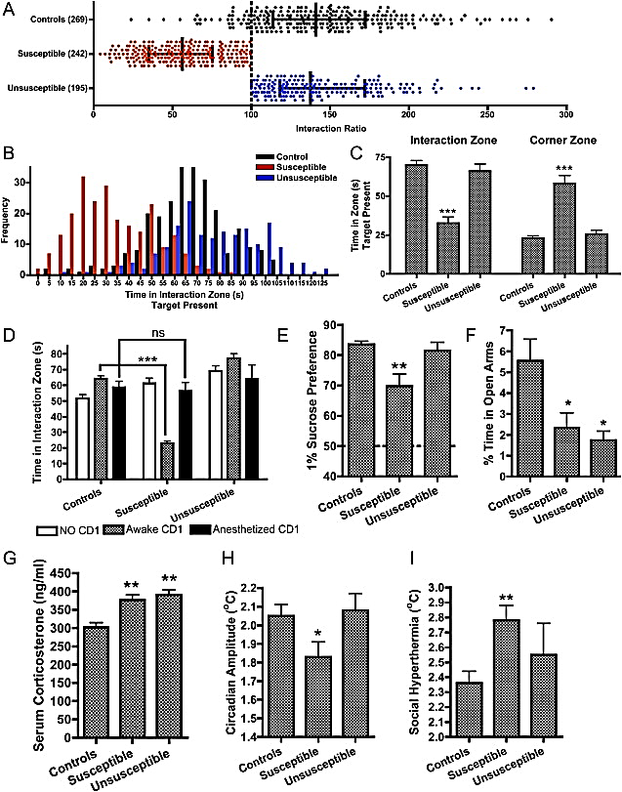
Fig 1: Identifying Vulnerable & Resilient Phenotypes
Horizontal scatterplot: distribution of interaction ratios for control, Susceptible, and Unsusceptible mice over multiple social defeat experiments (mean ± interquartile range).
(C) Absolute time spent in interaction zone and corner zone in presence of CD1 social target.
  Only Vulnerable mice avoid the interaction zone (F_{2,54} = 33.20, p < 0.0001)
  Only Vulnerable mice prefer the corner zones (F_{2,54} = 35.27, p < 0.0001).
(***p < 0.001 vs. non-defeated controls, post-hoc, n = 10-20, Mean + SE)
Krishnan et al. (2007). Cell.
Notes:
Figure 1. Identification of Susceptible and Unsusceptible Subgroups
(A) Horizontal scatterplot depicting the distribution of interaction ratios for control, Susceptible, and Unsusceptible mice over multiple social defeat experiments (error bars represent mean ± interquartile range). (B) Frequency distribution histogram for the absolute time spent in interaction zone. (C) In response to an aversive CD1 social target, only Susceptible mice avoid the interaction zone (F_{2,54} = 33.20, p < 0.0001) and prefer the corner zones (F_{2,54} = 35.27, p < 0.0001). Bars represent mean + SE (standard error) with n = 10–20, ∗ indicates significant post hoc differences with respect to nondefeated control mice, ∗p < 0.05, ∗∗p < 0.01, ∗∗∗p < 0.001.

Slide 15
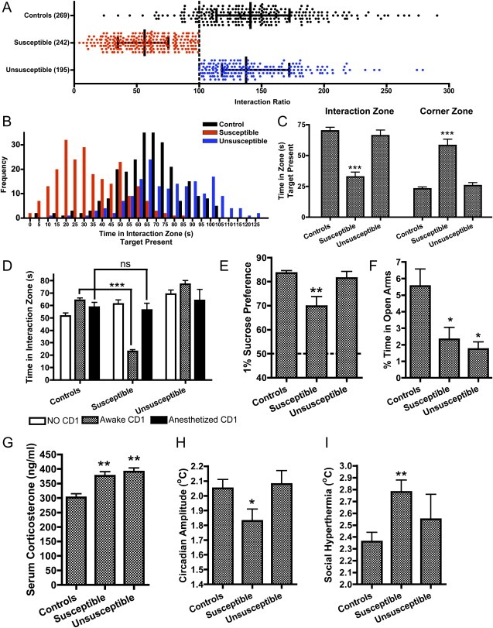
Fig 1E-I: Extensive Phenotypic Characterization
(E) Only Vulnerable mice show anhedonia (reduction in 1% sucrose preference).
(F) Vulnerable & Resilient mice show ↓ exploration on the EPM and enhanced CORT response to 6 min swim stress (G).
(H) Only Vulnerable mice show blunted circadian rhythms & ↑ social hyperthermia ([I], ↑ hyperthermic response to CD1 target).
*significant post hoc difference vs non-defeated control mice, ∗p < 0.05, ∗∗p < 0.01, ∗∗∗p < 0.001, Mean + SE, n = 10–20.
Krishnan et al. (2007). Cell.
Notes:
To examine whether resistance to defeat-induced social avoidance generalizes to other behavioral measures
Figure 1. Identification of Susceptible and Unsusceptible Subgroups
(E) Only Susceptible mice display anhedonia as measured by a reduction in 1% sucrose preference, whereas both Susceptible and Unsusceptible mice display decreased exploration on the elevated plus maze test (F) and enhanced CORT response to a 6 min swim stress (G). Only Susceptible mice display blunted circadian rhythms (H) and significantly enhanced social hyperthermia ([I], an elevated hyperthermic response to the CD1 target). Bars represent mean + SE (standard error) with n = 10–20, ∗ indicates significant post hoc differences with respect to nondefeated control mice, ∗p < 0.05, ∗∗p < 0.01, ∗∗∗p < 0.001.

Slide 16
Fig S2D: Vulnerable Mice: Sensitization to Cocaine Reward
(S2D) Only Vulnerable mice show significant CPP to a low dose of cocaine, demonstrating sensitization to psychostimulant reward. Avg pre- and post-conditioning CPP scores (time spent in drug-paired side minus saline-paired side). 2-way ANOVA: sig effect of conditioning session (F_{1,36} = 12.93, p<0.001).
Krishnan et al. (2007). Cell.
Notes:
Figure 1. Identification of Susceptible and Unsusceptible Subgroups
(E) Only Susceptible mice display anhedonia as measured by a reduction in 1% sucrose preference, whereas both Susceptible and Unsusceptible mice display decreased exploration on the elevated plus maze test (F) and enhanced CORT response to a 6 min swim stress (G). Only Susceptible mice display blunted circadian rhythms (H) and significantly enhanced social hyperthermia ([I], an elevated hyperthermic response to the CD1 target). Bars represent mean + SE (standard error) with n = 10–20, ∗ indicates significant post hoc differences with respect to nondefeated control mice, ∗p < 0.05, ∗∗p < 0.01, ∗∗∗p < 0.001.

Slide 17
Table 1: Distinct Susceptible & Unsusceptible Syndromes
Phenotype | Day 11 |  | Day 39
 | Vulnerable | Resilient | Vulnerable | Resilient
Social avoidance | ↑ | ↔ | ↑ | ↔
Anxiety-like behavior (time in closed arms) | ↑ | ↑ | ↑ | ↑
Despair behavior (immobility on TST) | ↔ | ↔ | ↔ | ↔
Despair behavior (immobility on FST) | ↔ | ↔ | N/A | N/A
Anhedonia (change in sucrose preference) | ↓ | ↔ | ↔ | ↔
Cocaine-conditioned place preference | ↑ | ↔ | N/A | N/A
Stress-induced polydipsia (increased fluid intake) | ↑ | ↑ | ↔ | ↔
Locomotor activity (ambulatory beam breaks) | ↔ | ↔ | ↔ | ↔
Social hyperthermia | ↑ | ↔ | ↑ | ↔
Circadian amplitude | ↓ | ↔ | ↔ | ↔
Weight change | ↓ | ↔ | ↔ | ↔
AM serum corticosterone | ↔ | ↔ | ↓ | ↑
Swim-stress-induced corticosterone levels | ↑ | ↑ | N/A | N/A
AM serum DHEA-S | ↔ | ↔ | ↔ | ↔
Cardiac hypertrophy (heart wt/body wt ratio) | N/A | N/A | ↔ | ↑
Phenotypic differences between Vulnerable & Resilient mice on d 11 and persisting 4 weeks later (day 39).
↔: no change , ↑ / ↓ (sig vs. non-defeated controls, p < 0.05);
N/A, not available. TST/FST: tail suspension or forced swim test;
Krishnan et al. (2007). Cell.
Notes:
Figure 1. Identification of Susceptible and Unsusceptible Subgroups
(E) Only Susceptible mice display anhedonia as measured by a reduction in 1% sucrose preference, whereas both Susceptible and Unsusceptible mice display decreased exploration on the elevated plus maze test (F) and enhanced CORT response to a 6 min swim stress (G). Only Susceptible mice display blunted circadian rhythms (H) and significantly enhanced social hyperthermia ([I], an elevated hyperthermic response to the CD1 target). Bars represent mean + SE (standard error) with n = 10–20, ∗ indicates significant post hoc differences with respect to nondefeated control mice, ∗p < 0.05, ∗∗p < 0.01, ∗∗∗p < 0.001.

Slide 18
Molecular Underpinnings of CSDS-Induced Vulnerability
Resident-Intruder model of social defeat
http://schaechter.asmblog.org/schaechter/2012/08/the-road-to-microbial-endocrinology.html
Social Interaction Testing
www.sfn.org, obtained 3/1/2014
Hyman, S.E., 2007
Notes:
Dipesh Chaudhury’s 2013 article “rapid regulation of depression-related behaviors by control of midbrain dopamine neurons” – out of MH Han’s lab in collaboration with Eric Nestler – which adapted from Krishnan 2007 a Subthreshold social defeat paradigm – that also produced susceptible and resiliant “depression-related” phenotypes and incorporates optigenetic techniques.

Slide 19
Exp 2: Does NAc BDNF Protein Differ in Vulnerable Mice?
(Berton et al., 2006): CSDS Increased BDNF in the NAc
Control
CSDS
Control
CSDS
10d CSDS ↑ NAc BDNF 24h & 4 weeks after social interaction test
(Berton et al., 2006; Fig 1F)
Notes:
Figure 2. Increased NAc BDNF: A Molecular Signature of Susceptibility
(A) Results from immunoblotting experiments showing a 90% increase in BDNF levels in Susceptible mice compared to controls, without any changes in Unsusceptible mice and without changes in levels of phospho-TrkB.F (pTrkB.F) or total TrkB.F or TrkB.T (B). (C) Increases in NAc BDNF levels in Susceptible mice are accompanied by the significant activation of downstream signaling molecules, including Akt, Gsk-3β, and p44/42 MAPK/ERK1,2. Mammalian target of rapamycin (mTOR) and phosphoinositol dependent kinase-1 (PDK1) proteins were not significantly activated. (D) A single intra-NAc infusion of recombinant BDNF (1.5 μg/side) decreases social interaction (promotes susceptibility) following a submaximal exposure to defeat (vehicle: t₂₀ = 3.96, p < 0.0001 and BDNF: t₂₀ = 1.44, p > 0.1). (E) While the NAc-specific overexpression of HSV-GFP in Susceptible mice did not alleviate social avoidance (t₈ = 3.49, p < 0.01), HSV-dnERK promoted an Unsusceptible phenotype (t₈ = 0.96, p > 0.3); groups were matched for day 11 interaction times (12.2 ± 4.6 and 16.9 ± 7.2 s). Bars represent mean + SE (n = 5–11), ∗ indicates significant post hoc comparisons to respective control groups, ∗p < 0.05, ∗∗p < 0.01, ∗∗∗p < 0.0001. C, Controls; S, Susceptible; U, Unsusceptible.

Slide 20
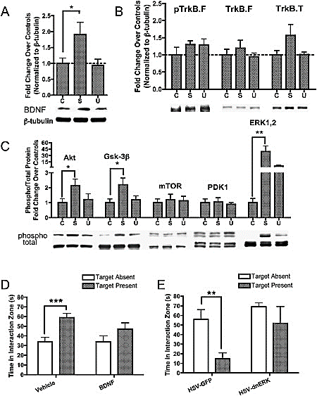
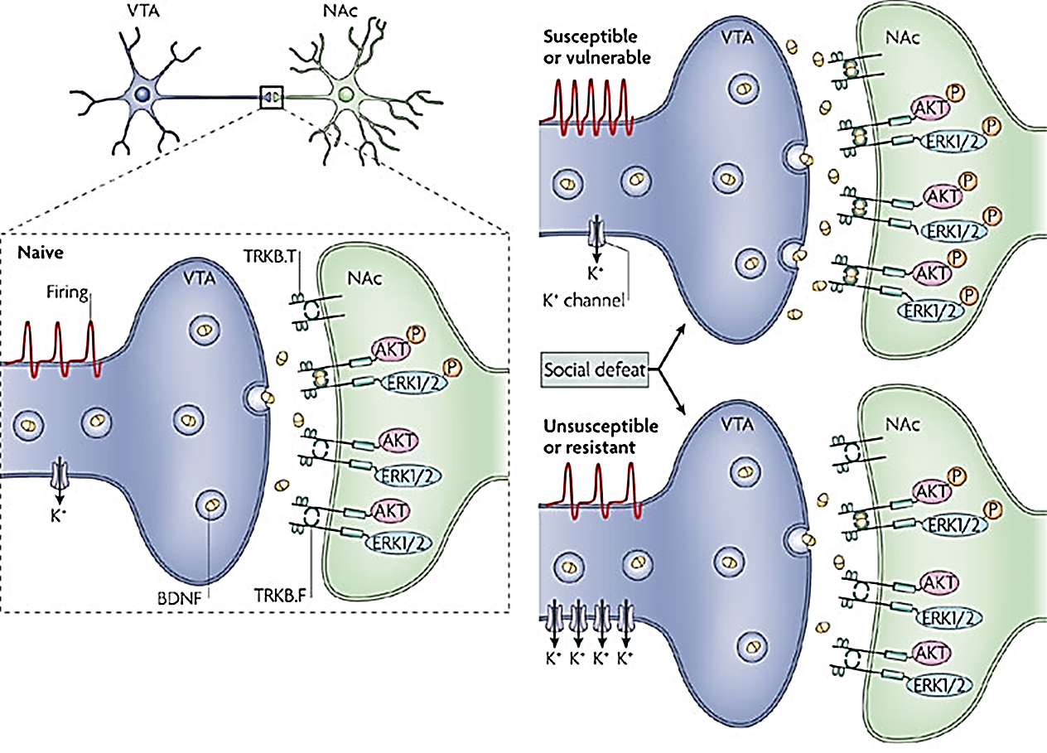
Fig 2: Increased NAc BDNF: Molecular Signature of Vulnerability
(A) 90% increase in NAc (C&S) BDNF in Vulnerable mice (vs. controls, p<0.05, post-hoc. Mean + SE, n = 5-11)
(B) Truncated TrkB is kinase deficient, sequesters BDNF
Krishnan et al. (2007). Cell.
Feder, Nestler, & Charney. (2009). Nature Reviews Neuroscience.
Notes:
Figure 2. Increased NAc BDNF: A Molecular Signature of Susceptibility
(A) Results from immunoblotting experiments showing a 90% increase in BDNF levels in Susceptible mice compared to controls, without any changes in Unsusceptible mice and without changes in levels of phospho-TrkB.F (pTrkB.F) or total TrkB.F or TrkB.T (B). (C) Increases in NAc BDNF levels in Susceptible mice are accompanied by the significant activation of downstream signaling molecules, including Akt, Gsk-3β, and p44/42 MAPK/ERK1,2. Mammalian target of rapamycin (mTOR) and phosphoinositol dependent kinase-1 (PDK1) proteins were not significantly activated. (D) A single intra-NAc infusion of recombinant BDNF (1.5 μg/side) decreases social interaction (promotes susceptibility) following a submaximal exposure to defeat (vehicle: t₂₀ = 3.96, p < 0.0001 and BDNF: t₂₀ = 1.44, p > 0.1). (E) While the NAc-specific overexpression of HSV-GFP in Susceptible mice did not alleviate social avoidance (t₈ = 3.49, p < 0.01), HSV-dnERK promoted an Unsusceptible phenotype (t₈ = 0.96, p > 0.3); groups were matched for day 11 interaction times (12.2 ± 4.6 and 16.9 ± 7.2 s). Bars represent mean + SE (n = 5–11), ∗ indicates significant post hoc comparisons to respective control groups, ∗p < 0.05, ∗∗p < 0.01, ∗∗∗p < 0.0001. C, Controls; S, Susceptible; U, Unsusceptible.

Slide 21
Fig 2: Increased NAc BDNF: Molecular Signature of Vulnerability
Western immunoblotting of NAc (core & shell lysed together) 24h after social interaction testing
(A) 90% increase in BDNF levels in Susceptible mice (vs. controls, p<0.05, post-hoc. Mean + SE, n = 5-11)
(B) No changes in levels of phospho-TrkB.F (pTrkB.F) or total TrkB.F or TrkB.T.
Controls (C), Susceptible (S); Unsusceptible (U).
Krishnan et al. (2007). Cell.
Notes:
Figure 2. Increased NAc BDNF: A Molecular Signature of Susceptibility
(A) Results from immunoblotting experiments showing a 90% increase in BDNF levels in Susceptible mice compared to controls, without any changes in Unsusceptible mice and without changes in levels of phospho-TrkB.F (pTrkB.F) or total TrkB.F or TrkB.T (B). (C) Increases in NAc BDNF levels in Susceptible mice are accompanied by the significant activation of downstream signaling molecules, including Akt, Gsk-3β, and p44/42 MAPK/ERK1,2. Mammalian target of rapamycin (mTOR) and phosphoinositol dependent kinase-1 (PDK1) proteins were not significantly activated. (D) A single intra-NAc infusion of recombinant BDNF (1.5 μg/side) decreases social interaction (promotes susceptibility) following a submaximal exposure to defeat (vehicle: t₂₀ = 3.96, p < 0.0001 and BDNF: t₂₀ = 1.44, p > 0.1). (E) While the NAc-specific overexpression of HSV-GFP in Susceptible mice did not alleviate social avoidance (t₈ = 3.49, p < 0.01), HSV-dnERK promoted an Unsusceptible phenotype (t₈ = 0.96, p > 0.3); groups were matched for day 11 interaction times (12.2 ± 4.6 and 16.9 ± 7.2 s). Bars represent mean + SE (n = 5–11), ∗ indicates significant post hoc comparisons to respective control groups, ∗p < 0.05, ∗∗p < 0.01, ∗∗∗p < 0.0001. C, Controls; S, Susceptible; U, Unsusceptible.

Slide 22
TrkB: Multiple Signaling Cascade(s)
Cunha, Brambilla, & Thomas. (2010). Front Mol. Neurosci.

Slide 23

Fig 2: Increased BDNF Signaling in Vulnerable Mice
C
(C) Increases in NAc BDNF in Vulnerable mice: accompanied by significantly greater phosphorylation of downstream signaling molecules: Akt, Gsk-3β, and ERK1/2. No change in total levels of these cell signals. Mean + SE (n = 5–11), *significant post hoc comparisons vs control groups, ∗p < 0.05, ∗∗p < 0.01, C, Controls; S, Susceptible; U, Unsusceptible.
Cunha, Brambilla, & Thomas. (2010). Front Mol. Neurosci.
Krishnan et al. (2007). Cell.
Notes:
Figure 2. Increased NAc BDNF: A Molecular Signature of Susceptibility
(A) Results from immunoblotting experiments showing a 90% increase in BDNF levels in Susceptible mice compared to controls, without any changes in Unsusceptible mice and without changes in levels of phospho-TrkB.F (pTrkB.F) or total TrkB.F or TrkB.T (B). (C) Increases in NAc BDNF levels in Susceptible mice are accompanied by the significant activation of downstream signaling molecules, including Akt, Gsk-3β, and p44/42 MAPK/ERK1,2. Mammalian target of rapamycin (mTOR) and phosphoinositol dependent kinase-1 (PDK1) proteins were not significantly activated. (D) A single intra-NAc infusion of recombinant BDNF (1.5 μg/side) decreases social interaction (promotes susceptibility) following a submaximal exposure to defeat (vehicle: t₂₀ = 3.96, p < 0.0001 and BDNF: t₂₀ = 1.44, p > 0.1). (E) While the NAc-specific overexpression of HSV-GFP in Susceptible mice did not alleviate social avoidance (t₈ = 3.49, p < 0.01), HSV-dnERK promoted an Unsusceptible phenotype (t₈ = 0.96, p > 0.3); groups were matched for day 11 interaction times (12.2 ± 4.6 and 16.9 ± 7.2 s). Bars represent mean + SE (n = 5–11), ∗ indicates significant post hoc comparisons to respective control groups, ∗p < 0.05, ∗∗p < 0.01, ∗∗∗p < 0.0001. C, Controls; S, Susceptible; U, Unsusceptible.

Slide 24
Fig 2: Increased BDNF Signaling in Vulnerable Mice
C
‘Trend for ↑ pERK in Unsusceptible mice: ERK activation could stem partly from non-neurotrophic pathways’
● pERK: ↑ spine density ● GR activation alters ERK signaling
Cunha, Brambilla, & Thomas. (2010). Front Mol. Neurosci.
Krishnan et al. (2007). Cell.
Notes:
Figure 2. Increased NAc BDNF: A Molecular Signature of Susceptibility
(A) Results from immunoblotting experiments showing a 90% increase in BDNF levels in Susceptible mice compared to controls, without any changes in Unsusceptible mice and without changes in levels of phospho-TrkB.F (pTrkB.F) or total TrkB.F or TrkB.T (B). (C) Increases in NAc BDNF levels in Susceptible mice are accompanied by the significant activation of downstream signaling molecules, including Akt, Gsk-3β, and p44/42 MAPK/ERK1,2. Mammalian target of rapamycin (mTOR) and phosphoinositol dependent kinase-1 (PDK1) proteins were not significantly activated. (D) A single intra-NAc infusion of recombinant BDNF (1.5 μg/side) decreases social interaction (promotes susceptibility) following a submaximal exposure to defeat (vehicle: t₂₀ = 3.96, p < 0.0001 and BDNF: t₂₀ = 1.44, p > 0.1). (E) While the NAc-specific overexpression of HSV-GFP in Susceptible mice did not alleviate social avoidance (t₈ = 3.49, p < 0.01), HSV-dnERK promoted an Unsusceptible phenotype (t₈ = 0.96, p > 0.3); groups were matched for day 11 interaction times (12.2 ± 4.6 and 16.9 ± 7.2 s). Bars represent mean + SE (n = 5–11), ∗ indicates significant post hoc comparisons to respective control groups, ∗p < 0.05, ∗∗p < 0.01, ∗∗∗p < 0.0001. C, Controls; S, Susceptible; U, Unsusceptible.

Slide 25
Exp 2 (D): Does ↑ NAc BDNF Promote Vulnerability?
Submaximal defeat (3x10m defeats in 1 day)
BL Intra-NAc infusion of recombinant BDNF
Social Interaction Test
Increasing NAc BDNF promotes vulnerability
↓ social interaction after submaximal defeat
BDNF: t₂₀ = 1.44, p > 0.1
Vehicle: t₂₀ = 3.96, p < 0.0001
Mean + SE (n = 5–11), ***p < 0.0001
Krishnan et al. (2007). Cell.
Notes:
Infusions were: AP 1.6, ML 1.5, DV -4.4, 10 degree angle
(D) A single intra-NAc infusion of recombinant BDNF (1.5 μg/side) decreases social interaction (promotes susceptibility) following a submaximal exposure to defeat (vehicle: t₂₀ = 3.96, p < 0.0001 and BDNF: t₂₀ = 1.44, p > 0.1). (E) While the NAc-specific overexpression of HSV-GFP in Susceptible mice did not alleviate social avoidance (t₈ = 3.49, p < 0.01), HSV-dnERK promoted an Unsusceptible phenotype (t₈ = 0.96, p > 0.3); groups were matched for day 11 interaction times (12.2 ± 4.6 and 16.9 ± 7.2 s). Bars represent mean + SE (n = 5–11), ∗ indicates significant post hoc comparisons to respective control groups, ∗p < 0.05, ∗∗p < 0.01, ∗∗∗p < 0.0001. C, Controls; S, Susceptible; U, Unsusceptible.

Slide 26
Exp 2 (E): Does ↓ NAc BDNF Signaling Prevent Vulnerability?
Submaximal defeat (3x10m defeats in 1 day)
Overexpression of dominant-negative ERK (HSV-dnERK) in NAc (to block ERK)
Social Interaction Test
Blockade of ↑ NAc ERK promotes resilience
(t₈ = 0.96, p > 0.3)
groups matched for day 11 interaction times (12.2 ± 4.6 and 16.9 ± 7.2 s)
Mean + SE (n = 5–11), ∗∗p < 0.01
Krishnan et al. (2007). Cell.
Notes:
Infusions were: AP 1.6, ML 1.5, DV -4.4, 10 degree angle
(D) A single intra-NAc infusion of recombinant BDNF (1.5 μg/side) decreases social interaction (promotes susceptibility) following a submaximal exposure to defeat (vehicle: t₂₀ = 3.96, p < 0.0001 and BDNF: t₂₀ = 1.44, p > 0.1). (E) While the NAc-specific overexpression of HSV-GFP in Susceptible mice did not alleviate social avoidance (t₈ = 3.49, p < 0.01), HSV-dnERK promoted an Unsusceptible phenotype (t₈ = 0.96, p > 0.3); groups were matched for day 11 interaction times (12.2 ± 4.6 and 16.9 ± 7.2 s). Bars represent mean + SE (n = 5–11), ∗ indicates significant post hoc comparisons to respective control groups, ∗p < 0.05, ∗∗p < 0.01, ∗∗∗p < 0.0001. C, Controls; S, Susceptible; U, Unsusceptible.

Slide 27
NAc BDNF Induction and ERK Signaling Mediates Vulnerability
(D) NAc infusion of recombinant BDNF ↓ social interaction (promote vulnerability) following submaximal exposure to defeat
(E) Blockade of increased ERK by NAc-specific overexpression of dominant negative ERK promotes Resilience
Krishnan et al. (2007). Cell.
Notes:
Infusions were: AP 1.6, ML 1.5, DV -4.4, 10 degree angle
(D) A single intra-NAc infusion of recombinant BDNF (1.5 μg/side) decreases social interaction (promotes susceptibility) following a submaximal exposure to defeat (vehicle: t₂₀ = 3.96, p < 0.0001 and BDNF: t₂₀ = 1.44, p > 0.1). (E) While the NAc-specific overexpression of HSV-GFP in Susceptible mice did not alleviate social avoidance (t₈ = 3.49, p < 0.01), HSV-dnERK promoted an Unsusceptible phenotype (t₈ = 0.96, p > 0.3); groups were matched for day 11 interaction times (12.2 ± 4.6 and 16.9 ± 7.2 s). Bars represent mean + SE (n = 5–11), ∗ indicates significant post hoc comparisons to respective control groups, ∗p < 0.05, ∗∗p < 0.01, ∗∗∗p < 0.0001. C, Controls; S, Susceptible; U, Unsusceptible.

Slide 28
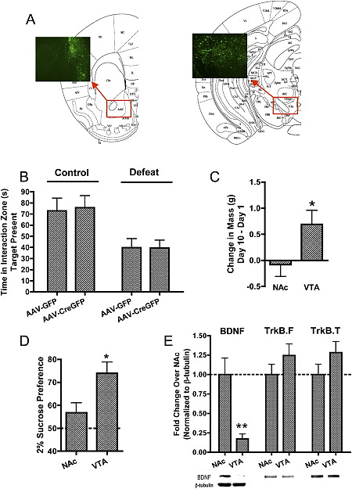
Exp 3: Explore Mechanisms by which CSDS ↑ NAc BDNF
CSDS Doesn’t Alter NAc BDNF mRNA
  qPCR: No change in Control, Vuln, or Resilient
  ↑ BDNF in vulnerable mice (2A): not dependent on local transcriptional regulation
bdnf knockdown in VTA prevents vulnerability
  (Berton et al., 2006)
Local NAc bdnf knockdown:
  Floxed BDNF Mice
  AAV-CreGFP (or AAV-GFP) infusion
  NAc (or VTA)
(A) Schematic coronal sections (Paxinos and Franklin, 2001) from NAc (left) and VTA (right), with insets showing representative high-power micrographs of viral GFP expression (n=7-12).
Krishnan et al. (2007). Cell.
Notes:
Figure 3. Effects of Region Specific BDNF Knockdowns
(A) Schematic coronal sections (Paxinos and Franklin, 2001) from NAc (left) and VTA (right), with insets showing representative high-power micrographs of viral GFP expression.
(B) Floxed BDNF mice were injected with either AAV-CreGFP or AAV-GFP into the NAc and subsequently subjected to the social defeat paradigm. In the presence of a significant effect of defeat (F_{1,33} = 14.00, p < 0.001), local knockdown of BDNF in NAc did not attenuate social avoidance (F_{1,33} = 0.01, p > 0.5).
(C–E) As compared to local BDNF knockdown within the NAc, an analogous VTA knockdown ameliorated the effects of social defeat on weight loss (C) and (D) sucrose preference. Immunoblotting NAc samples from these two groups revealed that VTA-injected mice displayed an 80% reduction in levels of BDNF protein (E). Bars represent mean + SE (n = 7–12), ∗p < 0.05, ∗∗p < 0.01.

Slide 29
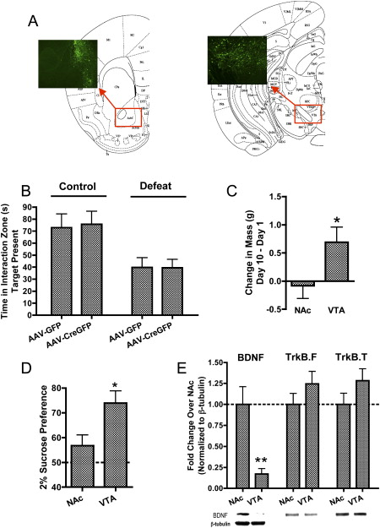
Exp 3: Effects of Region Specific BDNF Knockdowns
Bdnf KD in VTA:
Blocks CSDS-induced avoidance
Bdnf KD in NAc:
No change in social avoidance
(B, left) Local KD of BDNF in VTA recovered social behavior in defeated mice (Berton et al., 2006)
(B, right) Local knockdown of BDNF in NAc did not alter social interaction (F_{1,33} = 0.01, p > 0.5).
Right: Berton et al. (2006). Science. Left: Krishnan et al. (2007). Cell.
Notes:
Figure 3. Effects of Region Specific BDNF Knockdowns
(A) Schematic coronal sections (Paxinos and Franklin, 2001) from NAc (left) and VTA (right), with insets showing representative high-power micrographs of viral GFP expression.
(B) Floxed BDNF mice were injected with either AAV-CreGFP or AAV-GFP into the NAc and subsequently subjected to the social defeat paradigm. In the presence of a significant effect of defeat (F_{1,33} = 14.00, p < 0.001), local knockdown of BDNF in NAc did not attenuate social avoidance (F_{1,33} = 0.01, p > 0.5).
(C–E) As compared to local BDNF knockdown within the NAc, an analogous VTA knockdown ameliorated the effects of social defeat on weight loss (C) and (D) sucrose preference. Immunoblotting NAc samples from these two groups revealed that VTA-injected mice displayed an 80% reduction in levels of BDNF protein (E). Bars represent mean + SE (n = 7–12), ∗p < 0.05, ∗∗p < 0.01.

Slide 30
Fig 3: Effects of VTA & NAc Bdnf Knockdowns on NAc BDNF
VTA: Crucial Source of BDNF to the NAc during Defeat
(E) BDNF knockdown in the VTA resulted in 80% reduction of NAc BDNF protein.
Mean + SE (n = 7–12), *p < 0.05, **p < 0.01.
Krishnan et al. (2007). Cell.
Notes:
Figure 3. Effects of Region Specific BDNF Knockdowns
(A) Schematic coronal sections (Paxinos and Franklin, 2001) from NAc (left) and VTA (right), with insets showing representative high-power micrographs of viral GFP expression.
(B) Floxed BDNF mice were injected with either AAV-CreGFP or AAV-GFP into the NAc and subsequently subjected to the social defeat paradigm. In the presence of a significant effect of defeat (F_{1,33} = 14.00, p < 0.001), local knockdown of BDNF in NAc did not attenuate social avoidance (F_{1,33} = 0.01, p > 0.5).
(C–E) As compared to local BDNF knockdown within the NAc, an analogous VTA knockdown ameliorated the effects of social defeat on weight loss (C) and (D) sucrose preference. Immunoblotting NAc samples from these two groups revealed that VTA-injected mice displayed an 80% reduction in levels of BDNF protein (E). Bars represent mean + SE (n = 7–12), ∗p < 0.05, ∗∗p < 0.01.

Slide 31
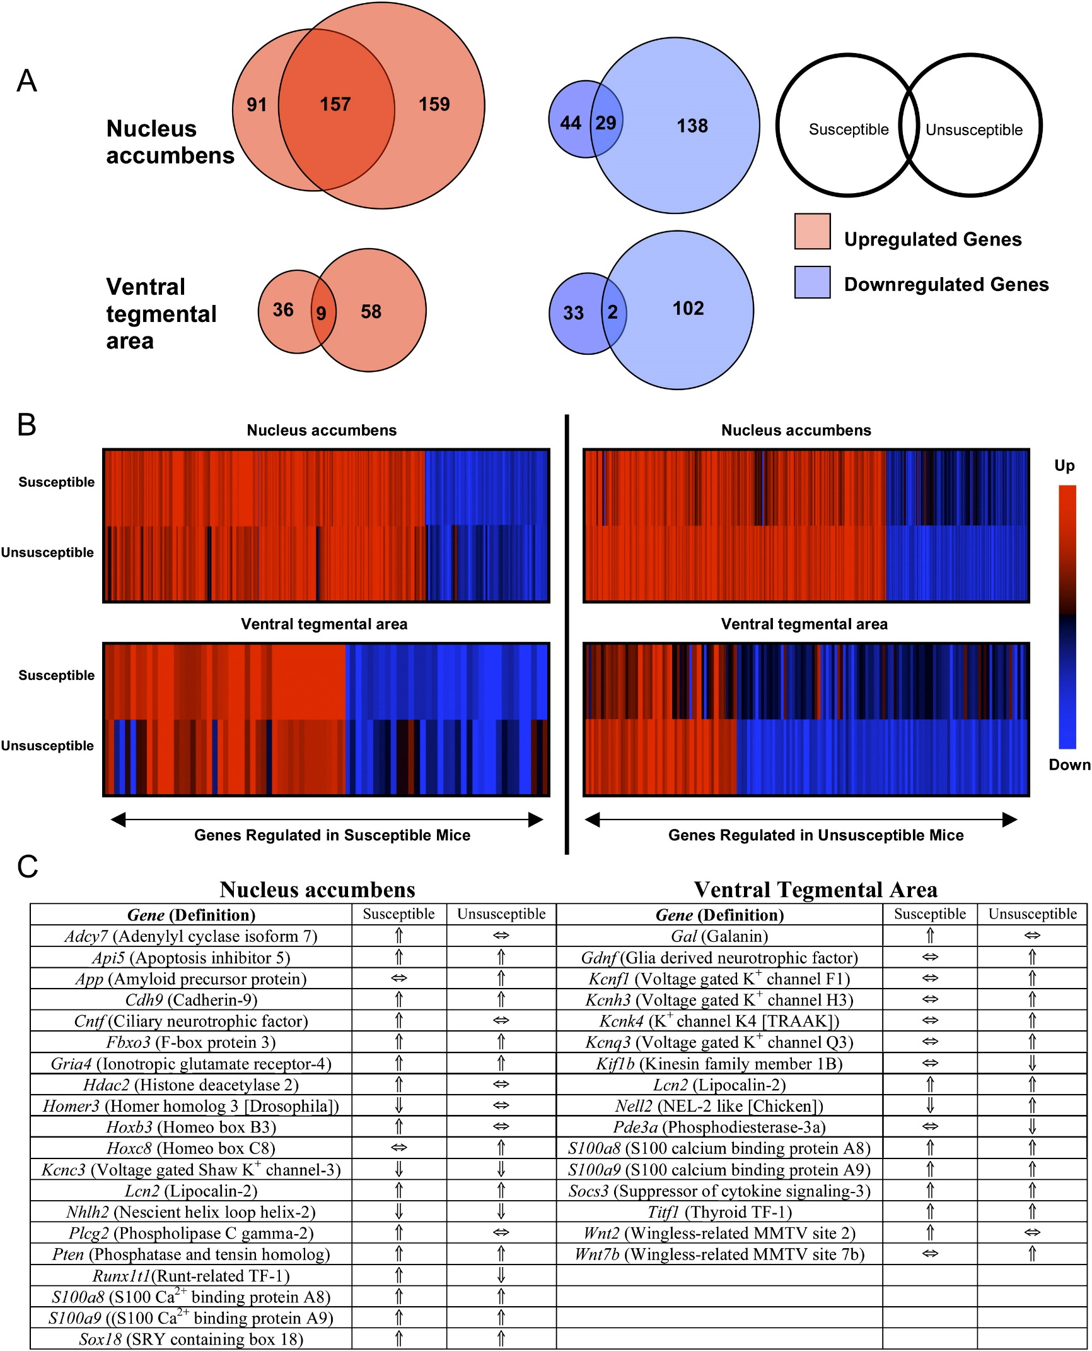
Exp 4: Identify Global Patterns of NAc & VTA Gene Expression
Absence of candidate “resistance genes”
CSDS (10d)
Social Interaction Test (d11)
DNA Microarray (d11)
Goal to identify genes regulated:
  Similarly in Vulnerable & Resilient mice (attributed to stress exposure)
  Differently (that may mediate behavior)
DNA microarrays: VTA and NAc of control, Susceptible, and Unsusceptible mice on day 11 after chronic social defeat. (A) Venn diagrams show # of uniquely regulated genes in Susceptible and Unsusceptible mice (vs controls).
Krishnan et al. (2007). Cell.
Notes:
Figure 4. Gene Expression Analysis after Social Defeat
DNA microarrays were performed on VTA and NAc of control, Susceptible, and Unsusceptible mice on day 11 after chronic social defeat. (A) Venn diagrams show the number of uniquely regulated genes in Susceptible and Unsusceptible mice (as compared to nondefeated controls), with the overlap depicting genes that were identically regulated by both conditions. Upregulated (red) and downregulated (blue) genes are shown separately (criteria for significance: ≥1.5-fold change compared to respective anatomical control group at p < 0.05). (B) Heatmaps illustrating the regulation of genes for each condition and anatomical structure, with red to blue gradient depicting an up to downregulation (≥2-fold increase → ≤2-fold decrease). For example, the upper left panel displays significantly regulated genes in Susceptible NAc (top row) and how each of those genes is regulated in Unsusceptible NAc (bottom row). (C) Summary table showing examples of genes significantly upregulated (↑) or downregulated (↓) as compared to the nondefeated control group for each brain region. TF, transcription factor; SRY, sex-determining region-Y; TRAAK, TWICK-related amino acid-sensitive K⁺ channel; NEL, neural epidermal growth factor-like; MMTV, mouse mammary tumor virus.

Slide 32
Fig 4A: Gene Expression Analysis after Social Defeat
DNA microarrays from VTA & NAc of control, Susceptible, and Unsusceptible mice on day 11 after CSDS.
(A) Venn diagrams: # of uniquely regulated genes in Vulnerable & Resilient mice (vs. non-defeated controls),
Upregulated (red) and downregulated (blue) genes shown separately.
Overlap: genes identically regulated by both conditions.
Significance Criteria: ≥1.5-fold change vs respective anatomical control group, p < 0.05.
Resilient phenotype associated with regulation of far more genes.
NAc showed larger list of regulated genes
VTA expression patterns: lack of similarly regulated genes in Vulnerable vs. Resilient Mice
VTA expression patterns correlated more strongly w behavioral data (Fig S4A)
Resilient phenotype associated with regulation of far more genes.
Suggests Resilient phenotype associated w heightened degree of molecular plasticity
Expression of Resilient phenotype is an active neurobiological process (not just absence of vulnerability)
Krishnan et al. (2007). Cell.
Notes:
Figure 4. Gene Expression Analysis after Social Defeat
DNA microarrays were performed on VTA and NAc of control, Susceptible, and Unsusceptible mice on day 11 after chronic social defeat. (A) Venn diagrams show the number of uniquely regulated genes in Susceptible and Unsusceptible mice (as compared to nondefeated controls), with the overlap depicting genes that were identically regulated by both conditions. Upregulated (red) and downregulated (blue) genes are shown separately (criteria for significance: ≥1.5-fold change compared to respective anatomical control group at p < 0.05). (B) Heatmaps illustrating the regulation of genes for each condition and anatomical structure, with red to blue gradient depicting an up to downregulation (≥2-fold increase → ≤2-fold decrease). For example, the upper left panel displays significantly regulated genes in Susceptible NAc (top row) and how each of those genes is regulated in Unsusceptible NAc (bottom row). (C) Summary table showing examples of genes significantly upregulated (↑) or downregulated (↓) as compared to the nondefeated control group for each brain region. TF, transcription factor; SRY, sex-determining region-Y; TRAAK, TWICK-related amino acid-sensitive K⁺ channel; NEL, neural epidermal growth factor-like; MMTV, mouse mammary tumor virus.

Slide 33
Fig 4B: Gene Expression Analysis after Social Defeat
DNA microarrays from VTA & NAc of control, Susceptible, and Unsusceptible mice on day 11 after CSDS. (B) Heatmaps: regulation of genes for each condition and anatomical structure
  Red to blue gradient depicts an up to downregulation (≥2-fold increase → ≤2-fold decrease).
  Ex: Upper left panel shows significantly regulated genes in Vulnerable NAc (top row) and how each of those genes is regulated in Resilient NAc (bottom row).
Unique regulation of gene expression in VTA of Resilient Mice
Krishnan et al. (2007). Cell.
Notes:
Figure 4. Gene Expression Analysis after Social Defeat
DNA microarrays were performed on VTA and NAc of control, Susceptible, and Unsusceptible mice on day 11 after chronic social defeat. (A) Venn diagrams show the number of uniquely regulated genes in Susceptible and Unsusceptible mice (as compared to nondefeated controls), with the overlap depicting genes that were identically regulated by both conditions. Upregulated (red) and downregulated (blue) genes are shown separately (criteria for significance: ≥1.5-fold change compared to respective anatomical control group at p < 0.05). (B) Heatmaps illustrating the regulation of genes for each condition and anatomical structure, with red to blue gradient depicting an up to downregulation (≥2-fold increase → ≤2-fold decrease). For example, the upper left panel displays significantly regulated genes in Susceptible NAc (top row) and how each of those genes is regulated in Unsusceptible NAc (bottom row). (C) Summary table showing examples of genes significantly upregulated (↑) or downregulated (↓) as compared to the nondefeated control group for each brain region. TF, transcription factor; SRY, sex-determining region-Y; TRAAK, TWICK-related amino acid-sensitive K⁺ channel; NEL, neural epidermal growth factor-like; MMTV, mouse mammary tumor virus.

Slide 34

Fig 4C: Significantly Regulated Genes
(C) Summary table showing examples of genes significantly upregulated (↑) or downregulated (↓) as compared to the nondefeated control group for each brain region. TF, transcription factor; SRY, sex-determining region-Y; TRAAK, TWICK-related amino acid-sensitive K⁺ channel; NEL, neural epidermal growth factor-like; MMTV, mouse mammary tumor virus.
Krishnan et al. (2007). Cell.
Notes:
Figure 4. Gene Expression Analysis after Social Defeat
DNA microarrays were performed on VTA and NAc of control, Susceptible, and Unsusceptible mice on day 11 after chronic social defeat. (A) Venn diagrams show the number of uniquely regulated genes in Susceptible and Unsusceptible mice (as compared to nondefeated controls), with the overlap depicting genes that were identically regulated by both conditions. Upregulated (red) and downregulated (blue) genes are shown separately (criteria for significance: ≥1.5-fold change compared to respective anatomical control group at p < 0.05). (B) Heatmaps illustrating the regulation of genes for each condition and anatomical structure, with red to blue gradient depicting an up to downregulation (≥2-fold increase → ≤2-fold decrease). For example, the upper left panel displays significantly regulated genes in Susceptible NAc (top row) and how each of those genes is regulated in Unsusceptible NAc (bottom row). (C) Summary table showing examples of genes significantly upregulated (↑) or downregulated (↓) as compared to the nondefeated control group for each brain region. TF, transcription factor; SRY, sex-determining region-Y; TRAAK, TWICK-related amino acid-sensitive K⁺ channel; NEL, neural epidermal growth factor-like; MMTV, mouse mammary tumor virus.

Slide 35

Fig 4: Gene Expression Analysis after Social Defeat
3 VG-K⁺ Channels Identified Among Upregulated VTA Genes in Resilient Mice
↑ VG-K⁺ Channels: ↓ Neuronal Excitability: ↓ VTA→NAc
Induction of VG-K⁺ Channels in Resilient Mice: Mechanism of Resilience
  Counteract defeat-induced excitation of VTA DA Neurons
Krishnan et al. (2007). Cell.
Notes:
Figure 4. Gene Expression Analysis after Social Defeat
DNA microarrays were performed on VTA and NAc of control, Susceptible, and Unsusceptible mice on day 11 after chronic social defeat. (A) Venn diagrams show the number of uniquely regulated genes in Susceptible and Unsusceptible mice (as compared to nondefeated controls), with the overlap depicting genes that were identically regulated by both conditions. Upregulated (red) and downregulated (blue) genes are shown separately (criteria for significance: ≥1.5-fold change compared to respective anatomical control group at p < 0.05). (B) Heatmaps illustrating the regulation of genes for each condition and anatomical structure, with red to blue gradient depicting an up to downregulation (≥2-fold increase → ≤2-fold decrease). For example, the upper left panel displays significantly regulated genes in Susceptible NAc (top row) and how each of those genes is regulated in Unsusceptible NAc (bottom row). (C) Summary table showing examples of genes significantly upregulated (↑) or downregulated (↓) as compared to the nondefeated control group for each brain region. TF, transcription factor; SRY, sex-determining region-Y; TRAAK, TWICK-related amino acid-sensitive K⁺ channel; NEL, neural epidermal growth factor-like; MMTV, mouse mammary tumor virus.

Slide 36
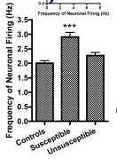
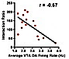
Exp 5 B-C: Does VTA Firing Rate Correlate with Vulnerability?
B
C
CSDS (10d)
Social Interaction Test (d11)
EC Single-Unit Recordings from VTA DA Neurons ex vivo (d25)
(5B): Vulnerable Mice: ↑ VTA DA Firing Rate
(5C): Correlation between VTA firing rate & Interaction Ratio (r = -0.67)
Interaction Ratio
Vulnerability is associated with long-lasting up-regulation of VTA DA firing rate
Avg. VTA DA Firing Rate (Hz)
(B) Only DA neurons from Vulnerable mice show enhanced firing rates (***p<0.001 vs control)
(C) Avg VTA firing rates for each mouse significantly correlated with interaction ratios on d11 (r= -0.67).
Mean + SE (n = 5–11)
Krishnan et al. (2007). Cell.
Notes:
Figure 5. Increased VTA Dopamine Neuron Firing Mediates Susceptibility
(A) Social defeat results in a significant increase in VTA dopamine neuron firing rates on day 11, with the inset showing a relative cumulative distribution histogram. (B) On day 25, dopamine neurons from only Susceptible mice display significantly enhanced firing rates. (C) Sample traces and spikes; inset shows that averaged VTA firing rates for each mouse are significantly correlated with interaction ratios measured on day 11. (D) Single-unit recordings of GFP-positive or GFP-negative VTA dopamine neurons in slice culture, showing that HSV-Kir2.1 and HSV-dnK are able to significantly modulate the spontaneous activity of VTA neurons in vitro (n = 3–5 mice/group, 20–30 neurons/group). (E) While the VTA-specific overexpression of HSV-GFP in Susceptible mice did not alleviate social avoidance (t₁₁ = 2.98, p < 0.05), HSV-Kir2.1 promoted resilient behavior (t₁₄ = 0.30, p > 0.3), and (F) resulted in a significant reduction in NAc BDNF levels (one-tailed t test). (G) An intra-VTA infusion of HSV-dnK decreased social interaction (produced a Susceptible phenotype) following a submaximal social defeat regimen (HSV-GFP: t₁₀ = 4.52, p < 0.001; and HSV-dnK: t₁₀ = 0.31, p > 0.5) and (H) resulted in a significant increase in BDNF levels (one-tailed t test). Bars represent mean + SE (n = 5–11), ∗ indicates significant post hoc comparisons to respective control groups, ∗p < 0.05, ∗∗p < 0.01, ∗∗∗p < 0.0001.

Slide 37



Exp 5 E-H: Can VTA Excitability Cause Vulnerability?
E
F
CSDS (Kir2.1) or submaximal (dnK)
VTA Overexpression (d11) of either:
  Kir2.1 (CSDS): Inward rectifying K⁺ channel
    Reliably suppresses excitability (5D)
  dnK (submax): dominant-negative K+ channel
  GFP Controls
Social Interaction Test (d11)
  Vulnerable mice matched for interaction time
Repeat Social Interaction Test (d14, Fig E, G)
  3d: peak of transgene expression peak (S5)
Western Immunoblotting for NAc BDNF (F, H)
Time in Interaction Zone (s)
NAc BDNF
HSV-GFP
HSV-Kir2.1
GFP
Kir2.1
G
H
Time in Interaction Zone (s)
NAc BDNF
HSV-GFP
HSV-dnK
GFP
dnK
(E) HSV-Kir2.1_{VTA} overexpression promoted resilient behavior (t₁₄ = 0.30, p > 0.3), and (F) reduced NAc BDNF (1-tailed t test). (G) HSV-dnK_{VTA} produced Vulnerable phenotype after submaximal social defeat (t₁₀ = 0.31, p > 0.5) and (H) increased BDNF.
Mean + SE (n = 5–11), *sig post hoc comparisons vs control groups, ∗p < 0.05, ∗∗p < 0.01.
Krishnan et al. (2007). Cell.
Notes:
Figure 5. Increased VTA Dopamine Neuron Firing Mediates Susceptibility
(D) Single-unit recordings of GFP-positive or GFP-negative VTA dopamine neurons in slice culture, showing that HSV-Kir2.1 and HSV-dnK are able to significantly modulate the spontaneous activity of VTA neurons in vitro (n = 3–5 mice/group, 20–30 neurons/group). (E) While the VTA-specific overexpression of HSV-GFP in Susceptible mice did not alleviate social avoidance (t₁₁ = 2.98, p < 0.05), HSV-Kir2.1 promoted resilient behavior (t₁₄ = 0.30, p > 0.3), and (F) resulted in a significant reduction in NAc BDNF levels (one-tailed t test). (G) An intra-VTA infusion of HSV-dnK decreased social interaction (produced a Susceptible phenotype) following a submaximal social defeat regimen (HSV-GFP: t₁₀ = 4.52, p < 0.001; and HSV-dnK: t₁₀ = 0.31, p > 0.5) and (H) resulted in a significant increase in BDNF levels (one-tailed t test). Bars represent mean + SE (n = 5–11), ∗ indicates significant post hoc comparisons to respective control groups, ∗p < 0.05, ∗∗p < 0.01, ∗∗∗p < 0.0001.

Slide 38
Exp 5 E-H: Can VTA Excitability Cause Vulnerability?
E
F
Kir2.1_{VTA} Overexpression:
Decreased VTA Firing of DA Neurons (D)
Induced Resilient Phenotype (E)
Reduced NAc BDNF (F).
Resilient phenotype lost after transgene expression degradation 8d later (S5E)
dnK_{VTA} Overexpression:
Increased VTA Firing of DA Neurons (D)
Promoted Vulnerable Phenotype (G, submx defeat)
Increased NAc BDNF (H)
Time in Interaction Zone (s)
NAc BDNF
HSV-GFP
HSV-Kir2.1
GFP
Kir2.1
G
H
Time in Interaction Zone (s)
NAc BDNF
HSV-GFP
HSV-dnK
GFP
dnK
Defeat-induced ↑ in VTA K⁺ channel activity: Molecular mechanism for resilience
Heightened VTA electrical activity: Mechanism for ↑ NAc BDNF release
(E) HSV-Kir2.1_{VTA} overexpression promoted resilient behavior (t₁₄ = 0.30, p > 0.3), and (F) reduced NAc BDNF (1-tailed t test). (G) HSV-dnK_{VTA} produced Vulnerable phenotype after submaximal social defeat (t₁₀ = 0.31, p > 0.5) and (H) increased BDNF.
Mean + SE (n = 5–11), *sig post hoc comparisons vs control groups, ∗p < 0.05, ∗∗p < 0.01.
Changes in VTA excitability → Changes in Vulnerability Phenotype
“Causative role for increased VTA firing in mediating defeat-induced avoidance”
Krishnan et al. (2007). Cell.
Notes:
Figure 5. Increased VTA Dopamine Neuron Firing Mediates Susceptibility
(D) Single-unit recordings of GFP-positive or GFP-negative VTA dopamine neurons in slice culture, showing that HSV-Kir2.1 and HSV-dnK are able to significantly modulate the spontaneous activity of VTA neurons in vitro (n = 3–5 mice/group, 20–30 neurons/group). (E) While the VTA-specific overexpression of HSV-GFP in Susceptible mice did not alleviate social avoidance (t₁₁ = 2.98, p < 0.05), HSV-Kir2.1 promoted resilient behavior (t₁₄ = 0.30, p > 0.3), and (F) resulted in a significant reduction in NAc BDNF levels (one-tailed t test). (G) An intra-VTA infusion of HSV-dnK decreased social interaction (produced a Susceptible phenotype) following a submaximal social defeat regimen (HSV-GFP: t₁₀ = 4.52, p < 0.001; and HSV-dnK: t₁₀ = 0.31, p > 0.5) and (H) resulted in a significant increase in BDNF levels (one-tailed t test). Bars represent mean + SE (n = 5–11), ∗ indicates significant post hoc comparisons to respective control groups, ∗p < 0.05, ∗∗p < 0.01, ∗∗∗p < 0.0001.

Slide 39

Exp6: Do deficits in BNDF Secretion (Val66Met) promote resilience?
Val66Met BNDF SNP:
Single Nucleotide Polymorphism (SNP) in BDNF Prodomain
Met/Met Impairs activity-dependent BDNF release
Met/Met and Val/Val Mice
CSDS (10d)
Social Interaction Test (d11)
BDNF Western Immunoblotting (NAc, d11)
Extracellular Recordings: VTA DA Neurons
http://www.alomone.com/InFocus
Notes:
Figure 6. Human Correlates: Variant BDNF (Val66Met) and Postmortem NAc Studies
(A) Socially defeated Val/Val mice demonstrated a significant reduction in social interaction upon exposure to a CD1 target mouse, while Met/Met mice behaved comparably in both trials. (B) Day 11 western blot analysis of defeated Val/Val and Met/Met mice showing 50% lower BDNF levels in NAc of Met/Met mice (one-tailed t test). (C) VTA dopamine neurons from socially defeated Val/Val and Met/Met mice displayed comparable firing rates. (D) ELISA comparing levels of total BDNF in NAc lysates from depressed humans and unaffected controls (n = 10) (inset: scatterplot). Bars represent mean + SE (n = 7–8), ∗ indicates significant changes compared to controls, ∗p < 0.05, ∗∗p < 0.01. (E) Schematic: in Susceptible mice, chronic social defeat increases the firing rate of VTA dopamine neurons, which subsequently gives rise to heightened BDNF signaling within the NAc. Unsusceptible mice display a resistance to this adverse cascade of events by upregulating various K⁺ channels within the VTA.

Slide 40
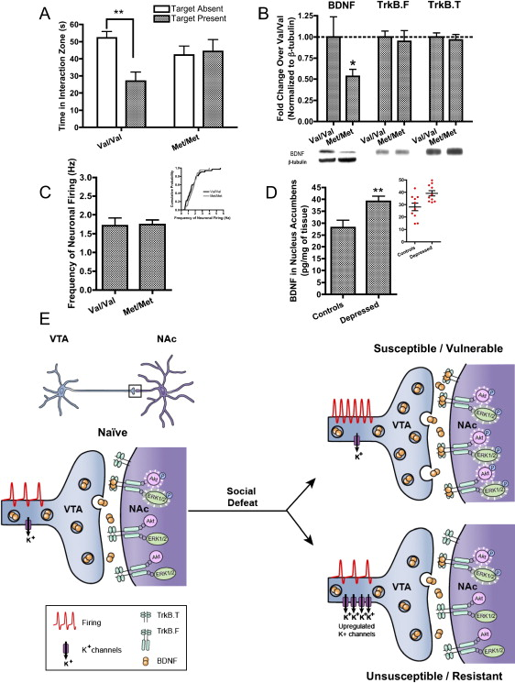
Exp6: Deficits in BNDF Secretion (Val66Met) Promote Resilience
A
B
C
Defeated Met/Met mice (impaired BDNF secretion) show: (A) Resilient Social Interaction Phenotype & (B) 50% lower NAc BDNF levels. (C) VTA DA firing rate is not altered in Met/Met mice.
Mean + SE (n = 7–8), *significant changes vs. controls, ∗p < 0.05, ∗∗p < 0.01.
Krishnan et al. (2007). Cell.
Notes:
Figure 6. Human Correlates: Variant BDNF (Val66Met) and Postmortem NAc Studies
(A) Socially defeated Val/Val mice demonstrated a significant reduction in social interaction upon exposure to a CD1 target mouse, while Met/Met mice behaved comparably in both trials. (B) Day 11 western blot analysis of defeated Val/Val and Met/Met mice showing 50% lower BDNF levels in NAc of Met/Met mice (one-tailed t test). (C) VTA dopamine neurons from socially defeated Val/Val and Met/Met mice displayed comparable firing rates. (D) ELISA comparing levels of total BDNF in NAc lysates from depressed humans and unaffected controls (n = 10) (inset: scatterplot). Bars represent mean + SE (n = 7–8), ∗ indicates significant changes compared to controls, ∗p < 0.05, ∗∗p < 0.01. (E) Schematic: in Susceptible mice, chronic social defeat increases the firing rate of VTA dopamine neurons, which subsequently gives rise to heightened BDNF signaling within the NAc. Unsusceptible mice display a resistance to this adverse cascade of events by upregulating various K⁺ channels within the VTA.

Slide 41
Fig 6E: Role of VTA Excitability/Firing & NAc BDNF in Vulnerability
(E) In Vulnerable mice, chronic social defeat increases firing rate of VTA dopamine neurons, which gives rise to heightened BDNF signaling within the NAc. Resilient mice display resistance to this adversity by upregulating VTA K⁺ channels.
Preventing BDNF signaling to the NAc may be a key molecular mechanism of resilience to CSDS.
Krishnan et al. (2007). Cell.
Notes:
Figure 6. Human Correlates: Variant BDNF (Val66Met) and Postmortem NAc Studies
(A) Socially defeated Val/Val mice demonstrated a significant reduction in social interaction upon exposure to a CD1 target mouse, while Met/Met mice behaved comparably in both trials. (B) Day 11 western blot analysis of defeated Val/Val and Met/Met mice showing 50% lower BDNF levels in NAc of Met/Met mice (one-tailed t test). (C) VTA dopamine neurons from socially defeated Val/Val and Met/Met mice displayed comparable firing rates. (D) ELISA comparing levels of total BDNF in NAc lysates from depressed humans and unaffected controls (n = 10) (inset: scatterplot). Bars represent mean + SE (n = 7–8), ∗ indicates significant changes compared to controls, ∗p < 0.05, ∗∗p < 0.01. (E) Schematic: in Susceptible mice, chronic social defeat increases the firing rate of VTA dopamine neurons, which subsequently gives rise to heightened BDNF signaling within the NAc. Unsusceptible mice display a resistance to this adverse cascade of events by upregulating various K⁺ channels within the VTA.

Slide 42
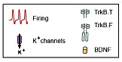
Takeaways:
Validation of CSDS Paradigm
Vulnerability: Changes in mesolimbic DA pathway
  ↓ natural reward (1E), ↑ drug reward (S2D)
  ↑ NAc BDNF and downstream signaling (2A,C)
  ↓ Molecular Plasticity (4A)
  ↑ VTA Firing Rate (long-lasting, latent; 5A-C)
Krishnan et al. (2007). Cell.
Notes:
Figure 6. Human Correlates: Variant BDNF (Val66Met) and Postmortem NAc Studies
(A) Socially defeated Val/Val mice demonstrated a significant reduction in social interaction upon exposure to a CD1 target mouse, while Met/Met mice behaved comparably in both trials. (B) Day 11 western blot analysis of defeated Val/Val and Met/Met mice showing 50% lower BDNF levels in NAc of Met/Met mice (one-tailed t test). (C) VTA dopamine neurons from socially defeated Val/Val and Met/Met mice displayed comparable firing rates. (D) ELISA comparing levels of total BDNF in NAc lysates from depressed humans and unaffected controls (n = 10) (inset: scatterplot). Bars represent mean + SE (n = 7–8), ∗ indicates significant changes compared to controls, ∗p < 0.05, ∗∗p < 0.01. (E) Schematic: in Susceptible mice, chronic social defeat increases the firing rate of VTA dopamine neurons, which subsequently gives rise to heightened BDNF signaling within the NAc. Unsusceptible mice display a resistance to this adverse cascade of events by upregulating various K⁺ channels within the VTA.

Slide 43
Takeaways:
Validation of CSDS Paradigm
Vulnerability: Changes in mesolimbic DA pathway
  CSDS: Chronic activation of VTA DA Neurons
  Deficit in Plastic Adaptations (no ↑ K⁺ channels)
  ↑ VTA DA activity: ↑ activity-dependent BDNF release from VTA DA neurons
  ↑ NAc BDNF and downstream signaling
Krishnan et al. (2007). Cell.
Notes:
Figure 6. Human Correlates: Variant BDNF (Val66Met) and Postmortem NAc Studies
(A) Socially defeated Val/Val mice demonstrated a significant reduction in social interaction upon exposure to a CD1 target mouse, while Met/Met mice behaved comparably in both trials. (B) Day 11 western blot analysis of defeated Val/Val and Met/Met mice showing 50% lower BDNF levels in NAc of Met/Met mice (one-tailed t test). (C) VTA dopamine neurons from socially defeated Val/Val and Met/Met mice displayed comparable firing rates. (D) ELISA comparing levels of total BDNF in NAc lysates from depressed humans and unaffected controls (n = 10) (inset: scatterplot). Bars represent mean + SE (n = 7–8), ∗ indicates significant changes compared to controls, ∗p < 0.05, ∗∗p < 0.01. (E) Schematic: in Susceptible mice, chronic social defeat increases the firing rate of VTA dopamine neurons, which subsequently gives rise to heightened BDNF signaling within the NAc. Unsusceptible mice display a resistance to this adverse cascade of events by upregulating various K⁺ channels within the VTA.

Slide 44
Takeaways:
Validation of CSDS Paradigm
Vulnerability: Changes in mesolimbic DA pathway
DA & BDNF in Acute vs Chronic Stress:
  “Increased DA release in NAc in context of social defeat may promote alertness during a potentially harmful situation, and simultaneous BDNF release may promote neuroplastic changes necessary for survival.
  “Excessive and prolonged VTA activation & BDNF signaling to the NAc may be maladaptive, as it could produce long-lasting inflexibility and overgeneralization, causing harmless social cues to become aversive.”
Krishnan et al. (2007). Cell.
Notes:
Figure 6. Human Correlates: Variant BDNF (Val66Met) and Postmortem NAc Studies
(A) Socially defeated Val/Val mice demonstrated a significant reduction in social interaction upon exposure to a CD1 target mouse, while Met/Met mice behaved comparably in both trials. (B) Day 11 western blot analysis of defeated Val/Val and Met/Met mice showing 50% lower BDNF levels in NAc of Met/Met mice (one-tailed t test). (C) VTA dopamine neurons from socially defeated Val/Val and Met/Met mice displayed comparable firing rates. (D) ELISA comparing levels of total BDNF in NAc lysates from depressed humans and unaffected controls (n = 10) (inset: scatterplot). Bars represent mean + SE (n = 7–8), ∗ indicates significant changes compared to controls, ∗p < 0.05, ∗∗p < 0.01. (E) Schematic: in Susceptible mice, chronic social defeat increases the firing rate of VTA dopamine neurons, which subsequently gives rise to heightened BDNF signaling within the NAc. Unsusceptible mice display a resistance to this adverse cascade of events by upregulating various K⁺ channels within the VTA.

Slide 46
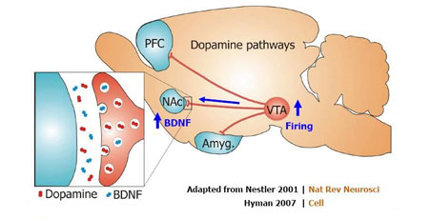
NAc DA: Good or Bad for Stress-Induced Depression?
DA Associated w Reward
Depression: “Dopamine deficiency” (Wise, 2008)
Depressed patients: ↓ DA metabolites (Dunlop & Nemeroff, 2007)
Antidepressants ↑ NAc DA (Di Matteo et al., 2000)
VTA→DA neurons reverse depressive behaviors in mice (Tye et al., 2013)
http://icahn.mssm.edu/research/labs/han-laboratory/projects-and-grants
Krishnan et al. (2007). Cell.
Notes:
Figure 6. Human Correlates: Variant BDNF (Val66Met) and Postmortem NAc Studies
(A) Socially defeated Val/Val mice demonstrated a significant reduction in social interaction upon exposure to a CD1 target mouse, while Met/Met mice behaved comparably in both trials. (B) Day 11 western blot analysis of defeated Val/Val and Met/Met mice showing 50% lower BDNF levels in NAc of Met/Met mice (one-tailed t test). (C) VTA dopamine neurons from socially defeated Val/Val and Met/Met mice displayed comparable firing rates. (D) ELISA comparing levels of total BDNF in NAc lysates from depressed humans and unaffected controls (n = 10) (inset: scatterplot). Bars represent mean + SE (n = 7–8), ∗ indicates significant changes compared to controls, ∗p < 0.05, ∗∗p < 0.01. (E) Schematic: in Susceptible mice, chronic social defeat increases the firing rate of VTA dopamine neurons, which subsequently gives rise to heightened BDNF signaling within the NAc. Unsusceptible mice display a resistance to this adverse cascade of events by upregulating various K⁺ channels within the VTA.

Slide 47
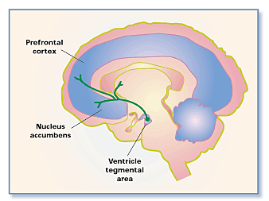
Exp1: Does Inhibition of VTA DA Neurons Induce Depressive Behaviors?
Depression:
  Reduced motivation, anhedonia, psychomotor retardation
Mesolimbic DA system
  Mediates motivation & reward
NAc (Shell) DA:
  Reward Salience: “Stay on Task!”
NAc (Core) DA:
  Approach Reward: “Go Get It!”
http://nawrot.psych.ndsu.nodak.edu/Courses/465Projects09/NeuroscienceofAddiction/MesolimbicDopaminePathway_files/image001.gif
Notes:
IRES: Internal ribosomal entry site; enables translation intiation in middle of a mRNA sequence
Figure 6. Human Correlates: Variant BDNF (Val66Met) and Postmortem NAc Studies
(A) Socially defeated Val/Val mice demonstrated a significant reduction in social interaction upon exposure to a CD1 target mouse, while Met/Met mice behaved comparably in both trials. (B) Day 11 western blot analysis of defeated Val/Val and Met/Met mice showing 50% lower BDNF levels in NAc of Met/Met mice (one-tailed t test). (C) VTA dopamine neurons from socially defeated Val/Val and Met/Met mice displayed comparable firing rates. (D) ELISA comparing levels of total BDNF in NAc lysates from depressed humans and unaffected controls (n = 10) (inset: scatterplot). Bars represent mean + SE (n = 7–8), ∗ indicates significant changes compared to controls, ∗p < 0.05, ∗∗p < 0.01. (E) Schematic: in Susceptible mice, chronic social defeat increases the firing rate of VTA dopamine neurons, which subsequently gives rise to heightened BDNF signaling within the NAc. Unsusceptible mice display a resistance to this adverse cascade of events by upregulating various K⁺ channels within the VTA.

Slide 48
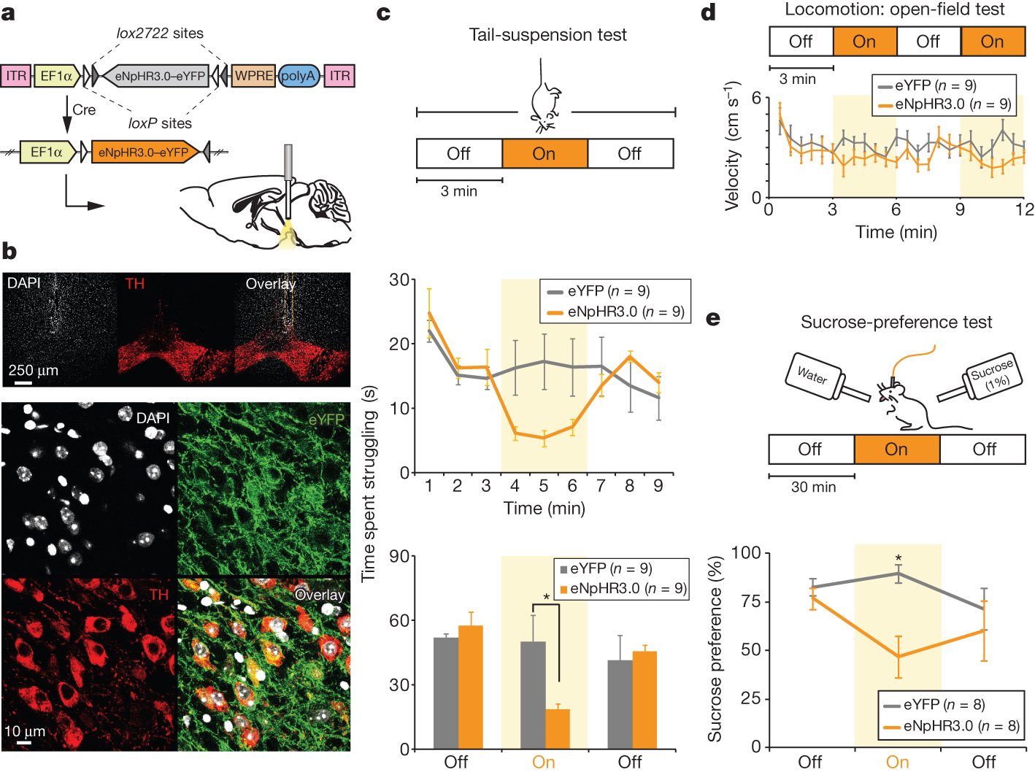
Exp1: Can Inhibition of VTA DA Neurons Induce Depressive Behaviors?
TH::IRES-Cre male mice (8-16 wks)
VTA: pAAV2-MCs–ITR–EF1α–eNpHR3.0–eYFP–WPRE_{VTA}
  pAAV2-MCs: cloned viral vector (carrier)
  ITR: Inverted terminal repeat (delivery)
  EF1α: human elongation factor promoter (promoter)
  eNpHR3.0: halorhodopsin - membrane hyperpolarization
  WPRE: Woodchuck hep virus post-transcrptnl reg element (↑ expression)
VTA Fiber Optic Implantation
  Constant 593-nm yellow light stimulation: 1.9-4.9mW mm⁻²
b
Fig 1 (a) Cre-dependent AAV. (b) Top: Confocal images of midbrain DA neurons. Orange dotted lines: location of fibre optic. Bottom: Images of VTA neurons directly below fibre track. Bottom Right: TH+ VTA neurons expressing eNpHR3.0-eYFP
Tye et al., (2013). Nature. 493(7433):537-41
Notes:
IRES: Internal ribosomal entry site; enables translation intiation in middle of a mRNA sequence
a, Cre-dependent AAV. b, Confocal images of midbrain dopamine neurons. Orange dotted lines, location of fibre optic. Bottom, images of VTA neurons directly below fibre track. c, Photoinhibition of VTA dopamine neurons acutely reduces escape-related behaviour. Two-way ANOVA demonstrates the group-by-light epoch interaction (interaction of the experimental-group factor and light-condition factor in the test), F_{4,38} = 3.95, P = 0.00089; Bonferroni post-hoc test shows reduced struggling in the eNpHR3.0 group relative to the eYFP group, *P < 0.05. Error bars, s.e.m. d, Inhibition of VTA dopamine neurons does not produce a significant difference in open-field locomotion; two-way ANOVA did not demonstrate a significant group-by-light epoch interaction, F_{3,48} = 1.76, P = 0.17. Error bars, s.e.m. e, Schematic and results of the 90-min sucrose-preference test. Photoinhibition of VTA dopamine neurons acutely reduces sucrose preference; two-way ANOVA revealed that opsin expression has a significant effect, F_{1,42} = 6.31, P = 0.016; Bonferroni post-hoc test revealed significant differences between groups only in the light-on epoch, *P < 0.05. Error bars, s.e.m. Off, light off; On, light on; WPRE; woodchuck hepatitis virus post-transcriptional regulatory element.

Slide 49
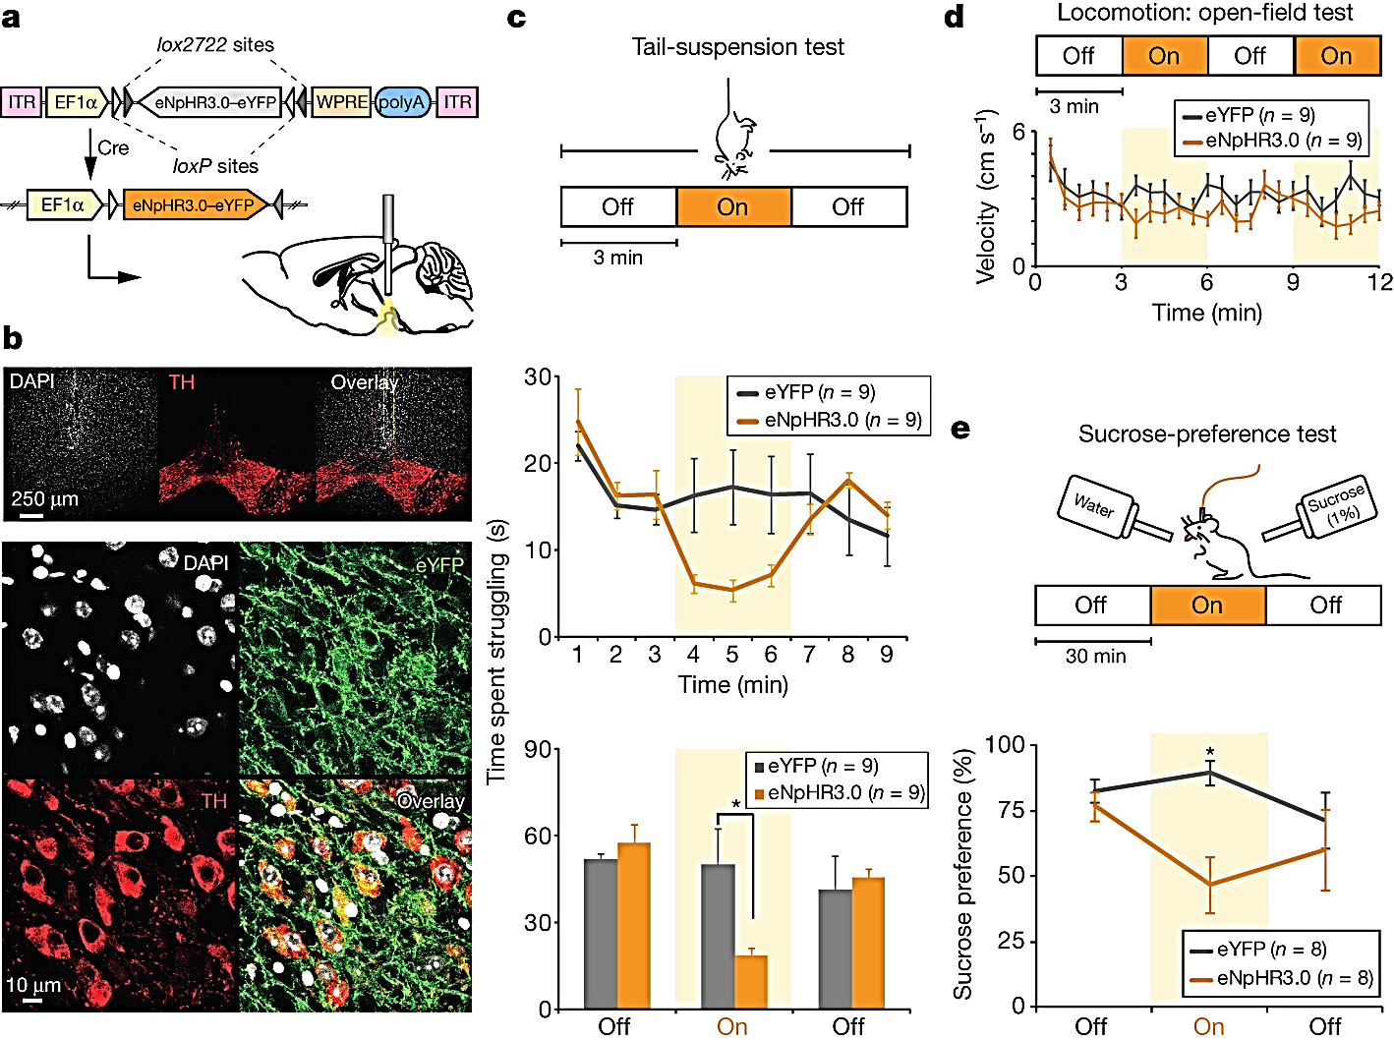
Exp1: Can Inhibition of VTA DA Neurons Induce Depressive Behaviors?
c
c
TH::IRES-Cre male mice (8-16 wks)
VTA: pAAV2-MCs–ITR–EF1α–eNpHR3.0–eYFP–WPRE_{VTA}
  eNpHR3.0: halorhodopsin - membrane hyperpolarization
VTA Fiber Optic Implantation
  Constant 593-nm yellow light stimulation
Behavioral Assays:
  Tail Suspension Test (c) – Behavioral despair/passivity
    Time struggling (escape behavior) vs. time immobile
  Open Field Test (d) – Rule out gross locomotor effects
  Sucrose Preference Test (e) – anhedonia
    # licks on spout delivering H₂O vs. sucrose (90m)
    Temporal precision!
d
e
Fig 1 Design used in (c) Tail suspension test, (d) open field test, & (e) sucrose preference test.
Tye et al., (2013). Nature. 493(7433):537-41
Notes:
IRES: Internal ribosomal entry site; enables translation intiation in middle of a mRNA sequence
a, Cre-dependent AAV. b, Confocal images of midbrain dopamine neurons. Orange dotted lines, location of fibre optic. Bottom, images of VTA neurons directly below fibre track. c, Photoinhibition of VTA dopamine neurons acutely reduces escape-related behaviour. Two-way ANOVA demonstrates the group-by-light epoch interaction (interaction of the experimental-group factor and light-condition factor in the test), F_{4,38} = 3.95, P = 0.00089; Bonferroni post-hoc test shows reduced struggling in the eNpHR3.0 group relative to the eYFP group, *P < 0.05. Error bars, s.e.m. d, Inhibition of VTA dopamine neurons does not produce a significant difference in open-field locomotion; two-way ANOVA did not demonstrate a significant group-by-light epoch interaction, F_{3,48} = 1.76, P = 0.17. Error bars, s.e.m. e, Schematic and results of the 90-min sucrose-preference test. Photoinhibition of VTA dopamine neurons acutely reduces sucrose preference; two-way ANOVA revealed that opsin expression has a significant effect, F_{1,42} = 6.31, P = 0.016; Bonferroni post-hoc test revealed significant differences between groups only in the light-on epoch, *P < 0.05. Error bars, s.e.m. Off, light off; On, light on; WPRE; woodchuck hepatitis virus post-transcriptional regulatory element.

Slide 50
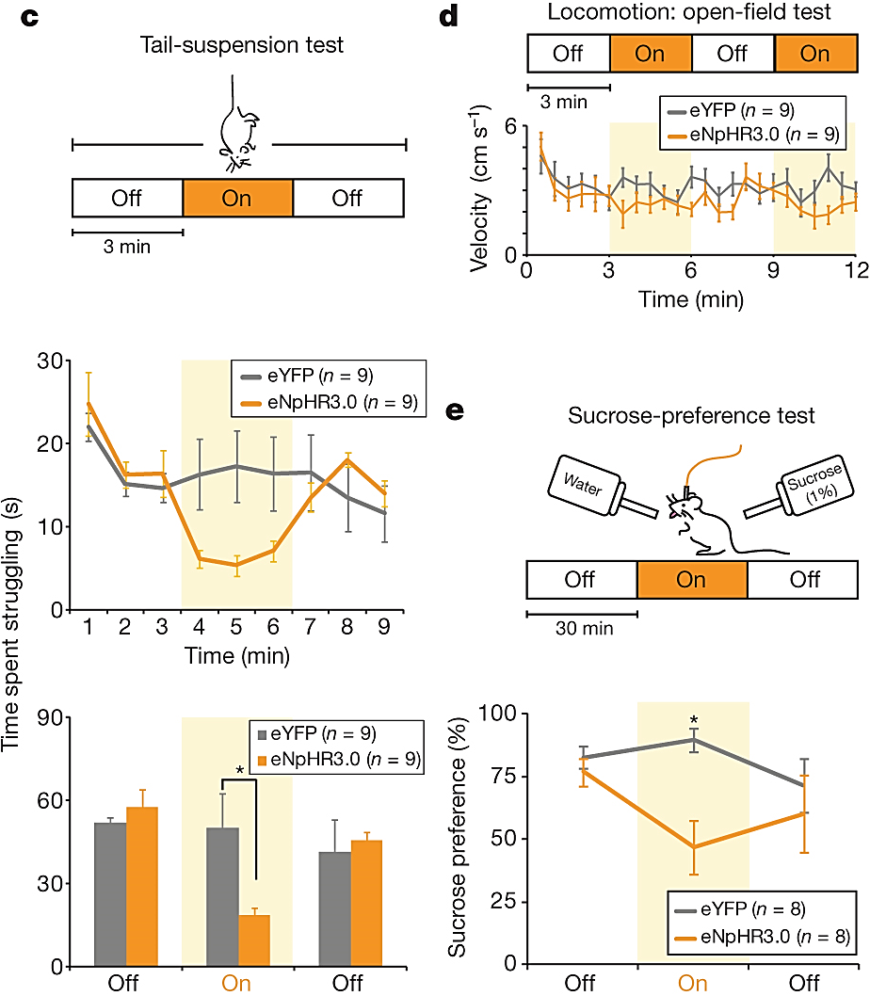
Fig 1: Inhibition of VTA DA Neurons Induce Depressive Behaviors
(c) VTA DA inhibition acutely reduces escape behavior
  VTA DA cells implicated in behavioral motivation
  Two-way ANOVA: interaction: experimental-group & light-condition (F_{4,38} = 3.95, P = 0.00089; Bonferroni post-hoc: reduced struggling in eNpHR3.0 mice)
(d) VTA DA inhibition does not alter open-field locomotion
  (F_{3,48} = 1.76, P = 0.17)
(e) VTA DA inhibition acutely reduces sucrose preference
  VTA DA neurons implicated in reward
  Main effect of eNpHR3.0 (F_{1,42} = 6.31, P = 0.016; Bonferroni post-hoc: sig. diff. between groups only in the light-on epoch
*P < 0.05. Error bars, SEM.
  “Optogenetic inhibition of VTA DA neurons defined a phenotype that could be immediately induced and reversed, and that was consistent with the multiple depression-symptom categories of behavioral despair and anhedonia.”
Tye et al., (2013). Nature. 493(7433):537-41
Notes:
c, Photoinhibition of VTA dopamine neurons acutely reduces escape-related behaviour. Two-way ANOVA demonstrates the group-by-light epoch interaction (interaction of the experimental-group factor and light-condition factor in the test), F_{4,38} = 3.95, P = 0.00089; Bonferroni post-hoc test shows reduced struggling in the eNpHR3.0 group relative to the eYFP group, *P < 0.05. Error bars, s.e.m. d, Inhibition of VTA dopamine neurons does not produce a significant difference in open-field locomotion; two-way ANOVA did not demonstrate a significant group-by-light epoch interaction, F_{3,48} = 1.76, P = 0.17. Error bars, s.e.m. e, Schematic and results of the 90-min sucrose-preference test. Photoinhibition of VTA dopamine neurons acutely reduces sucrose preference; two-way ANOVA revealed that opsin expression has a significant effect, F_{1,42} = 6.31, P = 0.016; Bonferroni post-hoc test revealed significant differences between groups only in the light-on epoch, *P < 0.05. Error bars, s.e.m. Off, light off; On, light on; WPRE; woodchuck hepatitis virus post-transcriptional regulatory element.

Slide 51
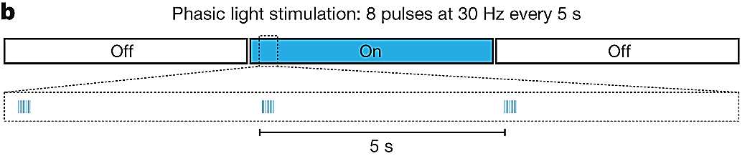
Exp2: Can Activating VTA DA Neurons Correct Stress-Induced Depression?
TH::IRES-Cre male mice (8-16 wks)
VTA: pAAV2-MCs–ITR–EF1α–ChR2/eYFP–WPRE_{VTA}
  ChR2: Channelrhodopsin-2
    Temporally precise excitation
  eYFP: Control
VTA Fiber Optic Implantation
  Blue light stimulation (473-nm)
  Sparse bursting illumination pattern
    8 pulses at 30Hz, 5-ms pulse width, every 5 sec
    Elicits phasic spiking of DA transients
Fig 2b: 473-nm light used to elicit phasic bursts of activity in ChR2-expressing VTA DA neurons.
Tye et al., (2013). Nature. 493(7433):537-41
Notes:
a, Experimental groups. b, Schematic of illumination pattern; 473-nm light used to elicit phasic bursts of activity in ChR2-expressing VTA dopamine neurons. c, Phasic illumination of VTA dopamine neurons rescues stress-induced reduction in struggling on TST in ChR2 CMS but not eYFP CMS mice (**P < 0.001; eYFP CMS = 26.8 s ± 3.5 s; ChR2 CMS = 28.0 s ± 2.7 s; ChR2 non-CMS = 55.63 s ± 4.4 s; eYFP non-CMS = 56.0 s ± 4.7 s). Two-way ANOVA revealed a significant group-by-light epoch interaction (F_{6,134} = 6.04, P < 0.0001) and a significant influence of experimental condition on performance as revealed by one-way ANOVA (F_{3,67} = 6.20, P = 0.0009; Bonferroni post-hoc test). Error bars, s.e.m. d, Illumination parameters, as used in the TST, did not change locomotor activity in the open field, with no significant group-by-epoch interaction in two-way ANOVA (F_{9,152} = 0.99, P = 0.4493), and no detectable differences revealed by Bonferroni post-hoc tests on the same timescale. Error bars, s.e.m. e, Phasic activation of VTA dopamine neurons rescued the stress-induced decrease in sucrose preference in ChR2 CMS, but not eYFP CMS mice; one-way ANOVA, Dunn’s post-hoc test comparing baseline to light-on epoch, P < 0.01 for ChR2 CMS mice, P = 0.2851 for eYFP CMS mice. Two-way ANOVA revealed a significant group-by-light epoch interaction (F_{6,62} = 4.33, P = 0.001), and a significant influence of experimental condition on performance was revealed by one-way ANOVA (F_{3,31} = 3.40, P = 0.0299); **P < 0.01 for ChR2 CMS mice. Error bars, s.e.m.

Slide 52



Exp2: Can Activating VTA DA Neurons Correct Stress-Induced Depression?
TH-Cre male mice (8-16 wks)
pAAV2-MCs–ITR–EF1α–ChR2/eYFP–WPRE_{VTA}
Chronic Mild Stress (CMS) Exposure (8-12 wks):
  Unpredictable stressor: 1 by day, another by night
  Decreases motivation (TST, FST), Induces anhedonia
    45° Cage Tilt (1-16h), Food/water deprivation (12-16h),
    White noise (1-16h), Strobe light illumination (1-16h),
    Crowded housing (1-3h), Individual housing (1-16h),
    Continual light/dark cycle (24-36h), wet bedding (16h)
Behavioral Testing:
  Tail suspension test
  Open field
  Sucrose preference
Phasic VTA Activation during Testing
Fig 2a: Experimental Groups.
Fig 2b: Phasic VTA Activation Protocol.
Tye et al., (2013). Nature. 493(7433):537-41
Notes:
a, Experimental groups. b, Schematic of illumination pattern; 473-nm light used to elicit phasic bursts of activity in ChR2-expressing VTA dopamine neurons. c, Phasic illumination of VTA dopamine neurons rescues stress-induced reduction in struggling on TST in ChR2 CMS but not eYFP CMS mice (**P < 0.001; eYFP CMS = 26.8 s ± 3.5 s; ChR2 CMS = 28.0 s ± 2.7 s; ChR2 non-CMS = 55.63 s ± 4.4 s; eYFP non-CMS = 56.0 s ± 4.7 s). Two-way ANOVA revealed a significant group-by-light epoch interaction (F_{6,134} = 6.04, P < 0.0001) and a significant influence of experimental condition on performance as revealed by one-way ANOVA (F_{3,67} = 6.20, P = 0.0009; Bonferroni post-hoc test). Error bars, s.e.m. d, Illumination parameters, as used in the TST, did not change locomotor activity in the open field, with no significant group-by-epoch interaction in two-way ANOVA (F_{9,152} = 0.99, P = 0.4493), and no detectable differences revealed by Bonferroni post-hoc tests on the same timescale. Error bars, s.e.m. e, Phasic activation of VTA dopamine neurons rescued the stress-induced decrease in sucrose preference in ChR2 CMS, but not eYFP CMS mice; one-way ANOVA, Dunn’s post-hoc test comparing baseline to light-on epoch, P < 0.01 for ChR2 CMS mice, P = 0.2851 for eYFP CMS mice. Two-way ANOVA revealed a significant group-by-light epoch interaction (F_{6,62} = 4.33, P = 0.001), and a significant influence of experimental condition on performance was revealed by one-way ANOVA (F_{3,31} = 3.40, P = 0.0299); **P < 0.01 for ChR2 CMS mice. Error bars, s.e.m.

Slide 53

Fig 2: Phasic VTA DA Excitation Corrects Stress-Induced Depression
(c) Phasic VTA firing rescues struggling in CMS-ChR2 mice
  CMS ↓ escape behavior by 50% vs non-CMS controls
  VTA activation ↑ escape behavior in ChR2 vs eYFP (p<0.001)
  Phasic VTA firing reversed CMS-induced depression phenotype with timing on the order of seconds
*P < 0.05, **P < 0.01 . Error bars, SEM.
Time spent struggling (s)
Time spent struggling (s)
Tye et al., (2013). Nature. 493(7433):537-41
Notes:
Phasic illumination of VTA dopamine neurons rescues stress-induced reduction in struggling on TST in ChR2 CMS but not eYFP CMS mice (**P < 0.001; eYFP CMS = 26.8 s ± 3.5 s; ChR2 CMS = 28.0 s ± 2.7 s; ChR2 non-CMS = 55.63 s ± 4.4 s; eYFP non-CMS = 56.0 s ± 4.7 s). Two-way ANOVA revealed a significant group-by-light epoch interaction (F_{6,134} = 6.04, P < 0.0001) and a significant influence of experimental condition on performance as revealed by one-way ANOVA (F_{3,67} = 6.20, P = 0.0009; Bonferroni post-hoc test). Error bars, s.e.m.
d, Illumination parameters, as used in the TST, did not change locomotor activity in the open field, with no significant group-by-epoch interaction in two-way ANOVA (F_{9,152} = 0.99, P = 0.4493), and no detectable differences revealed by Bonferroni post-hoc tests on the same timescale. Error bars, s.e.m. e, Phasic activation of VTA dopamine neurons rescued the stress-induced decrease in sucrose preference in ChR2 CMS, but not eYFP CMS mice; one-way ANOVA, Dunn’s post-hoc test comparing baseline to light-on epoch, P < 0.01 for ChR2 CMS mice, P = 0.2851 for eYFP CMS mice. Two-way ANOVA revealed a significant group-by-light epoch interaction (F_{6,62} = 4.33, P = 0.001), and a significant influence of experimental condition on performance was revealed by one-way ANOVA (F_{3,31} = 3.40, P = 0.0299); **P < 0.01 for ChR2 CMS mice. Error bars, s.e.m.

Slide 54
Fig 2: Phasic VTA DA Excitation Corrects Stress-Induced Depression
(c) Phasic VTA firing rescues struggling in CMS-ChR2 mice
  CMS ↓ escape behavior by 50% vs non-CMS controls
  VTA activation ↑ escape behavior in ChR2 vs eYFP (p<0.001)
  Phasic VTA firing reversed CMS-induced depression phenotype with timing on the order of seconds
(d) Phasic VTA DA firing does not alter open-field locomotion
*P < 0.05, **P < 0.01 . Error bars, SEM.
Tye et al., (2013). Nature. 493(7433):537-41
Notes:
Phasic illumination of VTA dopamine neurons rescues stress-induced reduction in struggling on TST in ChR2 CMS but not eYFP CMS mice (**P < 0.001; eYFP CMS = 26.8 s ± 3.5 s; ChR2 CMS = 28.0 s ± 2.7 s; ChR2 non-CMS = 55.63 s ± 4.4 s; eYFP non-CMS = 56.0 s ± 4.7 s). Two-way ANOVA revealed a significant group-by-light epoch interaction (F_{6,134} = 6.04, P < 0.0001) and a significant influence of experimental condition on performance as revealed by one-way ANOVA (F_{3,67} = 6.20, P = 0.0009; Bonferroni post-hoc test). Error bars, s.e.m.
d, Illumination parameters, as used in the TST, did not change locomotor activity in the open field, with no significant group-by-epoch interaction in two-way ANOVA (F_{9,152} = 0.99, P = 0.4493), and no detectable differences revealed by Bonferroni post-hoc tests on the same timescale. Error bars, s.e.m. e, Phasic activation of VTA dopamine neurons rescued the stress-induced decrease in sucrose preference in ChR2 CMS, but not eYFP CMS mice; one-way ANOVA, Dunn’s post-hoc test comparing baseline to light-on epoch, P < 0.01 for ChR2 CMS mice, P = 0.2851 for eYFP CMS mice. Two-way ANOVA revealed a significant group-by-light epoch interaction (F_{6,62} = 4.33, P = 0.001), and a significant influence of experimental condition on performance was revealed by one-way ANOVA (F_{3,31} = 3.40, P = 0.0299); **P < 0.01 for ChR2 CMS mice. Error bars, s.e.m.

Slide 55
Fig 2: Phasic VTA DA Excitation Corrects Stress-Induced Depression
(c) Phasic VTA firing rescues struggling in CMS-ChR2 mice
  CMS ↓ escape behavior by 50% vs non-CMS controls
  VTA activation ↑ escape behavior in ChR2 vs eYFP (p<0.001)
  Phasic VTA firing reversed CMS-induced depression phenotype with timing on the order of seconds
(d) Phasic VTA DA firing does not alter open-field locomotion
(e) Phasic VTA Firing recovers sucrose preference
  CMS ↓ reduced sucrose preference in ChR2 & eYFP mice before illumination (P < 0.05 & 0.01 respectively)
  Phasic VTA activation acutely reversed CMS-induced anhedonic effect in ChR2 (but not eYFP) CMS mice
  Total # of licks across groups not altered (S5b)
*P < 0.05, **P < 0.01 . Error bars, SEM.
Tye et al., (2013). Nature. 493(7433):537-41
Notes:
Phasic illumination of VTA dopamine neurons rescues stress-induced reduction in struggling on TST in ChR2 CMS but not eYFP CMS mice (**P < 0.001; eYFP CMS = 26.8 s ± 3.5 s; ChR2 CMS = 28.0 s ± 2.7 s; ChR2 non-CMS = 55.63 s ± 4.4 s; eYFP non-CMS = 56.0 s ± 4.7 s). Two-way ANOVA revealed a significant group-by-light epoch interaction (F_{6,134} = 6.04, P < 0.0001) and a significant influence of experimental condition on performance as revealed by one-way ANOVA (F_{3,67} = 6.20, P = 0.0009; Bonferroni post-hoc test). Error bars, s.e.m.
d, Illumination parameters, as used in the TST, did not change locomotor activity in the open field, with no significant group-by-epoch interaction in two-way ANOVA (F_{9,152} = 0.99, P = 0.4493), and no detectable differences revealed by Bonferroni post-hoc tests on the same timescale. Error bars, s.e.m. e, Phasic activation of VTA dopamine neurons rescued the stress-induced decrease in sucrose preference in ChR2 CMS, but not eYFP CMS mice; one-way ANOVA, Dunn’s post-hoc test comparing baseline to light-on epoch, P < 0.01 for ChR2 CMS mice, P = 0.2851 for eYFP CMS mice. Two-way ANOVA revealed a significant group-by-light epoch interaction (F_{6,62} = 4.33, P = 0.001), and a significant influence of experimental condition on performance was revealed by one-way ANOVA (F_{3,31} = 3.40, P = 0.0299); **P < 0.01 for ChR2 CMS mice. Error bars, s.e.m.

Slide 56
Figs 1-2: VTA DA Neurons Rapidly Regulate Depression Behaviors
  “Bidirectional effects of VTA DA neuron activity on rapidly inducing and ameliorating diverse depression-related behaviors.”
Tye et al., (2013). Nature. 493(7433):537-41
Notes:
Phasic illumination of VTA dopamine neurons rescues stress-induced reduction in struggling on TST in ChR2 CMS but not eYFP CMS mice (**P < 0.001; eYFP CMS = 26.8 s ± 3.5 s; ChR2 CMS = 28.0 s ± 2.7 s; ChR2 non-CMS = 55.63 s ± 4.4 s; eYFP non-CMS = 56.0 s ± 4.7 s). Two-way ANOVA revealed a significant group-by-light epoch interaction (F_{6,134} = 6.04, P < 0.0001) and a significant influence of experimental condition on performance as revealed by one-way ANOVA (F_{3,67} = 6.20, P = 0.0009; Bonferroni post-hoc test). Error bars, s.e.m.
d, Illumination parameters, as used in the TST, did not change locomotor activity in the open field, with no significant group-by-epoch interaction in two-way ANOVA (F_{9,152} = 0.99, P = 0.4493), and no detectable differences revealed by Bonferroni post-hoc tests on the same timescale. Error bars, s.e.m. e, Phasic activation of VTA dopamine neurons rescued the stress-induced decrease in sucrose preference in ChR2 CMS, but not eYFP CMS mice; one-way ANOVA, Dunn’s post-hoc test comparing baseline to light-on epoch, P < 0.01 for ChR2 CMS mice, P = 0.2851 for eYFP CMS mice. Two-way ANOVA revealed a significant group-by-light epoch interaction (F_{6,62} = 4.33, P = 0.001), and a significant influence of experimental condition on performance was revealed by one-way ANOVA (F_{3,31} = 3.40, P = 0.0299); **P < 0.01 for ChR2 CMS mice. Error bars, s.e.m.

Slide 57
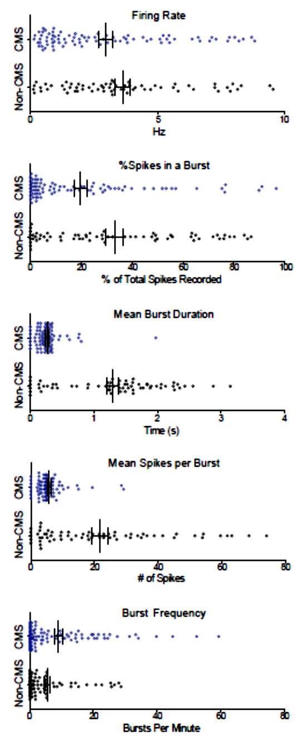
Exp S9: Does CMS (alone) alter VTA Neuronal Activity?
In vivo recording from VTA of +/- CMS (4-6wks) rats:
      VTA neurons in non-CMS rats:
        ↑ proportion of spikes within bursts
        Longer duration bursts
        More spikes per burst
  CMS did not alter mean spike rate
Tye et al., (2013). Nature. 493(7433):537-41
Notes:
c, Photoinhibition of VTA dopamine neurons acutely reduces escape-related behaviour. Two-way ANOVA demonstrates the group-by-light epoch interaction (interaction of the experimental-group factor and light-condition factor in the test), F_{4,38} = 3.95, P = 0.00089; Bonferroni post-hoc test shows reduced struggling in the eNpHR3.0 group relative to the eYFP group, *P < 0.05. Error bars, s.e.m. d, Inhibition of VTA dopamine neurons does not produce a significant difference in open-field locomotion; two-way ANOVA did not demonstrate a significant group-by-light epoch interaction, F_{3,48} = 1.76, P = 0.17. Error bars, s.e.m. e, Schematic and results of the 90-min sucrose-preference test. Photoinhibition of VTA dopamine neurons acutely reduces sucrose preference; two-way ANOVA revealed that opsin expression has a significant effect, F_{1,42} = 6.31, P = 0.016; Bonferroni post-hoc test revealed significant differences between groups only in the light-on epoch, *P < 0.05. Error bars, s.e.m. Off, light off; On, light on; WPRE; woodchuck hepatitis virus post-transcriptional regulatory element.

Slide 58
Exp S9: Does CMS (alone) alter VTA Neuronal Activity?
In vivo recording from VTA of +/- CMS rats:
CMS alters normal bursting activity
Tye et al., (2013). Nature. 493(7433):537-41
Notes:
c, Photoinhibition of VTA dopamine neurons acutely reduces escape-related behaviour. Two-way ANOVA demonstrates the group-by-light epoch interaction (interaction of the experimental-group factor and light-condition factor in the test), F_{4,38} = 3.95, P = 0.00089; Bonferroni post-hoc test shows reduced struggling in the eNpHR3.0 group relative to the eYFP group, *P < 0.05. Error bars, s.e.m. d, Inhibition of VTA dopamine neurons does not produce a significant difference in open-field locomotion; two-way ANOVA did not demonstrate a significant group-by-light epoch interaction, F_{3,48} = 1.76, P = 0.17. Error bars, s.e.m. e, Schematic and results of the 90-min sucrose-preference test. Photoinhibition of VTA dopamine neurons acutely reduces sucrose preference; two-way ANOVA revealed that opsin expression has a significant effect, F_{1,42} = 6.31, P = 0.016; Bonferroni post-hoc test revealed significant differences between groups only in the light-on epoch, *P < 0.05. Error bars, s.e.m. Off, light off; On, light on; WPRE; woodchuck hepatitis virus post-transcriptional regulatory element.

Slide 59
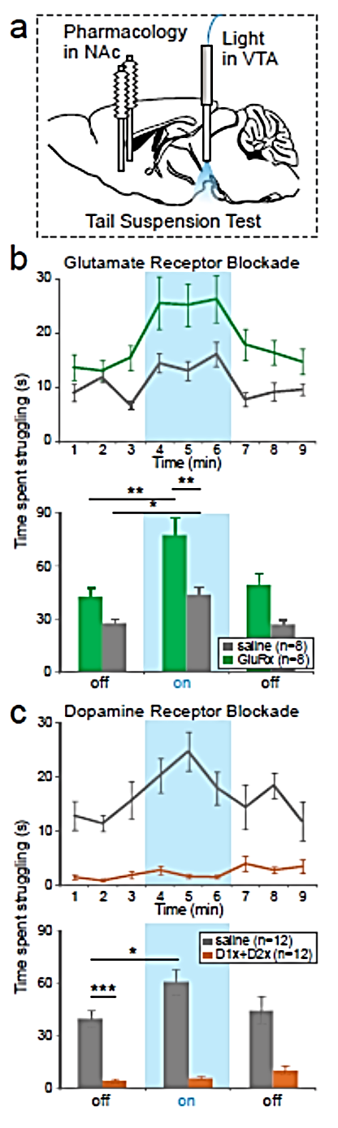
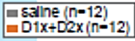
ExpS11: Does NAc DA Mediate Optogenetic Rescue of Depressed Behvior?
TH::IRES-Cre male mice
VTA: pAAV2-MCs–ITR–EF1α–ChR2/eYFP–WPRE_{VTA}
VTA Optic Fiber Implantation; BL NAc Cannula Implantation
Chronic Mild Stress (CMS) Exposure
DA Antagonist Infusion
  SCH23390 (D1-like Receptor Antagonist)
  Raclopride (D2-like Receptor Antagonist)
Tail Suspension Test (10m post-infusion)
  +/- Phasic (Sparse Bursting) VTA Activation
S11a
S11c
Time spent struggling (s)
(a) Schematic of BL NAc pharmacologic manipulation with VTA-DA neuron illumination in CMS+ & - rats. (c) NAc DA blockade blunts escape-related behavior in Tail Suspension Test.
Tye et al., (2013). Nature. 493(7433):537-41

Slide 60
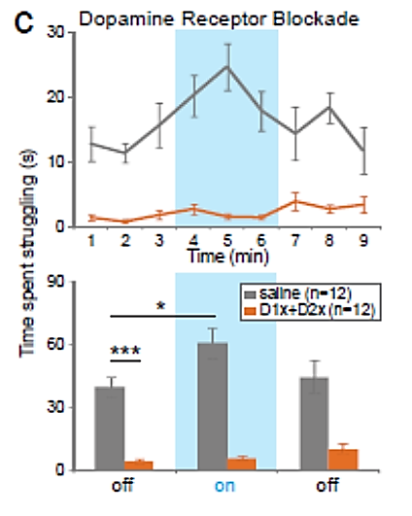
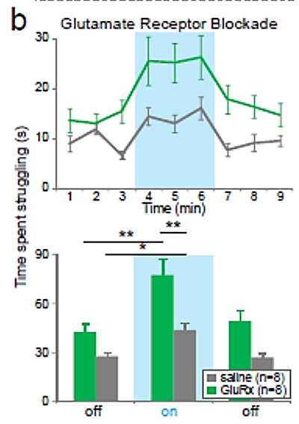
ExpS11: NAc DA Mediates Optogenetic Rescue of Depressed Behavior
(c) NAc DA Receptor blockade:
↓ reduced baseline struggling
Blocked optogenetic reversal of CMS-induced passivity
VTA→NAc DA innervation: important for maintaining baseline levels of motivated escape behavior (& behavioral changes induced by phasic VTA DA activity)
(d) NAc Glutamate Receptor blockade:
↑ overall struggling
Net effect of glutamatergic limbic inputs may suppress struggling in the TST
*P < 0.05, **P < 0.01 . Error bars, SEM.
Selective inhibition of VTA DA neurons acutely produces depression-related behavior in measures of motivation and anhedonia
Phasic activation of VTA DA neurons acutely rescues a CMS-induced depression-like phenotype
  Requires NAc DA receptor activation
(c) NAc DA blockade blunts escape-related behavior in Tail Suspension Test. (b) NAc glutamate blockade enhances escape behavior.
Tye et al., (2013). Nature. 493(7433):537-41

Slide 61

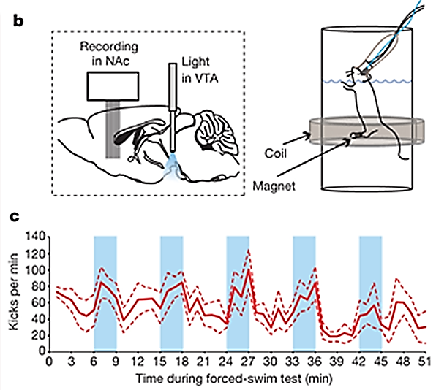
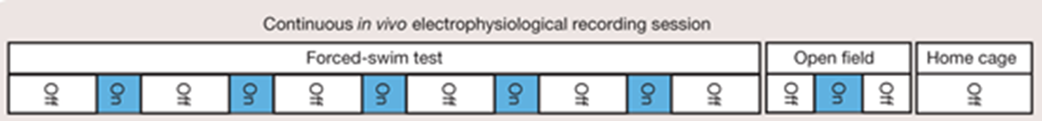
Exp3: Does NAc DA Mediate Optogenetic Rescue of Depressed Behvior?
TH::Cre male rats (5-7 months)
VTA: pAAV2-MCs–ITR–EF1α–ChR2/eYFP–WPRE_{VTA}
Chronic Mild Stress (CMS) Exposure (5-7 wks)
Forced Swim Test
  Small magnet on hind-paw measures kicks/min
    ms-temporal-resolution
  15m pre-test (d1), min 6-51 used for analysis (d2)
Phasic VTA Activation (3m intervals)
In vivo NAc electrophysiology
Tye et al., (2013). Nature. 493(7433):537-41
Notes:
a, In vivo electrophysiology sessions. b, Integration of recordings in the NAc, illumination of ChR2-expressing VTA dopamine neurons, and precision measurement of swimming behaviour in five TH::Cre rats treated with CMS. c, Light-induced modulation of swimming; phasic illumination of ChR2-expressing VTA dopamine neurons increases escape behaviour of TH::Cre rats in FST. Thick red line, mean kick rate; dotted lines, s.e.m. d, Phasic illumination of ChR2-expressing VTA dopamine neurons increases kick rate in FST (paired t-test; **P = 0.0088; mean increase in kick rate of 73.9% ± 21.2% relative to light-off epochs) but not ambulation rate in OFT (mean decrease of 60.2% ± 22.9%; mean ± s.e.m.). e, Peri-event raster histogram showing kick events referenced to the train of 8 light pulses at 30 Hz every 5 s (blue); kick events are not time-locked to light pulses (bin width of 0.175 s for all histograms). f, Scatter-plot relating the degree to which behaviour of each rat was modulated by light-driven VTA dopamine neuron activation, to the proportion of all light-responsive units recorded from the same subject (Pearson’s correlation Test, P = 0.0271, r = 0.9195).

Slide 62
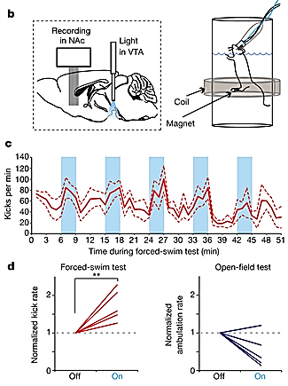
Exp3: Does NAc DA Mediate Optogenetic Rescue of Depressed Behvior?
Phasic VTA Activation:
(c) Increased kick frequency (vs light off)
  Thick line: mean kick; dotted line = SEM.
(d) Increased kick rate in FST, but not ambulation in OFT
  **P=0.0088 by paired t-test
Tye et al., (2013). Nature. 493(7433):537-41
Notes:
a, In vivo electrophysiology sessions. b, Integration of recordings in the NAc, illumination of ChR2-expressing VTA dopamine neurons, and precision measurement of swimming behaviour in five TH::Cre rats treated with CMS. c, Light-induced modulation of swimming; phasic illumination of ChR2-expressing VTA dopamine neurons increases escape behaviour of TH::Cre rats in FST. Thick red line, mean kick rate; dotted lines, s.e.m. d, Phasic illumination of ChR2-expressing VTA dopamine neurons increases kick rate in FST (paired t-test; **P = 0.0088; mean increase in kick rate of 73.9% ± 21.2% relative to light-off epochs) but not ambulation rate in OFT (mean decrease of 60.2% ± 22.9%; mean ± s.e.m.). e, Peri-event raster histogram showing kick events referenced to the train of 8 light pulses at 30 Hz every 5 s (blue); kick events are not time-locked to light pulses (bin width of 0.175 s for all histograms). f, Scatter-plot relating the degree to which behaviour of each rat was modulated by light-driven VTA dopamine neuron activation, to the proportion of all light-responsive units recorded from the same subject (Pearson’s correlation Test, P = 0.0271, r = 0.9195).

Slide 63
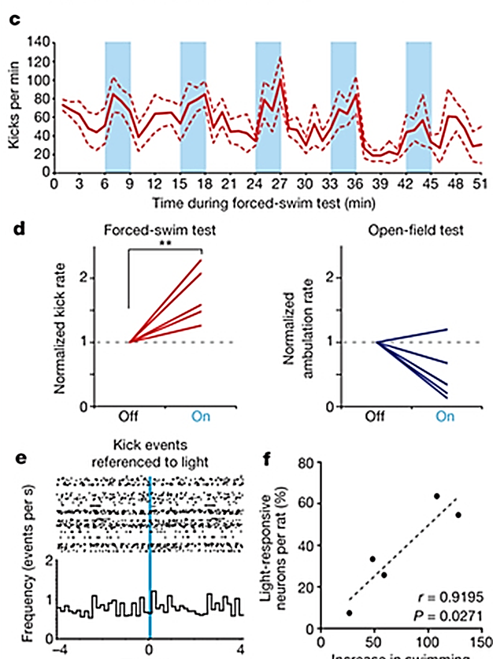
Exp3: Does NAc DA Mediate Optogenetic Rescue of Depressed Behvior?
Phasic VTA Activation ↑ kick frequency & rate (c-d)
Kick events were not time-locked to light pulses (e)
Kick (escape) behavior may be modulated by dopaminergic tone rater than individual dopamine transients
↑ NAc neurons showing phasic responses to VTA dopamine activation correlates with greater relative increase in escape-related behavior (f)
Phasic VTA Activation:
(c) Increased kick frequency (vs light off)
  Thick line: mean kick; dotted line = SEM.
(d) Increased kick rate in FST, but not OFT ambulation
  **P=0.0088 by paired t-test
Kick events were not time-locked to light pulses:
(e) Peri-event raster histogram: kick events referenced to train of 8 light pulses of 30 Hz every 5s (blue)
(f) Scatter-plot showing correlation between:
  Degree to which individual rat behavior was modulated by light-driven VTA DA activation
  Proportion of all NAc light-responsive units recorded from same subject
  R = 0.9195
Perievent (peristimulus) histogram:
Times at which kicks occurred in relation to stimulation
Rate & timing of kick activity in relation to optogenetic stimulation
Time (s)
↑ swimming w light (%)
Tye et al., (2013). Nature. 493(7433):537-41
Notes:
Thick red line, mean kick rate; dotted lines, s.e.m. d, Phasic illumination of ChR2-expressing VTA dopamine neurons increases kick rate in FST (paired t-test; **P = 0.0088; mean increase in kick rate of 73.9% ± 21.2% relative to light-off epochs) but not ambulation rate in OFT (mean decrease of 60.2% ± 22.9%; mean ± s.e.m.). e, Peri-event raster histogram showing kick events referenced to the train of 8 light pulses at 30 Hz every 5 s (blue); kick events are not time-locked to light pulses (bin width of 0.175 s for all histograms). f, Scatter-plot relating the degree to which behaviour of each rat was modulated by light-driven VTA dopamine neuron activation, to the proportion of all light-responsive units recorded from the same subject (Pearson’s correlation Test, P = 0.0271, r = 0.9195).

Slide 64
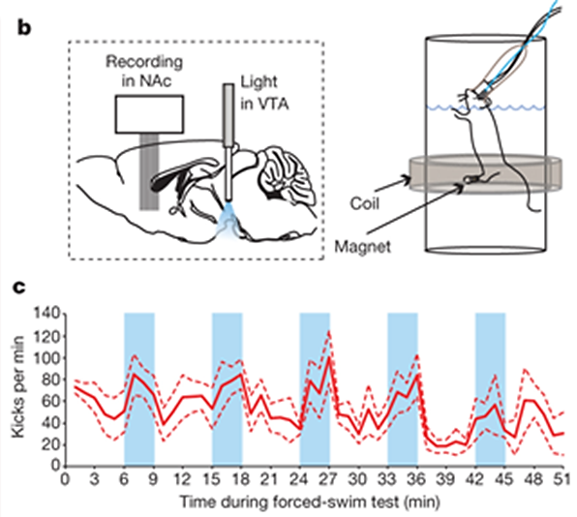
Exp4: What proportion of NAc MSNs respond to phasic VTA activity or kicks?
TH::Cre male rats (5-7 months)
VTA: pAAV2-MCs–ITR–EF1α–ChR2/eYFP–WPRE_{VTA}
Chronic Mild Stress (CMS) Exposure (5-7 wks)
Forced Swim Test
  Phasic VTA Activation (3m intervals)
  In vivo NAc electrophysiology
Analysis of NAc (medial shell) recordings:
  Baseline (BL) vs response window (RW) comparisons
  Fractional change (FC) in avg. firing rate (BL vs RW)
  Sig of FC: percentile in bootstrap distribution
    500 random circular permutations of spike times vs event times, P<0.05
Tye et al., (2013). Nature. 493(7433):537-41
Notes:
a, In vivo electrophysiology sessions. b, Integration of recordings in the NAc, illumination of ChR2-expressing VTA dopamine neurons, and precision measurement of swimming behaviour in five TH::Cre rats treated with CMS. c, Light-induced modulation of swimming; phasic illumination of ChR2-expressing VTA dopamine neurons increases escape behaviour of TH::Cre rats in FST. Thick red line, mean kick rate; dotted lines, s.e.m. d, Phasic illumination of ChR2-expressing VTA dopamine neurons increases kick rate in FST (paired t-test; **P = 0.0088; mean increase in kick rate of 73.9% ± 21.2% relative to light-off epochs) but not ambulation rate in OFT (mean decrease of 60.2% ± 22.9%; mean ± s.e.m.). e, Peri-event raster histogram showing kick events referenced to the train of 8 light pulses at 30 Hz every 5 s (blue); kick events are not time-locked to light pulses (bin width of 0.175 s for all histograms). f, Scatter-plot relating the degree to which behaviour of each rat was modulated by light-driven VTA dopamine neuron activation, to the proportion of all light-responsive units recorded from the same subject (Pearson’s correlation Test, P = 0.0271, r = 0.9195).

Slide 65
Exp4: What proportion of NAc MSNs respond to phasic VTA activity or kicks?
TH::Cre male rats (5-7 months)
VTA: pAAV2-MCs–ITR–EF1α–ChR2/eYFP–WPRE_{VTA}
Chronic Mild Stress (CMS) Exposure (5-7 wks)
Forced Swim Test
  Phasic VTA Activation (3m intervals)
  In vivo NAc electrophysiology
Analysis of NAc (medial shell) recordings
Burst-Firing Analysis:
  Start: 2 spikes with inter-spike interval < 80 ms
  End: inter-spike interval > 135 mg
Tye et al., (2013). Nature. 493(7433):537-41
Notes:
a, In vivo electrophysiology sessions. b, Integration of recordings in the NAc, illumination of ChR2-expressing VTA dopamine neurons, and precision measurement of swimming behaviour in five TH::Cre rats treated with CMS. c, Light-induced modulation of swimming; phasic illumination of ChR2-expressing VTA dopamine neurons increases escape behaviour of TH::Cre rats in FST. Thick red line, mean kick rate; dotted lines, s.e.m.

Slide 66
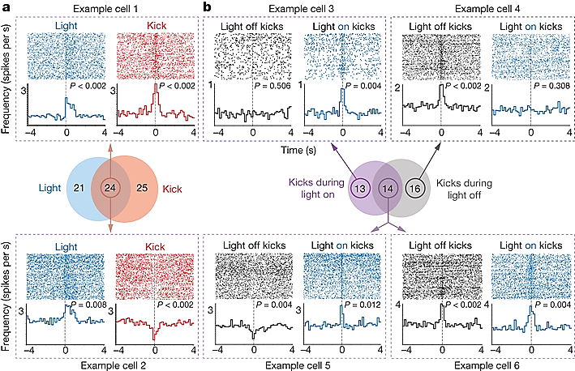
Fig 4a: Phasic VTA DA Neuron Activity Modulates NAc Encoding of Escape
37% NAc MSNs = responsive to phasic VTA firing (45/123)
  13%: phasic inhibition to light (6/45)
  87%: phasic excitation to light (39/45)
Most NAc MSNs: ↓ firing rate in FST (vs home cage) (Fig S19)
40% NAc MSNs: phasic responses associated with kick events
  (49/123 NAc MSNs)
  “Encode escape-related behavior”
  29%: phasic inhibition with kick (14/49)
  71%: phasic excitation with kick (35/49)
20% NAc MSNs encoded light pulses and kick events (24/123)
D2?
D1?
D2?
D1?
Fig 4a: Peri-event raster histograms for rep. neurons showing:
Phasic excitation associated with both light pulses and kick events (Ex: cell 1)
Or phasic responses with light pulses vs. kick events (Example cell 2)
Tye et al., (2013). Nature. 493(7433):537-41
Notes:
Recording of 123 NAc neurons from 5 CMS TH::Cre rats expressing ChR2 in VTA dopamine neurons. a, Peri-event raster histograms for representative neurons showing phasic excitation associated with both light pulses and kick events (Example cell 1; 15 out of 24 cells) or for representative neurons showing different phasic responses with light pulses versus kick events (Example cell 2; 9 out of 24 cells). b, Peri-event raster histograms for representative neurons that selectively encoded kick events during either the light-on epoch (Example cell 3; 13 cells) or the light-off epoch (Example cell 4; 16 cells), or encoded kick events in both light-on and light-off epochs differentially (Example cell 5; 1 out of 14 cells) or similarly (Example cell 6; 13 out of 14 cells).

Slide 67
Exp4b: Do VTA DA Neurons Modulate Neural Representation of Kicks in NAc?
TH::Cre male rats (5-7 months)
VTA: pAAV2-MCs–ITR–EF1α–ChR2/eYFP–WPRE_{VTA}
Chronic Mild Stress (CMS) Exposure (5-7 wks)
Forced Swim Test
  Phasic VTA Activation (3m intervals)
  In vivo NAc electrophysiology
Analysis of NAc (medial shell) recordings
  ID: kick events during light-ON vs light-OFF
Tye et al., (2013). Nature. 493(7433):537-41
Notes:
a, In vivo electrophysiology sessions. b, Integration of recordings in the NAc, illumination of ChR2-expressing VTA dopamine neurons, and precision measurement of swimming behaviour in five TH::Cre rats treated with CMS. c, Light-induced modulation of swimming; phasic illumination of ChR2-expressing VTA dopamine neurons increases escape behaviour of TH::Cre rats in FST. Thick red line, mean kick rate; dotted lines, s.e.m.

Slide 68
Fig 4b: Phasic VTA DA Neuron Activity Modulates NAc Encoding of Escape
11% of VTA-responsive NAc MSNs: phasic responses to kicks that occurred during light-ON & OFF (14/123)
  93% similarly represented kick in light-ON & light-OFF (13/14, Ex. cell 6)
  1 MSN differentially represented kick in light-ON/OFF (1/14, Ex. cell 5)
VTA DA activation altered encoding of kick events in 2 substantial populations of NAc MSNs:
  11% of VTA-responsive NAc MSNs selectively encoded kick behavior ONLY during VTA activation
  13% of VTA-responsive NAc MSNs selectively encoded kicking ONLY during light-OFF condition
D1?
D2?
Fig 4b: Peri-event raster histograms for rep. neurons that encoded:
Kick events during VTA stimulation (or none) selectively (Ex cell 4)
Kick events in both light-on and light-off:
  differentially (Ex cell 5) or similarly (Ex cell 6)
Tye et al., (2013). Nature. 493(7433):537-41
Notes:
Recording of 123 NAc neurons from 5 CMS TH::Cre rats expressing ChR2 in VTA dopamine neurons. a, Peri-event raster histograms for representative neurons showing phasic excitation associated with both light pulses and kick events (Example cell 1; 15 out of 24 cells) or for representative neurons showing different phasic responses with light pulses versus kick events (Example cell 2; 9 out of 24 cells). b, Peri-event raster histograms for representative neurons that selectively encoded kick events during either the light-on epoch (Example cell 3; 13 cells) or the light-off epoch (Example cell 4; 16 cells), or encoded kick events in both light-on and light-off epochs differentially (Example cell 5; 1 out of 14 cells) or similarly (Example cell 6; 13 out of 14 cells).

Slide 69
Fig 4b: Phasic VTA DA Neuron Activity Modulates NAc Encoding of Escape
Activation of VTA DA Neurons gives rise to antidepessed-like escape behavior
New representation of escape action in the NAc of freely moving rats
Could social isolation (↑ time in the corner zones of the open field) be an escape behavior, mediated by phasic activation of VTA DA neurons?
Fig 4b: Peri-event raster histograms for rep. neurons that encoded:
Kick events during VTA stimulation (or none) selectively (Ex cell 4)
Kick events in both light-on and light-off:
  differentially (Ex cell 5) or similarly (Ex cell 6)
Tye et al., (2013). Nature. 493(7433):537-41
Notes:
Recording of 123 NAc neurons from 5 CMS TH::Cre rats expressing ChR2 in VTA dopamine neurons. a, Peri-event raster histograms for representative neurons showing phasic excitation associated with both light pulses and kick events (Example cell 1; 15 out of 24 cells) or for representative neurons showing different phasic responses with light pulses versus kick events (Example cell 2; 9 out of 24 cells). b, Peri-event raster histograms for representative neurons that selectively encoded kick events during either the light-on epoch (Example cell 3; 13 cells) or the light-off epoch (Example cell 4; 16 cells), or encoded kick events in both light-on and light-off epochs differentially (Example cell 5; 1 out of 14 cells) or similarly (Example cell 6; 13 out of 14 cells).

Slide 70
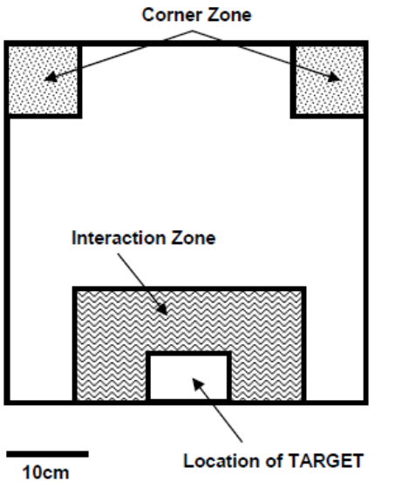
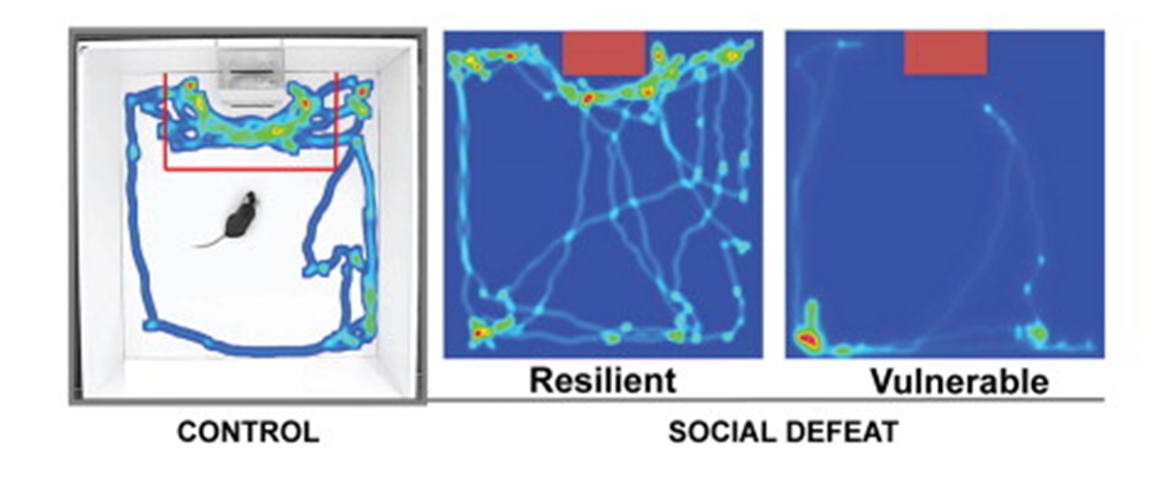
New Representation of Escape Action in NAc?
Activation of VTA DA Neurons gives rise to antidepessed-like escape behavior?
Could social isolation (↑ time in the corner zones of open field) be an escape behavior, mediated by phasic activation of VTA DA neurons?
Resilient
(Adaptive Learning, Motivated to Escape)
Maladaptive Learning
Krishnan et al. (2007). Cell.
Notes:
Recording of 123 NAc neurons from 5 CMS TH::Cre rats expressing ChR2 in VTA dopamine neurons. a, Peri-event raster histograms for representative neurons showing phasic excitation associated with both light pulses and kick events (Example cell 1; 15 out of 24 cells) or for representative neurons showing different phasic responses with light pulses versus kick events (Example cell 2; 9 out of 24 cells). b, Peri-event raster histograms for representative neurons that selectively encoded kick events during either the light-on epoch (Example cell 3; 13 cells) or the light-off epoch (Example cell 4; 16 cells), or encoded kick events in both light-on and light-off epochs differentially (Example cell 5; 1 out of 14 cells) or similarly (Example cell 6; 13 out of 14 cells).

Slide 71
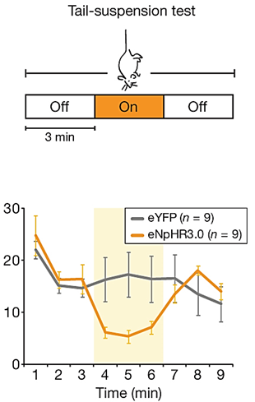
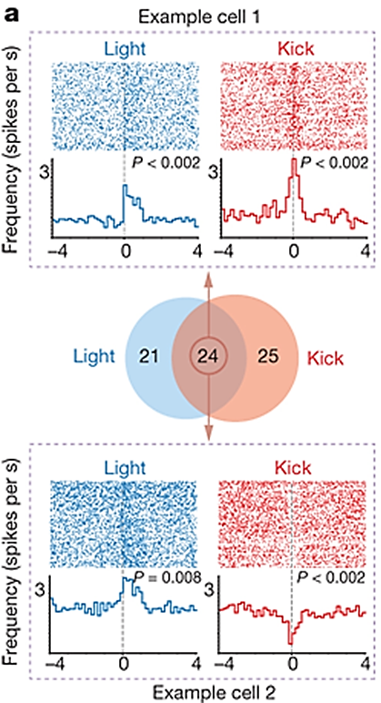
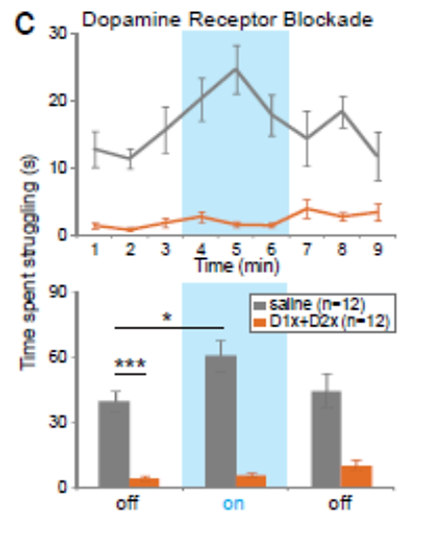
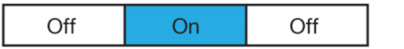

Takeaways:
Selective inhibition of VTA DA neurons acutely induces multiple depression-like behaviors (Fig 1)
Chronic mild stress induces a lasting depression-like phenotype with multiple symptoms reversed by phasic activation of VTA DA neurons (Figs 2-3)
NAc DA (but not glutamate) receptors are required for the action of VTA DA neurons in depression-related escape behavior (Fig S11)
NAc neurons encode phasic activation of VTA DA neurons, and depression-related escape (Fig 4)
Time spent struggling (s)
Krishnan et al. (2007). Cell.
Notes:
Figure 6. Human Correlates: Variant BDNF (Val66Met) and Postmortem NAc Studies
(A) Socially defeated Val/Val mice demonstrated a significant reduction in social interaction upon exposure to a CD1 target mouse, while Met/Met mice behaved comparably in both trials. (B) Day 11 western blot analysis of defeated Val/Val and Met/Met mice showing 50% lower BDNF levels in NAc of Met/Met mice (one-tailed t test). (C) VTA dopamine neurons from socially defeated Val/Val and Met/Met mice displayed comparable firing rates. (D) ELISA comparing levels of total BDNF in NAc lysates from depressed humans and unaffected controls (n = 10) (inset: scatterplot). Bars represent mean + SE (n = 7–8), ∗ indicates significant changes compared to controls, ∗p < 0.05, ∗∗p < 0.01. (E) Schematic: in Susceptible mice, chronic social defeat increases the firing rate of VTA dopamine neurons, which subsequently gives rise to heightened BDNF signaling within the NAc. Unsusceptible mice display a resistance to this adverse cascade of events by upregulating various K⁺ channels within the VTA.

Slide 72
Takeaways:
Selective inhibition of VTA DA neurons acutely induces multiple depression-like behaviors (Fig 1)
Chronic mild stress induces a lasting depression-like phenotype with multiple symptoms reversed by phasic activation of VTA DA neurons (Figs 2-3)
NAc neurons encode phasic activation of VTA DA neurons and depression-related escape (Fig 4)
NAc representation of depression-related behavioral action is fundamentally altered by VTA DA activation
Time spent struggling (s)
Krishnan et al. (2007). Cell.
Notes:
Figure 6. Human Correlates: Variant BDNF (Val66Met) and Postmortem NAc Studies
(A) Socially defeated Val/Val mice demonstrated a significant reduction in social interaction upon exposure to a CD1 target mouse, while Met/Met mice behaved comparably in both trials. (B) Day 11 western blot analysis of defeated Val/Val and Met/Met mice showing 50% lower BDNF levels in NAc of Met/Met mice (one-tailed t test). (C) VTA dopamine neurons from socially defeated Val/Val and Met/Met mice displayed comparable firing rates. (D) ELISA comparing levels of total BDNF in NAc lysates from depressed humans and unaffected controls (n = 10) (inset: scatterplot). Bars represent mean + SE (n = 7–8), ∗ indicates significant changes compared to controls, ∗p < 0.05, ∗∗p < 0.01. (E) Schematic: in Susceptible mice, chronic social defeat increases the firing rate of VTA dopamine neurons, which subsequently gives rise to heightened BDNF signaling within the NAc. Unsusceptible mice display a resistance to this adverse cascade of events by upregulating various K⁺ channels within the VTA.

Slide 73
Takeaways:
NAc representation of depression-related behavioral action is fundamentally altered by VTA DA activation
Antidepressants ↓ VTA burst firing (Friedman et al., 2008)
↓ VTA firing induces depression behavior (Fig 1)
↓ mesocortical DA → social-defeat vulnerability (Ranaka et al., 2012)
↑ VTA firing in vulnerable CSDS mice (Krishnan et al., 2007)
  Differences in models: “CMS may ↓ firing while “more severe stressors” like CSDS may ↑ firing”
  “effects of stress on mesolimbic DA system are highly complex, as different stressors can cause opposite responses from VTA neurons depending on pre-exposure & severity”
Time spent struggling (s)
Krishnan et al. (2007). Cell.
Notes:
Figure 6. Human Correlates: Variant BDNF (Val66Met) and Postmortem NAc Studies
(A) Socially defeated Val/Val mice demonstrated a significant reduction in social interaction upon exposure to a CD1 target mouse, while Met/Met mice behaved comparably in both trials. (B) Day 11 western blot analysis of defeated Val/Val and Met/Met mice showing 50% lower BDNF levels in NAc of Met/Met mice (one-tailed t test). (C) VTA dopamine neurons from socially defeated Val/Val and Met/Met mice displayed comparable firing rates. (D) ELISA comparing levels of total BDNF in NAc lysates from depressed humans and unaffected controls (n = 10) (inset: scatterplot). Bars represent mean + SE (n = 7–8), ∗ indicates significant changes compared to controls, ∗p < 0.05, ∗∗p < 0.01. (E) Schematic: in Susceptible mice, chronic social defeat increases the firing rate of VTA dopamine neurons, which subsequently gives rise to heightened BDNF signaling within the NAc. Unsusceptible mice display a resistance to this adverse cascade of events by upregulating various K⁺ channels within the VTA.

Slide 74
Notes:
DA signaling in the Mesolimbic Reward System (VTA to Nac)
Neural substrates of the rewarding properties (food, mating behaviors, and addictive drugs)
Motivate social behaviors
Social interactions engage reward pathways (Krishnan et al., 2007)
Mediate responses to social defeat (Krishnan et al., 2007):
↑ VTA DA neurons in CSDS-vulnerable mice
↑ VTA BDNF in CSDS-vulnerable mice
↑ TrkB receptor signaling in NAc
Dipesh Chaudhury’s 2013 article “rapid regulation of depression-related behaviors by control of midbrain dopamine neurons” – out of MH Han’s lab in collaboration with Eric Nestler – which adapted from Krishnan 2007 a Subthreshold social defeat paradigm – that also produced susceptible and resiliant “depression-related” phenotypes and incorporates optigenetic techniques.

Slide 75
Stress-Induced Depression & Mesolimbic DA System
Social Stress → Depression (humans, rodents)
CSDS paradigm (10d): Vulnerable vs Resilient
  Vulnerability: ↑ Phasic VTA DA activity
  ↑ VTA→NAc BDNF → ↑ Vulnerability
Submax Defeat + Phasic VTA Stimulation:
  ↑ Social Avoidance & ↑ BDNF
Phasic VTA→NAc Activity: BDNF & DA Release
  BDNF can facilitate terminal DA release
  DA neurons express BDNF & TrkB
  BDNF may modulate DA release (via TrkB)
  NAc BDNF antibody infusion ↓ DA release
  BDNF “controls” DA D3R expression
  Feedback onto presynaptic terminals to potentiate neurotransmission
http://icahn.mssm.edu/research/labs/han-laboratory/projects-and-grants
Notes:
Figure 6. Human Correlates: Variant BDNF (Val66Met) and Postmortem NAc Studies
(A) Socially defeated Val/Val mice demonstrated a significant reduction in social interaction upon exposure to a CD1 target mouse, while Met/Met mice behaved comparably in both trials. (B) Day 11 western blot analysis of defeated Val/Val and Met/Met mice showing 50% lower BDNF levels in NAc of Met/Met mice (one-tailed t test). (C) VTA dopamine neurons from socially defeated Val/Val and Met/Met mice displayed comparable firing rates. (D) ELISA comparing levels of total BDNF in NAc lysates from depressed humans and unaffected controls (n = 10) (inset: scatterplot). Bars represent mean + SE (n = 7–8), ∗ indicates significant changes compared to controls, ∗p < 0.05, ∗∗p < 0.01. (E) Schematic: in Susceptible mice, chronic social defeat increases the firing rate of VTA dopamine neurons, which subsequently gives rise to heightened BDNF signaling within the NAc. Unsusceptible mice display a resistance to this adverse cascade of events by upregulating various K⁺ channels within the VTA.

Slide 76
Phasic VTA→NAc Activity: ↑ BDNF & DA Release
Social Stress → Depression (humans, rodents)
CSDS paradigm (10d): Vulnerable vs Resilient
  Vulnerability: ↑ Phasic VTA DA activity
  ↑ VTA→NAc BDNF → ↑ Vulnerability
Submax Defeat + Phasic VTA Stimulation:
  ↑ Social Avoidance & ↑ BDNF
Phasic VTA→NAc Activity: BDNF & DA Release
  BDNF can facilitate terminal DA release
  DA neurons express BDNF & TrkB
  BDNF may modulate DA release (via TrkB)
  NAc BDNF antibody infusion ↓ DA release
  BDNF “controls” DA D3R expression
  Feedback onto presynaptic terminals to potentiate neurotransmission
NAc
MSN
VTA DA Neuron
Krishnan et al. (2007). Cell.
Notes:
Figure 6. Human Correlates: Variant BDNF (Val66Met) and Postmortem NAc Studies
(A) Socially defeated Val/Val mice demonstrated a significant reduction in social interaction upon exposure to a CD1 target mouse, while Met/Met mice behaved comparably in both trials. (B) Day 11 western blot analysis of defeated Val/Val and Met/Met mice showing 50% lower BDNF levels in NAc of Met/Met mice (one-tailed t test). (C) VTA dopamine neurons from socially defeated Val/Val and Met/Met mice displayed comparable firing rates. (D) ELISA comparing levels of total BDNF in NAc lysates from depressed humans and unaffected controls (n = 10) (inset: scatterplot). Bars represent mean + SE (n = 7–8), ∗ indicates significant changes compared to controls, ∗p < 0.05, ∗∗p < 0.01. (E) Schematic: in Susceptible mice, chronic social defeat increases the firing rate of VTA dopamine neurons, which subsequently gives rise to heightened BDNF signaling within the NAc. Unsusceptible mice display a resistance to this adverse cascade of events by upregulating various K⁺ channels within the VTA.

Slide 77
Stress-Induced Depression & Mesolimbic DA System
a
b
↑ spine
density
pERK
NAc
MSN
VTA DA Neuron
Stress gates up-regulation of NAc BDNF signaling in conjunction with: phasic firing of VTA→NAc DA neurons as well as pre- and post-synaptic CRF actions in NAc.
Stress-induced CRF signaling in NAc activates presynaptic CRF receptors on VTA DA terminals, works together with arriving phasic spikes to release BDNF. BDNF then activates TrkB receptors on NAc MSNs to promote vulnerability (VIA ERK-induced increase in spine density)??
Walsh et al. (2014). Stress and CRF gate neural activation of BDNF in the mesolimbic reward pathway. Nat Neurosci, 17(1), 27-29.
Notes:
Together, these findings implicate CRF, acting in the Nac, in gating the ability of phasic firing, in the context of stress, to increase BDNF signaling in the NAc.

Slide 78
NAc DA: Good or Bad for Stress-Induced Depression?
ExpS1: What is the role of DA signaling in the NAc?
DA Associated w Reward
Depression: “Dopamine deficiency” (Wise, 2008)
Depressed patients: ↓ DA metabolites (Dunlop & Nemeroff, 2007)
Antidepressants ↑ NAc DA (Di Matteo et al., 2000)
VTA→DA neurons reverse depressive behaviors in mice (Tye et al., 2013)
http://icahn.mssm.edu/research/labs/han-laboratory/projects-and-grants
Notes:
Figure 6. Human Correlates: Variant BDNF (Val66Met) and Postmortem NAc Studies
(A) Socially defeated Val/Val mice demonstrated a significant reduction in social interaction upon exposure to a CD1 target mouse, while Met/Met mice behaved comparably in both trials. (B) Day 11 western blot analysis of defeated Val/Val and Met/Met mice showing 50% lower BDNF levels in NAc of Met/Met mice (one-tailed t test). (C) VTA dopamine neurons from socially defeated Val/Val and Met/Met mice displayed comparable firing rates. (D) ELISA comparing levels of total BDNF in NAc lysates from depressed humans and unaffected controls (n = 10) (inset: scatterplot). Bars represent mean + SE (n = 7–8), ∗ indicates significant changes compared to controls, ∗p < 0.05, ∗∗p < 0.01. (E) Schematic: in Susceptible mice, chronic social defeat increases the firing rate of VTA dopamine neurons, which subsequently gives rise to heightened BDNF signaling within the NAc. Unsusceptible mice display a resistance to this adverse cascade of events by upregulating various K⁺ channels within the VTA.

Slide 79
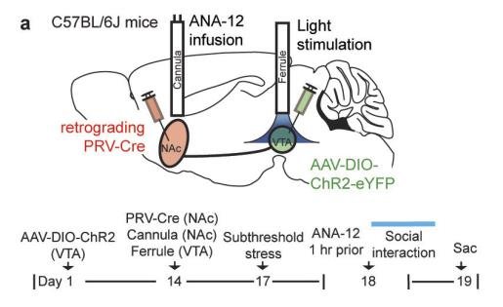
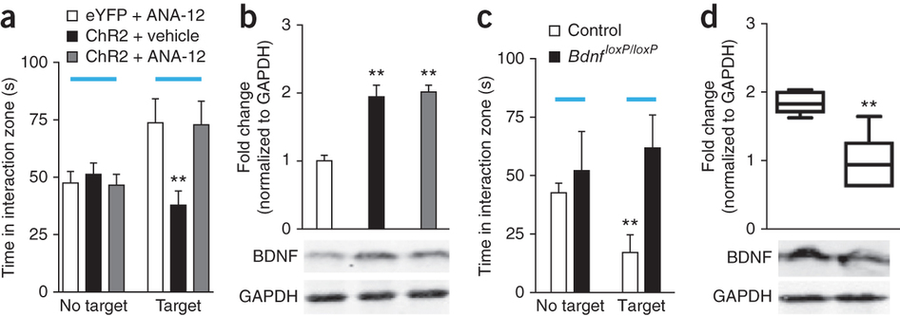
TrkB Antagonist blocks social avoidance elicited by acute stress paradigm (Walsch et al., 2014)
ExpS1: What is the role of DA signaling in the NAc?
TrkB Inhibitor ANA-12 blocked the ability of phasic stimulation to induce social avoidance (a) without affecting BDNF amounts (b)
Submaximal defeat (3x1d) followed by TrkB Inhibitor (ANA-12) 1h before social interaction
Walsch et al. (2014). Nat Neurosci.
Notes:
The BDNF TrkB Receptor Antagonist (ANA-12) completely blocked the ability of phasic stimulation to iduce social avoidance (Fig 2A) without affecting BDNF amounts (Fig 2B).
http://www.sigmaaldrich.com/catalog/product/sigma/sml0209?lang=en&region=US
(a) Duration of social interaction during tonic and phasic stimulation of VTA-NAc cells (F_{2,20} = 4.56, *P = 0.0231, n = 7,7,9 mice). eYFP and ChR2 represent control and AAV-DIO-ChR2-eYFP vectors, respectively. 'No target' and 'target' denote absence and presence, respectively, of a social target (CD1 mouse) during behavior. Blue bars represent activation with light during social interaction. (b) NAc BDNF amounts (top) and western blot gels (bottom) 24 h after stimulation (F_{2,19} = 14.55, **P = 0.0058, n = 7,7,8 mice). (c) Durations of social interaction of Th^{cre} mice during tonic and phasic stimulation of VTA-NAc DA neurons (F_{2,15} = 19.35, ***P < 0.0001, n = 6,6,6 mice). (d) NAc BDNF amounts in Th^{cre} mice 24 h after stimulation (F_{2,15} = 3.69, *P = 0.0497, n = 6,6,6 mice). (e) Duration of social interaction of stress-naive mice during tonic or phasic stimulation (F_{2,18} = 1.12, P = 0.3473, n = 6,7,8 animals). (f) NAc BDNF amounts in stress-naive mice 24 h after stimulation (F_{2,18} = 0.03, P = 0.9730, n = 6,7,8 mice). (g) Duration of social interaction of stress-naive mice after 5 d of 20 min/day repeated stimulation (F_{2,24} = 0.30, P = 0.7437, n = 9,10,8 mice). (h) NAc BDNF amounts 24 h after social interaction (F_{2,21} = 0.38, P = 0.6883, n = 8,8,8 mice). Full-length blots are available in Supplementary Figure 10. All bars represent mean ± s.e.m. P values were calculated using one-way analysis of variance (ANOVA).

Slide 80
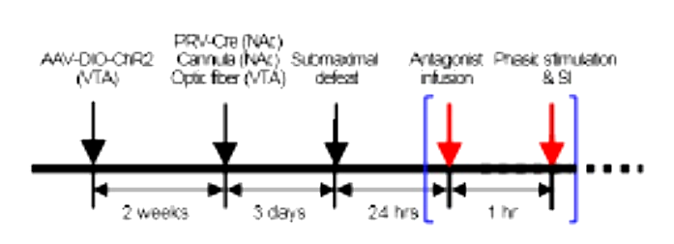
ExpS1: What is the role of DA signaling in the NAc?
C57BL/6J male mice (7-12wks)
AAV-DIO-ChR2-eYFP_{VTA (bilateral)}
  AAV: Adeno-Associated Virus
  DIO: double floxed inverted orientation
    (floxed DNA section inverted by Cre recombinase)
  ChR2: Channelrhodopsin-2 fused to eYFP
    Temporally precise excitation
  eYFP: Enhanced yellow fluorescent protein
PRV-Cre _{NAc (bilateral)}
  PRV: pseudorabies virus
    Retrograde traveling
    Replication-defective
    Expressing Cre
  Cre recombinase induces ChR2-eYFP expression
Tye et al., (2013). Nature. 493(7433):537-41

Slide 81

ExpS1: What is the role of DA signaling in the NAc?
C57BL/6J male mice (7-12wks)
AAV-DIO-ChR2-eYFP_{VTA (bilateral)}
PRV-Cre _{NAc (bilateral)}
Submaximal defeat (1d of 2 x 5 min defeats)
  3d after PRV-Cre Infusion
Antagonist Infusion (BL NAc)
  24h after last defeat, 1h before Social Interaction
  SCH 23390: D1R antagonist
  Eticlopride: D2R antagonist
Phasic Stimulation & Social Interaction Test
  5 x 20-Hz pulses, Xms pulse width, every 10s
Tye et al., (2013). Nature. 493(7433):537-41
Notes:
D1, D2, or ANA infused 24h post defeat. Opto phasic stimulation during social interaction test

Slide 82
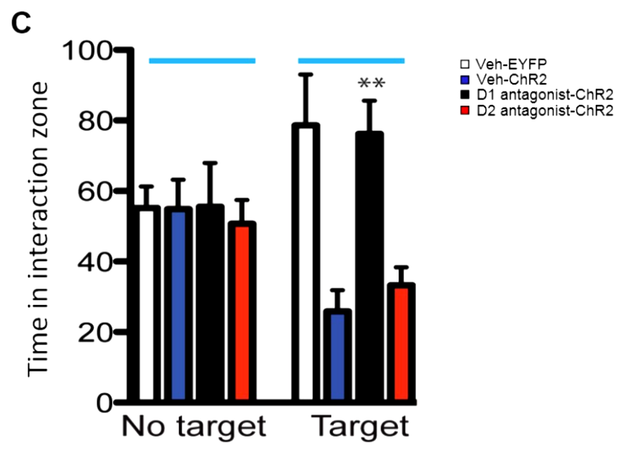
ExpS1: What is the role of DA signaling in the NAc?
Acutely socially defeated animals spend more time in interaction zone with target present
Phasic VAT-NAc activation during social interaction (24 h after acute social defeat) induces social avoidance
D1 Antagonism blocks the ability of VTA-NAc activation to induce social avoidance
  (F2,18=8.73, **p<0.01, n=6-8)
D2 Antagonism does not block acute defeat-induced social avoidance
Phasic D1R Activation Mediates Social Avoidance
Both BDNF and DA signaling in NAc mediate the ability of acute phasic VTA Activation to induce social avoidance during acute social stress
Tye et al., (2013). Nature. 493(7433):537-41
Notes:
D1, D2, or ANA infused 24h post defeat. Opto phasic stimulation during social interaction test

Slide 83
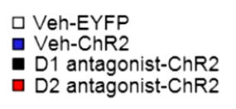

Both BDNF and DA signaling in the NAc mediate the ability of acute VTA Activation to induce social avoidance during acute social stress
ExpS1: What is the role of DA signaling in the NAc?
Tye et al., (2013). Nature. 493(7433):537-41
Walsch et al. (2014). Nat Neurosci.
Notes:
D1, D2, or ANA infused 24h post defeat. Opto phasic stimulation during social interaction test

Slide 84

ExpS1: What is the role of DA signaling in the NAc?
Exp1: What is the role of NAc DA signaling in Chronic (vs Acute) Defeat?
C57BL/6J male mice (7-12wks)
Chronic Social Defeat Stress
  10 days x 5m session w CD1 aggressor
Antagonist Infusion (bilateral NAc)
  15 min before each defeat session
  SCH 23390: D1R antagonist
  Eticlopride: D2R antagonist
  ANA-12: TrkB antaonist
Social Interaction Test
  SI Ratio: (time in interaction zone w target present / time wo target) * 100
Tye et al., (2013). Nature. 493(7433):537-41
Notes:
Role of brain-derived neurotrophic factor and dopamine signaling in nucleus accumbens (NAc) during chronic social stress. (A) Schematic diagrams depicting the experimental procedures for chronic social defeat stress (CSDS) and intra-NAc infusion of a D ₁ receptor (SCH 23390, 1.0 µg/.5 μL/side), D ₂ receptor (eticlopride, 1.0 µg/.5 μL/side), or tyrosine receptor kinase B (ANA-12, 1.0 µg/.5 μL/side) antagonist. (B, C) Drugs were infused into NAc 15 minutes before daily defeat events. Social interaction tests were performed 24 hours after the 10 daily defeats (gray arrows). (D) Intra-NAc infusion of a D ₁ or D ₂ receptor antagonist did not affect social avoidance induced by CSDS, but intra-NAc ANA-12 infusion blocked the social avoidance. The number in each bar indicates the percentage of resilient mice over total mice in each group. One-way analysis of variance ( F _{4,41} = 4.977, p < .01, n = 7–13) with Fisher’s protected least significant difference post hoc tests, * p < .05, ** p < .01 compared with control group; # p < .05, ## p < .01 compared with ANA-12 group. Bar graphs show mean ± SEM. CTRL, control; SI, social interaction; VTA, ventral tegmental area.

Slide 85
ExpS1: What is the role of DA signaling in the NAc?
Exp1: What is the role of NAc DA signaling in chronic (vs acute) defeat?
CSDS-induced avoidance (depressed phenotype, vulnerability):
  Not altered by D1 or D2 MSN activity
  Altered by TrkB blockade
D1R (S1) & TrkB (1D) mediate acute stress/ phasic stimulation-induced social avoidance
TrkB/BDNF (NOT DA) mediate CSDS-induced social avoidance (depression)
Neither D1 nor D2 NAc Inhibition blocked social avoidance following CSDS
TrkB Inhibition counteracted the social avoidance induced by CSDS
  As observed after acute (1d) defeat
*p<0.05, **p<0.01 vs control group; #p<0.05, ##p<0.01 vs ANA-12
Tye et al., (2013). Nature. 493(7433):537-41
Notes:
(D) Intra-NAc infusion of a D ₁ or D ₂ receptor antagonist did not affect social avoidance induced by CSDS, but intra-NAc ANA-12 infusion blocked the social avoidance. The number in each bar indicates the percentage of resilient mice over total mice in each group. One-way analysis of variance ( F _{4,41} = 4.977, p < .01, n = 7–13) with Fisher’s protected least significant difference post hoc tests, * p < .05, ** p < .01 compared with control group; # p < .05, ## p < .01 compared with ANA-12 group. Bar graphs show mean ± SEM. CTRL, control; SI, social interaction; VTA, ventral tegmental area.

Slide 86


Exp2: Behavioral effects of VTA-NAc activation in chronic (vs acute) defeat?
C57BL/6J male mice (7-12wks)
(2C) AAV2.5-hsyn-ChR2-eYFP_{NAc (bilateral)} (Fig 2B-C)
  AAV2.5: Retrograde Adeno-Associated Virus
    NAc (bilateral) infusion
  hsyn: human synapsin (promoter)
  ChR2: Channelrhodopsin-2 fused to eYFP
    Temporally precise excitation (450-500nm)
  eYFP: Enhanced yellow fluorescent protein
Fiber optic Implantation (Fig 2B)
  Bilateral VTA
  3wks post transfection
Transfection Verification (Fig 2D)
  eYFP-TH double labeling
(B) Schematic of retrograde traveling AAV2.5-hsyn-ChR2-eYFP infused into NAc and optic fiber implantation into VTA.
(C) AAV2.5-ChR2-eYFP NAc injection site (scale bar: 100 μm).
(D) Confocal images: ChR2-EYFP (green) localization in tyrosine hydroxylase (TH)-positive cells (red) in VTA (scale bar = 50 μm).
Tye et al., (2013). Nature. 493(7433):537-41
Notes:
Effects of repeated optogenetic phasic stimulation of the ventral tegmental area (VTA)-nucleus accumbens (NAc) pathway during chronic social stress. (A) Schematic diagram depicting the experimental procedures for chronic social defeat stress (CSDS) and 20-Hz phasic VTA activation. (B) Schematic illustrating validation of NAc injection site. Scale bar = 100 μm. (C) Schematic of retrograde traveling adeno-associated virus (AAV2.5) vectors that express channelrhodopsin-2 (ChR2), fused with enhanced yellow fluorescent protein (EYFP) (AAV2.5-hsyn-ChR2-eYFP) infused into NAc and optic fiber implantation into VTA. (D) Representative confocal images showing localization of ChR2-EYFP (green) in tyrosine hydroxylase (TH)–positive cells (red) in VTA. Scale bar = 50 μm. (E, F) Two phasic stimulation protocols were used: 5-minute phasic stimulation was performed (E) during defeat episodes (phasic stimulation during defeat) or (F) immediately after defeat (phasic stimulation post defeat). (G) Phasic stimulation during defeat had no effect on social avoidance behavior induced by CSDS. However, phasic stimulation post defeat exacerbated the effect of CSDS. The number in each bar indicates the percentage of resilient mice over total mice in each group. Two-way analysis of variance (protocol effect [ F _{2,44} = 6.217, p < .01], stimulation effect [ F _{1,44} = 4.574, p < .05], protocol × stimulation effect [ F _{2,44} = .415, p = .663], n = 6–11) with Fisher’s protected least significant difference post hoc tests, * p < .05 AAV-EYFP versus AAV-ChR2 within each stimulation protocol; # p < .05 compared with control-EYFP group; ^{τ} p < .1, $ p < .05 compared with control-ChR2 group. Bar graphs show mean ± SEM. aca, anterior part of anterior commissure; Dstr, dorsal striatum; SI, social interaction.

Slide 87

Exp2: Behavioral effects of VTA-NAc activation in chronic (vs acute) defeat?
C57BL/6J male mice (7-12wks)
(2C) AAV2.5-hsyn-ChR2-eYFP_{NAc (bilateral)}
Fiber optic Implantation (2C)
  CSDS
    10 days x 5m session w CD1 aggressor
VTA Stimulation during defeat (2 protocols):
  (2E) Phasic stimulation during defeat
  (2F) Phasic stimulation after defeat
  5min of: 5 x 20 Hz pulses every 10sec
Social Interaction Testing (G)
  (24h after last defeat)
G
E
F
(E-F) Two phasic stimulation protocols were used:
(E) 5-min phasic stimulation during defeat episodes
(F) 5-min phasic stimulation immediately after defeat
(G) Effects of phasic VTA stimulation during vs after CSDS on social interaction.
SI ratio: (time spent in interaction zone with target present – time wo target) * 100
Tye et al., (2013). Nature. 493(7433):537-41
Notes:
Effects of repeated optogenetic phasic stimulation of the ventral tegmental area (VTA)-nucleus accumbens (NAc) pathway during chronic social stress. (A) Schematic diagram depicting the experimental procedures for chronic social defeat stress (CSDS) and 20-Hz phasic VTA activation. (B) Schematic illustrating validation of NAc injection site. Scale bar = 100 μm. (C) Schematic of retrograde traveling adeno-associated virus (AAV2.5) vectors that express channelrhodopsin-2 (ChR2), fused with enhanced yellow fluorescent protein (EYFP) (AAV2.5-hsyn-ChR2-eYFP) infused into NAc and optic fiber implantation into VTA. (D) Representative confocal images showing localization of ChR2-EYFP (green) in tyrosine hydroxylase (TH)–positive cells (red) in VTA. Scale bar = 50 μm. (E, F) Two phasic stimulation protocols were used: 5-minute phasic stimulation was performed (E) during defeat episodes (phasic stimulation during defeat) or (F) immediately after defeat (phasic stimulation post defeat). (G) Phasic stimulation during defeat had no effect on social avoidance behavior induced by CSDS. However, phasic stimulation post defeat exacerbated the effect of CSDS. The number in each bar indicates the percentage of resilient mice over total mice in each group. Two-way analysis of variance (protocol effect [ F _{2,44} = 6.217, p < .01], stimulation effect [ F _{1,44} = 4.574, p < .05], protocol × stimulation effect [ F _{2,44} = .415, p = .663], n = 6–11) with Fisher’s protected least significant difference post hoc tests, * p < .05 AAV-EYFP versus AAV-ChR2 within each stimulation protocol; # p < .05 compared with control-EYFP group; ^{τ} p < .1, $ p < .05 compared with control-ChR2 group. Bar graphs show mean ± SEM. aca, anterior part of anterior commissure; Dstr, dorsal striatum; SI, social interaction.

Slide 88



Exp2: Behavioral effects of VTA-NAc activation in chronic (vs acute) defeat?
CSDS Reduced Social Interaction Ratio
  # in eYFP controls (vs non-defeated eYFP)
  ^{J, $} in ChR2 (vs. non-defeated ChR2)
Phasic VTA-NAc Activation during defeat had no effect on CSDS-induced avoidance (vs e-YFP)
Phasic VTA-NAc Activation after defeat worsened the effects of CSDS on social avoidance (ChR2 vs eYFP, *p<0.05, n=6-11)
Phasic VTA-NAc activation potentiates CSDS-induced social avoidance
Time in interaction zone:
(target present / target absent) * 100
No defeat
Tye et al., (2013). Nature. 493(7433):537-41
Notes:
(G) Phasic stimulation during defeat had no effect on social avoidance behavior induced by CSDS. However, phasic stimulation post defeat exacerbated the effect of CSDS. The number in each bar indicates the percentage of resilient mice over total mice in each group. Two-way analysis of variance (protocol effect [ F _{2,44} = 6.217, p < .01], stimulation effect [ F _{1,44} = 4.574, p < .05], protocol × stimulation effect [ F _{2,44} = .415, p = .663], n = 6–11) with Fisher’s protected least significant difference post hoc tests, * p < .05 AAV-EYFP versus AAV-ChR2 within each stimulation protocol; # p < .05 compared with control-EYFP group; ^{τ} p < .1, $ p < .05 compared with control-ChR2 group. Bar graphs show mean ± SEM. aca, anterior part of anterior commissure; Dstr, dorsal striatum; SI, social interaction.

Slide 89
ExpS2: CSDS context required for phasic VTA-NAc to alter social interaction
Phasic VTA-NAc activation alone (without CSDS): no change in social interaction
Importance of context association
D1 MSNs at play (mediate context)?
Time in interaction zone:
(target present / target absent) * 100
Tye et al., (2013). Nature. 493(7433):537-41
Notes:
(G) Phasic stimulation during defeat had no effect on social avoidance behavior induced by CSDS. However, phasic stimulation post defeat exacerbated the effect of CSDS. The number in each bar indicates the percentage of resilient mice over total mice in each group. Two-way analysis of variance (protocol effect [ F _{2,44} = 6.217, p < .01], stimulation effect [ F _{1,44} = 4.574, p < .05], protocol × stimulation effect [ F _{2,44} = .415, p = .663], n = 6–11) with Fisher’s protected least significant difference post hoc tests, * p < .05 AAV-EYFP versus AAV-ChR2 within each stimulation protocol; # p < .05 compared with control-EYFP group; ^{τ} p < .1, $ p < .05 compared with control-ChR2 group. Bar graphs show mean ± SEM. aca, anterior part of anterior commissure; Dstr, dorsal striatum; SI, social interaction.

Slide 90

Exp3: BDNF: Role in CSDS+VTA activation-induced social avoidance?
C57BL/6J male mice (7-12wks)
AAV2.5-hsyn-ChR2-eYFP_{NAc}
Fiber Optic Implantation (VTA) Cannula Implantation (NAc)
CSDS + ANA-12 + Stimulation:
  CSDS: 5m defeat x 10d
  ANA-12: 15m before defeat
  VTA-NAc stimulation:
    5min after each defeat: 5x20Hz pulses every 10sec
Social Interaction Test:
  D6 & 11 of CSDS (3D-E)
Western Immunoblotting (24h post SI)
  NAc BDNF
(A-B) Experimental Design.
(C) Schematic of retrograde traveling AAV2.5-hsyn-ChR2-eYFP infused into NAc, intra-NAc ANA-12, and optic fiber implantation into VTA.
(D) Social Interaction Test Scores (d5): 5d of defeat stress w phasic activation does not alter social interaction (with or without blocking TrkB)
(E) Social Interaction Test Scores (d11): CSDS w phasic VTA activation reduces social interaction, which is restored by blocking TrkB
Tye et al., (2013). Nature. 493(7433):537-41
Notes:
Role of brain-derived neurotrophic factor (BDNF) signaling in nucleus accumbens (NAc) during repeated phasic optogenetic stimulation of the ventral tegmental area (VTA)-NAc pathway and chronic social stress. (A, B) Schematic diagrams depicting the experimental procedures for intra-NAc ANA-12 infusions and 20-Hz optical activation during chronic social defeat stress (CSDS). Social interaction tests were performed 24 hours after the 5 daily defeats and again 24 hours after 10 daily defeats (gray arrows). (C) Schematic of retrograde traveling adeno-associated virus (AAV2.5) vectors that express channelrhodopsin-2 (ChR2), fused with enhanced yellow fluorescent protein (EYFP) (AAV2.5-hsyn-ChR2-eYFP) infused into NAc, intra-NAc ANA-12 infusions, and optic fiber implantation into VTA. (D) Defeat stress for 5 days plus phasic activation had no effect on social avoidance (one-way analysis of variance [ F _{3,31} = .0813, p = not significant, n = 6–11]). (E) Defeat stress for 10 days reduced social interaction, and this impaired social interaction was exacerbated by repeated phasic activation of the VTA-NAc pathway. Additional post hoc analyses with unpaired t tests showed that the CSDS Vehicle+EYFP group had lower social interaction time than the control Vehicle+EYFP group ( t ₁₅ = 2.277, $ p < .05, n = 6, 11). ANA-12 infusion into NAc totally reversed the effects of optogenetic stimulation on social avoidance ( F _{3,31} = 6.360, p < .01, n = 6–11). The number in each bar indicates the percentage of resilient mice over total mice in each group. (F) Repeated phasic stimulation of the VTA-NAc pathway during CSDS increased BDNF protein levels in NAc ( F _{3,23} = 3.485, p < .05, n = 5–9). Additional post hoc analyses with unpaired t tests showed that BDNF protein levels in the CSDS Vehicle+EYFP group are higher than the levels in the control Vehicle+EYFP group ( t ₁₂ = 2.508, $ p < .05, n = 5, 9). One-way analysis of variance with Fisher’s protected least significant difference post hoc tests, ^{τ} p < .1, ** p < .01 compared with control Vehicle+EYFP group; # p < .05, ## p < .001 compared with CSDS Vehicle+ChR2 group. (G) Schematic diagrams depicting the experimental procedures for localized genetic depletion of VTA Bdnf and 20-Hz optogenetic activation of VTA during CSDS. (H) Retrograde AAV2.5-hsyn-ChR2-eYFP was infused into NAc for optogenetic activation of the VTA-NAc pathway. AAV-Cre was infused into VTA of floxed Bdnf mice for localized knockdown of BDNF expression in VTA. (I) Knockdown of BDNF in VTA reversed the detrimental effect of repeated optogenetic VTA stimulation on social interaction ( F _{2,23} = 4.823, p < .05, n = 8–9). Additional post hoc analyses with unpaired t tests showed that phasic stimulation of the VTA-NAc pathway reduced social interaction (NAc EYFP+VTA green fluorescent protein [GFP] group vs. NAc ChR2+VTA GFP group [ t ₁₅ = 2.700, $ p < .05, n = 8, 9]). Bar graphs show mean ± SEM. CTRL, control; Sac, sacrifice; SI, social interaction.

Slide 91



Exp3: BDNF: Role in CSDS+VTA activation-induced social avoidance?
A
(D) 5d of daily defeat + phasic VTA activation (↑ vulnerability) did not alter social interaction
(E) CSDS: ↓ social interaction (Veh-eYFP)
  #,$ p<0.05 Veh-eYFP vs non-defeat group
CSDS + phasic VTA Activation (↑ vulnerability):
  ↓ social interaction (p<0.01 Veh-ChR2 vs Veh-eYFP)
  Reversed by blocking TrkB Activation (p<0.01, n=6-11)
CSDS induced social avoidance, which was worsened by phasic VTA activation, blocked by TrkB inhibition (Fig 3E)
Social Interaction Ratio
(E) Social Interaction Test Scores (d11): CSDS Vehicle+EYFP had lower social interaction time than the control Vehicle+EYFP group ( t ₁₅ = 2.277, $ p < .05, n = 6, 11). NAc ANA-12 infusion totally reversed the effects of optogenetic stimulation on social avoidance ( F _{3,31} = 6.360, p < .01, n = 6–11). Number in each bar indicates % of resilient mice over total mice in each group.
(A) Experimental Design.
(D) Social Interaction Test Scores (d5): 5d of defeat stress w phasic activation does not alter social interaction (with or without blocking TrkB)
Tye et al., (2013). Nature. 493(7433):537-41
Notes:
(D) Defeat stress for 5 days plus phasic activation had no effect on social avoidance (one-way analysis of variance [ F _{3,31} = .0813, p = not significant, n = 6–11]). (E) Defeat stress for 10 days reduced social interaction, and this impaired social interaction was exacerbated by repeated phasic activation of the VTA-NAc pathway. Additional post hoc analyses with unpaired t tests showed that the CSDS Vehicle+EYFP group had lower social interaction time than the control Vehicle+EYFP group ( t ₁₅ = 2.277, $ p < .05, n = 6, 11). ANA-12 infusion into NAc totally reversed the effects of optogenetic stimulation on social avoidance ( F _{3,31} = 6.360, p < .01, n = 6–11). The number in each bar indicates the percentage of resilient mice over total mice in each group. (F) Repeated phasic stimulation of the VTA-NAc pathway during CSDS increased BDNF protein levels in NAc ( F _{3,23} = 3.485, p < .05, n = 5–9). Additional post hoc analyses with unpaired t tests showed that BDNF protein levels in the CSDS Vehicle+EYFP group are higher than the levels in the control Vehicle+EYFP group ( t ₁₂ = 2.508, $ p < .05, n = 5, 9). One-way analysis of variance with Fisher’s protected least significant difference post hoc tests, ^{τ} p < .1, ** p < .01 compared with control Vehicle+EYFP group; # p < .05, ## p < .001 compared with CSDS Vehicle+ChR2 group. (G) Schematic diagrams depicting the experimental procedures for localized genetic depletion of VTA Bdnf and 20-Hz optogenetic activation of VTA during CSDS. (H) Retrograde AAV2.5-hsyn-ChR2-eYFP was infused into NAc for optogenetic activation of the VTA-NAc pathway. AAV-Cre was infused into VTA of floxed Bdnf mice for localized knockdown of BDNF expression in VTA. (I) Knockdown of BDNF in VTA reversed the detrimental effect of repeated optogenetic VTA stimulation on social interaction ( F _{2,23} = 4.823, p < .05, n = 8–9). Additional post hoc analyses with unpaired t tests showed that phasic stimulation of the VTA-NAc pathway reduced social interaction (NAc EYFP+VTA green fluorescent protein [GFP] group vs. NAc ChR2+VTA GFP group [ t ₁₅ = 2.700, $ p < .05, n = 8, 9]). Bar graphs show mean ± SEM. CTRL, control; Sac, sacrifice; SI, social interaction.

Slide 92

Exp3: BDNF: Role in CSDS+VTA activation-induced social avoidance?
E
(D) 5d of daily defeat + phasic VTA activation did not alter social interaction
(E) CSDS → social avoidance; worsened by phasic VTA activation, blocked by TrkB antag.
(F) CSDS ↑ NAc BDNF levels (24 after SI)
  Phasic VTA stimulation (CSDS VEH+ChR2) further ↑ BDNF (vs non-stimulated, CSDS Veh+EYFP; **p<0.01)
  ANA-12 had no effect on BDNF (Ʈ p<0.1 vs control VEH+eYFP)
SI Ratio
F
BDNF protein levels
(E) NAc BDNF (d12): VTA-NAc activation after CSDS ↑ NAc BDNF (p<0.05, n=5-9). NAc BDNF in CSDS VEH+eYFP > control VEH eYFP ($p<0.05, n=5,9). Ʈp<0.1, **p<0.01 vs control VEH+eYFP; #p<0.05, ##p<0.001 vs CSDS VEH+ChR2.
(A) Experimental Design.
(D) Social Interaction Test Scores (d5): 5d of defeat stress w phasic activation does not alter social interaction (with or without blocking TrkB)
Tye et al., (2013). Nature. 493(7433):537-41
Notes:
(F) Repeated phasic stimulation of the VTA-NAc pathway during CSDS increased BDNF protein levels in NAc ( F _{3,23} = 3.485, p < .05, n = 5–9). Additional post hoc analyses with unpaired t tests showed that BDNF protein levels in the CSDS Vehicle+EYFP group are higher than the levels in the control Vehicle+EYFP group ( t ₁₂ = 2.508, $ p < .05, n = 5, 9). One-way analysis of variance with Fisher’s protected least significant difference post hoc tests, ^{τ} p < .1, ** p < .01 compared with control Vehicle+EYFP group; # p < .05, ## p < .001 compared with CSDS Vehicle+ChR2 group.

Slide 93

Exp3: BDNF KD: Role in CSDS+VTA activation-induced social avoidance?
Local VTA BDNF Kockdown:
  Floxed Bdnf mice (7-15wks)
  AAV-CRE_{VTA} (AAV-GFP control)
  Bdnf removed from VTA only
AAV2.5-hsyn-ChR2-eYFP_{NAc}
  Chanelrhodopsin expressed VTA-NAc
CSDS + Phasic Stimulation:
  CSDS: 5m defeat x 10d
  VTA-NAc stimulation:
    5min after each defeat: 5x20Hz pulses every 10sec
Social Interaction Test:
  d11 of CSDS (Fig 3I)
(G) Experimental Design.
(H) Schematic of localized genetic depletion of VTA Bdnf with VTA infusion of AAV-Cre in floxed Bdnf mice and retrograde AAV2.5-hsyn-ChR2-eYFP infused into NAc (with optic fiber implantation into VTA).
(I) Social Interaction Test Scores (d11): VTA BDNF KD reversed the social avoidance induced by CSDS+phasic VTA stimulation (p<0.05, n=8-9)
Tye et al., (2013). Nature. 493(7433):537-41
Notes:
(G) Schematic diagrams depicting the experimental procedures for localized genetic depletion of VTA Bdnf and 20-Hz optogenetic activation of VTA during CSDS. (H) Retrograde AAV2.5-hsyn-ChR2-eYFP was infused into NAc for optogenetic activation of the VTA-NAc pathway. AAV-Cre was infused into VTA of floxed Bdnf mice for localized knockdown of BDNF expression in VTA. (I) Knockdown of BDNF in VTA reversed the detrimental effect of repeated optogenetic VTA stimulation on social interaction ( F _{2,23} = 4.823, p < .05, n = 8–9). Additional post hoc analyses with unpaired t tests showed that phasic stimulation of the VTA-NAc pathway reduced social interaction (NAc EYFP+VTA green fluorescent protein [GFP] group vs. NAc ChR2+VTA GFP group [ t ₁₅ = 2.700, $ p < .05, n = 8, 9]). Bar graphs show mean ± SEM. CTRL, control; Sac, sacrifice; SI, social interaction.

Slide 94

Exp3: BDNF KD: Role in CSDS+VTA activation-induced social avoidance?
BDNF expressed in VTA is required for the ability of repeated phasic stimulation of VTA-NAc pathway to exacerbate social avoidance induced by CSDS
(as occurs in vulnerable mice)
Phasic VTA Activation ↓ social interaction
  $p<0.05 vs eYFP+VTA GFP, n=8-9)
VTA→NAc BDNF KD (NAc ChR2+VTA Cre) recovered social interaction
  **p<0.05 vs NAc ChR2+VTA GFP, n= 8-9
Number in each bar indicates % of resilient mice over total mice in each group.
Mean +/- SEM.
(G) Experimental Design.
(I) Social Interaction Test Scores (d11): VTA BDNF KD reversed the social avoidance induced by CSDS+phasic VTA stimulation (p<0.05, n=8-9)
Tye et al., (2013). Nature. 493(7433):537-41
Notes:
(I) Knockdown of BDNF in VTA reversed the detrimental effect of repeated optogenetic VTA stimulation on social interaction ( F _{2,23} = 4.823, p < .05, n = 8–9). Additional post hoc analyses with unpaired t tests showed that phasic stimulation of the VTA-NAc pathway reduced social interaction (NAc EYFP+VTA green fluorescent protein [GFP] group vs. NAc ChR2+VTA GFP group [ t ₁₅ = 2.700, $ p < .05, n = 8, 9]). Bar graphs show mean ± SEM. CTRL, control; Sac, sacrifice; SI, social interaction.

Slide 95
VTA Stimulation+ANA-12
Takeaways:
3E
Social Interaction Ratio
NAc TrkB blockade (not DA blockade) prevents CSDS-induced social avoidance (Fig 1, 3E)
Repeated phasic VTA →NAc activation (that occurs in vulnerable mice) ↑ NAc BDNF (3F) & avoidance (vulnerable phenotype) (Figs 3)
  Blocked by NAc TrkB blockade (Fig 3E)
  Blocked by VTA Bdnf KD (Fig 3I)
VTA Stimulation+ANA-12
VTA Bdnf KD (+ stimulation)
3I
3F
BDNF protein levels
Tye et al., (2013). Nature. 493(7433):537-41
Notes:
Figure 6. Human Correlates: Variant BDNF (Val66Met) and Postmortem NAc Studies
(A) Socially defeated Val/Val mice demonstrated a significant reduction in social interaction upon exposure to a CD1 target mouse, while Met/Met mice behaved comparably in both trials. (B) Day 11 western blot analysis of defeated Val/Val and Met/Met mice showing 50% lower BDNF levels in NAc of Met/Met mice (one-tailed t test). (C) VTA dopamine neurons from socially defeated Val/Val and Met/Met mice displayed comparable firing rates. (D) ELISA comparing levels of total BDNF in NAc lysates from depressed humans and unaffected controls (n = 10) (inset: scatterplot). Bars represent mean + SE (n = 7–8), ∗ indicates significant changes compared to controls, ∗p < 0.05, ∗∗p < 0.01. (E) Schematic: in Susceptible mice, chronic social defeat increases the firing rate of VTA dopamine neurons, which subsequently gives rise to heightened BDNF signaling within the NAc. Unsusceptible mice display a resistance to this adverse cascade of events by upregulating various K⁺ channels within the VTA.

Slide 96

Takeaways:
NAc BDNF from VTA is critical for vulnerable phenotype after CSDS
BDNF signaling by VTA DA neurons is abnormal, pathologic mechanism that arises during a period of chronic stress
Image: Krishnan et al. (2007). Cell.; Tye et al., (2013). Nature. 493(7433):537-41
Notes:
Figure 6. Human Correlates: Variant BDNF (Val66Met) and Postmortem NAc Studies
(A) Socially defeated Val/Val mice demonstrated a significant reduction in social interaction upon exposure to a CD1 target mouse, while Met/Met mice behaved comparably in both trials. (B) Day 11 western blot analysis of defeated Val/Val and Met/Met mice showing 50% lower BDNF levels in NAc of Met/Met mice (one-tailed t test). (C) VTA dopamine neurons from socially defeated Val/Val and Met/Met mice displayed comparable firing rates. (D) ELISA comparing levels of total BDNF in NAc lysates from depressed humans and unaffected controls (n = 10) (inset: scatterplot). Bars represent mean + SE (n = 7–8), ∗ indicates significant changes compared to controls, ∗p < 0.05, ∗∗p < 0.01. (E) Schematic: in Susceptible mice, chronic social defeat increases the firing rate of VTA dopamine neurons, which subsequently gives rise to heightened BDNF signaling within the NAc. Unsusceptible mice display a resistance to this adverse cascade of events by upregulating various K⁺ channels within the VTA.

Slide 97


Exp4: Effects of CSDS and Phasic VTA Activation on NAcS DA Release?
C57BL/6J male mice (7-12wks)
AAV2.5-hsyn-ChR2-eYFP_{NAc}
CSDS + Phasic Stimulation:
Social Interaction Test (d11):
  Sacrifice 24h post SI Test
Ex vivo fast-scan cyclic voltammetry
  Characterize presynaptic DA release & uptake
  Ability of DA terminal to respond to phasic stimulation patterns in NAcS
(Top: 2A-B) Experimental Design.
(Bottom 4A) Social Interaction Ratio 24h after last defeat
(Bottom 4B) Color plots show evoked DA release from CTRL+eYFP, CSDS+EYFP, CSDS+eYFP, & CSDS+ChR2
(Bottom 4C) Evoked DA release to single pulse and 5 pulses across frequencies highlight frequency response in magnitude of DA in NAcS.
Tye et al., (2013). Nature. 493(7433):537-41
Notes:
Figure 4 Kinetics of dopamine (DA) release in nucleus accumbens (NAc) after optogenetic activation of ventral tegmental area (VTA) and chronic social stress using ex vivo fast scan cyclic voltammetry. (A) Repeated chronic social defeat stress (CSDS) induced social avoidance, and this effect was exacerbated by repeated phasic optogenetic stimulation of the VTA-NAc pathway. One-way analysis of variance ( F _{2,15} = 10.481, p < .001, n = 5–7) with Fisher’s protected least significant difference post hoc tests, * p < .05, *** p < .001 compared with the control plus enhanced yellow fluorescent protein (CTRL+EYFP) group. Additional post hoc analyses with unpaired t tests showed that repeated phasic stimulation of the VTA-NAc pathway aggravated the detrimental effect of CSDS on social interaction (CSDS+EYFP group vs. CSDS plus channelrhodopsin-2 [CSDS+ChR2] [ t ₁₁ = 2.651, $ p < .05, n = 6, 7]). (B) Color plots showing evoked DA release from CTRL+EYFP, CSDS+EYFP, and CSDS+ChR2 groups. (C) Evoked DA release to single pulse and five pulses across frequencies (range, 5–20) highlighting the frequency response in the magnitude of DA in NAc shell. (D) Group data demonstrating no effect of CSDS ± repeated phasic activation of the VTA-NAc pathway on DA release. Two-way analysis of variance (group effect [ F _{2,60} = 2.522, p = .0888], stimulation effect [ F _{3,60} = 4.935, p < .01], group × stimulation effect [ F _{6,60} = .445, p = .846], n = 5–7). Bar graphs show mean ± SEM. The number in each bar indicates the percentage of resilient mice over total mice in each group. No differences were seen between susceptible and resilient mice (not shown).

Slide 98
Exp4: Ex Vivo Fast-Scan Cyclic Voltammetry
Purpose:
Characterize presynaptic DA release & uptake
Ability of the DA terminal to respond to phasic stimulation patterns in NAcS
Methods (18-22h after SI):
Baseline (BL) recordings (400um sections)
  BL: Single-pulse stimulation (350 uA, 4ms, 5-20Hz) every 5 min (-400 to +400mV)
  Phasic stimulation curves
  Ex: single- & multiple pulse stimulations (5 stimulations at 5-20 Hz) (Fig 4C)
Interpretation (Fig 4B):
  ↑ color: ↑ DA oxidation current
  (↑ color: ~ ↑ DA release)
(4B) Color plots: evoked DA release from CTRL+eYFP, CSDS+EYFP, CSDS+eYFP, & CSDS+ChR2
(4C) Evoked DA release to single pulse and 5 pulses across frequencies highlight frequency response in magnitude of DA in NAcS.
Tye et al., (2013). Nature. 493(7433):537-41
Notes:
Figure 4 Kinetics of dopamine (DA) release in nucleus accumbens (NAc) after optogenetic activation of ventral tegmental area (VTA) and chronic social stress using ex vivo fast scan cyclic voltammetry. (A) Repeated chronic social defeat stress (CSDS) induced social avoidance, and this effect was exacerbated by repeated phasic optogenetic stimulation of the VTA-NAc pathway. One-way analysis of variance ( F _{2,15} = 10.481, p < .001, n = 5–7) with Fisher’s protected least significant difference post hoc tests, * p < .05, *** p < .001 compared with the control plus enhanced yellow fluorescent protein (CTRL+EYFP) group. Additional post hoc analyses with unpaired t tests showed that repeated phasic stimulation of the VTA-NAc pathway aggravated the detrimental effect of CSDS on social interaction (CSDS+EYFP group vs. CSDS plus channelrhodopsin-2 [CSDS+ChR2] [ t ₁₁ = 2.651, $ p < .05, n = 6, 7]). (B) Color plots showing evoked DA release from CTRL+EYFP, CSDS+EYFP, and CSDS+ChR2 groups. (C) Evoked DA release to single pulse and five pulses across frequencies (range, 5–20) highlighting the frequency response in the magnitude of DA in NAc shell. (D) Group data demonstrating no effect of CSDS ± repeated phasic activation of the VTA-NAc pathway on DA release. Two-way analysis of variance (group effect [ F _{2,60} = 2.522, p = .0888], stimulation effect [ F _{3,60} = 4.935, p < .01], group × stimulation effect [ F _{6,60} = .445, p = .846], n = 5–7). Bar graphs show mean ± SEM. The number in each bar indicates the percentage of resilient mice over total mice in each group. No differences were seen between susceptible and resilient mice (not shown).

Slide 99




Exp4: Effects of CSDS and Phasic VTA Activation on NAcS DA Release?
A
C
CSDS alone (CTRL-eYFP):
Induced social avoidance (SI Ratio<100%, Fig 4A)
Did not alter electrically-evoked DA release (4B-D)
CSDS + Phasic VTA→NAc Activation (CSDS-ChR2):
Worsened avoidance behavior (Fig 4A)
Did not alter electrically-evoked DA release (4B-D)
Ex vivo Limitation: (Death-evoked DA release)?
SI Ratio (%)
CTRL
eYFP
CSDS
eYFP
CSDS
ChR2
D
DA Release (uM)
(4A) Social Interaction Ratios. CSDS → avoidance, worsened by phasic VTA activation (p<0.001, n=5-7). *p<0.05, ***p<0.001 vs control+eYFP.
Phasic stimulation ↓ social interaction (CSDS-eYFP vs ChR2 $p<0.05)
(4C) NAcS DA release to single pulse and 5 frequency pulses
(4D) No effect of CSDS+phasic activationon DA release (p=0.09).
Tye et al., (2013). Nature. 493(7433):537-41
Notes:
Figure 4 Kinetics of dopamine (DA) release in nucleus accumbens (NAc) after optogenetic activation of ventral tegmental area (VTA) and chronic social stress using ex vivo fast scan cyclic voltammetry. (A) Repeated chronic social defeat stress (CSDS) induced social avoidance, and this effect was exacerbated by repeated phasic optogenetic stimulation of the VTA-NAc pathway. One-way analysis of variance ( F _{2,15} = 10.481, p < .001, n = 5–7) with Fisher’s protected least significant difference post hoc tests, * p < .05, *** p < .001 compared with the control plus enhanced yellow fluorescent protein (CTRL+EYFP) group. Additional post hoc analyses with unpaired t tests showed that repeated phasic stimulation of the VTA-NAc pathway aggravated the detrimental effect of CSDS on social interaction (CSDS+EYFP group vs. CSDS plus channelrhodopsin-2 [CSDS+ChR2] [ t ₁₁ = 2.651, $ p < .05, n = 6, 7]). (B) Color plots showing evoked DA release from CTRL+EYFP, CSDS+EYFP, and CSDS+ChR2 groups. (C) Evoked DA release to single pulse and five pulses across frequencies (range, 5–20) highlighting the frequency response in the magnitude of DA in NAc shell. (D) Group data demonstrating no effect of CSDS ± repeated phasic activation of the VTA-NAc pathway on DA release. Two-way analysis of variance (group effect [ F _{2,60} = 2.522, p = .0888], stimulation effect [ F _{3,60} = 4.935, p < .01], group × stimulation effect [ F _{6,60} = .445, p = .846], n = 5–7). Bar graphs show mean ± SEM. The number in each bar indicates the percentage of resilient mice over total mice in each group. No differences were seen between susceptible and resilient mice (not shown).

Slide 100
Takeaways:
4B
4C
CSDS does not alter electrically evoked DA release in NAc ex vivo (Fig 4)
  Negative correlation: [DA metabolites] & depressive sx; positive correlation: antidepressants and NAcS DA
  D1 (not D2) NAc antagonism– like acute TrkB antagonist – blocks ability of acute VTA-NAc activation to worsen effects of acute stress (S1).
  Diff mechanisms of acute vs chronic stress responses
Repeated chronic stress may ↑ VTA→NAc BDNF (not DA) release, resulting in depression pathology
4D
Time spent struggling (s)
DA Release (uM)
Tye et al., (2013). Nature. 493(7433):537-41
Notes:
Figure 6. Human Correlates: Variant BDNF (Val66Met) and Postmortem NAc Studies
(A) Socially defeated Val/Val mice demonstrated a significant reduction in social interaction upon exposure to a CD1 target mouse, while Met/Met mice behaved comparably in both trials. (B) Day 11 western blot analysis of defeated Val/Val and Met/Met mice showing 50% lower BDNF levels in NAc of Met/Met mice (one-tailed t test). (C) VTA dopamine neurons from socially defeated Val/Val and Met/Met mice displayed comparable firing rates. (D) ELISA comparing levels of total BDNF in NAc lysates from depressed humans and unaffected controls (n = 10) (inset: scatterplot). Bars represent mean + SE (n = 7–8), ∗ indicates significant changes compared to controls, ∗p < 0.05, ∗∗p < 0.01. (E) Schematic: in Susceptible mice, chronic social defeat increases the firing rate of VTA dopamine neurons, which subsequently gives rise to heightened BDNF signaling within the NAc. Unsusceptible mice display a resistance to this adverse cascade of events by upregulating various K⁺ channels within the VTA.

Slide 101
Exp5: Assess cell-type specificity of CSDS on BDNF-TrkB Signaling (pERK)
BDNF promotes dendritic spine growth VIA pERK
Chronic stress increases BDNF in NAc
Stress → ↑ Cort, CRF → ↑ BDNF transcription →
↑ NAc BDNF→ pERK → ↑ spine density
GR controls BDNF expression (Suri & Vaidya 2013)
  GR activation can alter ERK signaling
Cunha, Brambilla, & Thomas. (2010). Front Mol. Neurosci.
Bennett & Lagopoulos. (2014). Progress in Neurobiology 112: 80-99.

Slide 102
Krishnan 2007: Increased BDNF Signaling in Vulnerable Mice
C
‘Trend for ↑ pERK in Unsusceptible mice: ERK activation could stem partly from non-neurotrophic pathways’
● pERK: ↑ spine density ● GR activation alters ERK signaling
Cunha, Brambilla, & Thomas. (2010). Front Mol. Neurosci.
Krishnan et al. (2007). Cell.
Notes:
Figure 2. Increased NAc BDNF: A Molecular Signature of Susceptibility
(A) Results from immunoblotting experiments showing a 90% increase in BDNF levels in Susceptible mice compared to controls, without any changes in Unsusceptible mice and without changes in levels of phospho-TrkB.F (pTrkB.F) or total TrkB.F or TrkB.T (B). (C) Increases in NAc BDNF levels in Susceptible mice are accompanied by the significant activation of downstream signaling molecules, including Akt, Gsk-3β, and p44/42 MAPK/ERK1,2. Mammalian target of rapamycin (mTOR) and phosphoinositol dependent kinase-1 (PDK1) proteins were not significantly activated. (D) A single intra-NAc infusion of recombinant BDNF (1.5 μg/side) decreases social interaction (promotes susceptibility) following a submaximal exposure to defeat (vehicle: t₂₀ = 3.96, p < 0.0001 and BDNF: t₂₀ = 1.44, p > 0.1). (E) While the NAc-specific overexpression of HSV-GFP in Susceptible mice did not alleviate social avoidance (t₈ = 3.49, p < 0.01), HSV-dnERK promoted an Unsusceptible phenotype (t₈ = 0.96, p > 0.3); groups were matched for day 11 interaction times (12.2 ± 4.6 and 16.9 ± 7.2 s). Bars represent mean + SE (n = 5–11), ∗ indicates significant post hoc comparisons to respective control groups, ∗p < 0.05, ∗∗p < 0.01, ∗∗∗p < 0.0001. C, Controls; S, Susceptible; U, Unsusceptible.

Slide 103


Exp5: Does CSDS alter BDNF-TrkB Signaling (pERK) in D1 vs D2 MSNs?
Exp5: Does CSDS Δ BDNF Signaling in D1 or D2 MSNs to Δ behavior?
Drd2 (D2)-GFP mice (8-12 wks)
  Bacterial artificial chromosome selectively expresses GFP in D2-type MSNs
CSDS (5m x 10d):
  No stimulation
Social Interaction Test (d11):
  Vulnerable & Resilient Populations
  Vulnerable: SI Ratio < 100%
Immunohistochemistry (NAcS):
  pERK + GFP double-labeling
  Identifies pERK in D2-like MSNs
(Fig 5A) SI Testing: CSDS induces social avoidance in vulnerable but not resilient Drd2-GFP mice (p<0.001, n=4)
(Fig 5D) Rep confocal images showing pERK-positive cells (red) and D2-GFP-positive neurons (green) in NAc shell.
Scale bar = 100uM.
Tye et al., (2013). Nature. 493(7433):537-41
Notes:
Figure 5 Cell type–specific extracellular signal-regulated kinase phosphorylation (pERK) by chronic social stress. (A) Chronic social defeat stress induces social avoidance in susceptible, but not resilient, Drd2 (D ₂ ) mice expressing green fluorescent protein (GFP) (one-way analysis of variance [ F _{2,9} = 30.665, p < .001, n = 4]). (B) Schematic of coronal sections of nucleus accumbens (NAc), with insets showing representative counting zone (200 μm × 200 μm) of GFP immune-positive D ₂ medium spiny neurons. (C) Confocal images showing D ₂ GFP immune-positive medium spiny neurons in NAc core and shell with insets showing representative counting zones. Scale bar = 100 μm. (D) Representative confocal images showing pERK-positive (red) cells and D ₂ -GFP-positive neurons (green) in NAc shell. Scale bar = 100 μm. (E) Number of pERK-positive/D ₂ -negative cells in NAc shell of susceptible mice was higher than that seen in resilient and stress-naïve mice ( F _{2,9} = 5.517, p < .05). The number of pERK-positive cells is comparable to the number reported previously for this brain region (
). (F) However, there was no difference in number of pERK-positive/D ₂ -positive cells in NAc shell ( F _{2,9} = .0796, p = not significant). One-way analysis of variance with Fisher’s protected least significant difference post hoc tests, * p < .05, and ** p < .01 compared with control group; # p < .05 compared with susceptible group. Bar graphs show mean ± SEM. aca, anterior part of anterior commissure; CTRL, control; Dstr, dorsal striatum.

Slide 104

Exp5: Does CSDS Δ BDNF Signaling in D1 or D2 MSNs to Δ behavior?
Drd2 (D2)-GFP mice (8-12 wks)
  Bacterial artificial chromosome selectively expresses GFP in D2-type MSNs
CSDS (5m x 10d):
  No stimulation
Social Interaction Test (d11):
  Vulnerable & Resilient Populations
  Vulnerable: SI Ratio < 100%
Immunohistochemistry (NAcS):
  pERK + GFP double-labeling
  Identifies pERK in D2-like MSNs
(Fig 5A) SI Testing: CSDS induces social avoidance in vulnerable but not resilient Drd2-GFP mice (p<0.001, n=4)
(Fig 5B) Schematic showing representative counting zone(200um x 200um) of GFP+ D2 MSNs in NAc core and shell.
(Fig 5C) Confocal images of D2 GFP+ MSNs in NAc core and shell. Insets: rep counting zones (scale bar = 100um)
Tye et al., (2013). Nature. 493(7433):537-41
Notes:
Figure 5 Cell type–specific extracellular signal-regulated kinase phosphorylation (pERK) by chronic social stress. (A) Chronic social defeat stress induces social avoidance in susceptible, but not resilient, Drd2 (D ₂ ) mice expressing green fluorescent protein (GFP) (one-way analysis of variance [ F _{2,9} = 30.665, p < .001, n = 4]). (B) Schematic of coronal sections of nucleus accumbens (NAc), with insets showing representative counting zone (200 μm × 200 μm) of GFP immune-positive D ₂ medium spiny neurons. (C) Confocal images showing D ₂ GFP immune-positive medium spiny neurons in NAc core and shell with insets showing representative counting zones. Scale bar = 100 μm. (D) Representative confocal images showing pERK-positive (red) cells and D ₂ -GFP-positive neurons (green) in NAc shell. Scale bar = 100 μm. (E) Number of pERK-positive/D ₂ -negative cells in NAc shell of susceptible mice was higher than that seen in resilient and stress-naïve mice ( F _{2,9} = 5.517, p < .05). The number of pERK-positive cells is comparable to the number reported previously for this brain region (
). (F) However, there was no difference in number of pERK-positive/D ₂ -positive cells in NAc shell ( F _{2,9} = .0796, p = not significant). One-way analysis of variance with Fisher’s protected least significant difference post hoc tests, * p < .05, and ** p < .01 compared with control group; # p < .05 compared with susceptible group. Bar graphs show mean ± SEM. aca, anterior part of anterior commissure; CTRL, control; Dstr, dorsal striatum.

Slide 105





Exp5: Cell-type specificity of CSDS on BDNF-TrkB Signaling (pERK)
(5A) CSDS: vulnerable & resilient phenotypes
  SI Ratio: (time in interaction zone w target present / absent) * 100
    Vulnerable: SI Ratio < 100%
    Resilient: SI Ratio > 100%
Vulnerable: less SI vs CTRL (**p<0.01)
Resilient: more SI vs vulnerable (#p<0.05)
Drd2- cells
Drd2+ cells
pERK+ Neurons
pERK+ Neurons
(Fig 5A) SI Testing: CSDS induces social avoidance in vulnerable but not resilient Drd2-GFP mice (p<0.001, n=4)
(Fig 5E) Vulnerable mice had ↑ pERK-positive / D2-negative cells in NAc shell vs resilient and stress-naïve mice (p<0.05).
(Fig 5F) No diff in # of pERK-positive/D2-positive cells in NAcS
*p<0.05, **p<0.01 vs control group. #p<0.05 vs vulnerable group.
Tye et al., (2013). Nature. 493(7433):537-41
Notes:
Figure 5 Cell type–specific extracellular signal-regulated kinase phosphorylation (pERK) by chronic social stress. (A) Chronic social defeat stress induces social avoidance in susceptible, but not resilient, Drd2 (D ₂ ) mice expressing green fluorescent protein (GFP) (one-way analysis of variance [ F _{2,9} = 30.665, p < .001, n = 4]).
(E) Number of pERK-positive/D ₂ -negative cells in NAc shell of susceptible mice was higher than that seen in resilient and stress-naïve mice ( F _{2,9} = 5.517, p < .05). The number of pERK-positive cells is comparable to the number reported previously for this brain region ( ).
(F) However, there was no difference in number of pERK-positive/D ₂ -positive cells in NAc shell ( F _{2,9} = .0796, p = not significant). One-way analysis of variance with Fisher’s protected least significant difference post hoc tests, * p < .05, and ** p < .01 compared with control group; # p < .05 compared with susceptible group. Bar graphs show mean ± SEM. aca, anterior part of anterior commissure; CTRL, control; Dstr, dorsal striatum.

Slide 106
Exp5: Cell-type specificity of CSDS on BDNF-TrkB Signaling (pERK)
(5A) CSDS: vulnerable & resilient phenotypes
(5E) CSDS ↑ pERK-positive / D2-negative cells in NAcS of vulnerable (not resilient) mice
*p<0.05: vulnerable vs CTRL
#p<0.05: resilient vs vulnerable
(5F) CSDS did not alter pERK-positive /D2-positive cells in NAcS.
(S3) CSDS did not alter pERK-positive / D2-positive or negative cells in NAc core.
Drd2- cells
Drd2+ cells
pERK+ Neurons
pERK+ Neurons
(Fig 5A) SI Testing: CSDS induces social avoidance in vulnerable but not resilient Drd2-GFP mice (p<0.001, n=4)
(Fig 5E) Vulnerable mice had ↑ pERK-positive / D2-negative cells in NAc shell vs resilient and stress-naïve mice (p<0.05).
(Fig 5F) No diff in # of pERK-positive/D2-positive cells in NAcS
*p<0.05, **p<0.01 vs control group. #p<0.05 vs vulnerable group.
Tye et al., (2013). Nature. 493(7433):537-41
Notes:
Figure 5 Cell type–specific extracellular signal-regulated kinase phosphorylation (pERK) by chronic social stress. (A) Chronic social defeat stress induces social avoidance in susceptible, but not resilient, Drd2 (D ₂ ) mice expressing green fluorescent protein (GFP) (one-way analysis of variance [ F _{2,9} = 30.665, p < .001, n = 4]).
(E) Number of pERK-positive/D ₂ -negative cells in NAc shell of susceptible mice was higher than that seen in resilient and stress-naïve mice ( F _{2,9} = 5.517, p < .05). The number of pERK-positive cells is comparable to the number reported previously for this brain region ( ).
(F) However, there was no difference in number of pERK-positive/D ₂ -positive cells in NAc shell ( F _{2,9} = .0796, p = not significant). One-way analysis of variance with Fisher’s protected least significant difference post hoc tests, * p < .05, and ** p < .01 compared with control group; # p < .05 compared with susceptible group. Bar graphs show mean ± SEM. aca, anterior part of anterior commissure; CTRL, control; Dstr, dorsal striatum.

Slide 107
Takeaways:
pERK is increased only in D2-negative cells in NAc shell of vulnerable (not resilient) mice
  GFP-negative cells in D2-GFP mice: “highly reliable measure of D1-type MSNs” (Lobo et al, 2013)
  BDNF signaling in D1 MSNs → CSDS vulnerability
D1 MSNs: site of BDNF action in NAc after CSDS
  ↑ pERK: ↓ D1 MSN activity (Lobo et al., 2010)
  ↓ D1 MSN activity renders resilient mice vulnerable (Francis et al., 2015)
↑ NAc BDNF: ↓ D1 MSN activity → vulnerability
5E
Drd2- cells
Drd2+ cells
pERK+ Neurons
pERK+ Neurons
Tye et al., (2013). Nature. 493(7433):537-41
Notes:
Figure 6. Human Correlates: Variant BDNF (Val66Met) and Postmortem NAc Studies
(A) Socially defeated Val/Val mice demonstrated a significant reduction in social interaction upon exposure to a CD1 target mouse, while Met/Met mice behaved comparably in both trials. (B) Day 11 western blot analysis of defeated Val/Val and Met/Met mice showing 50% lower BDNF levels in NAc of Met/Met mice (one-tailed t test). (C) VTA dopamine neurons from socially defeated Val/Val and Met/Met mice displayed comparable firing rates. (D) ELISA comparing levels of total BDNF in NAc lysates from depressed humans and unaffected controls (n = 10) (inset: scatterplot). Bars represent mean + SE (n = 7–8), ∗ indicates significant changes compared to controls, ∗p < 0.05, ∗∗p < 0.01. (E) Schematic: in Susceptible mice, chronic social defeat increases the firing rate of VTA dopamine neurons, which subsequently gives rise to heightened BDNF signaling within the NAc. Unsusceptible mice display a resistance to this adverse cascade of events by upregulating various K⁺ channels within the VTA.

Slide 108

Takeaways:
1D
VTA→NAc BDNF (not DA) signaling is necessary for CSDS-induced vulnerability (Fig 1D)
NAc TrkB blockade (not DA blockade) prevents CSDS-induced social avoidance (Fig 1, 3E)
Time spent struggling (s)
3E
Social Interaction Ratio
Tye et al., (2013). Nature. 493(7433):537-41
Notes:
Figure 6. Human Correlates: Variant BDNF (Val66Met) and Postmortem NAc Studies
(A) Socially defeated Val/Val mice demonstrated a significant reduction in social interaction upon exposure to a CD1 target mouse, while Met/Met mice behaved comparably in both trials. (B) Day 11 western blot analysis of defeated Val/Val and Met/Met mice showing 50% lower BDNF levels in NAc of Met/Met mice (one-tailed t test). (C) VTA dopamine neurons from socially defeated Val/Val and Met/Met mice displayed comparable firing rates. (D) ELISA comparing levels of total BDNF in NAc lysates from depressed humans and unaffected controls (n = 10) (inset: scatterplot). Bars represent mean + SE (n = 7–8), ∗ indicates significant changes compared to controls, ∗p < 0.05, ∗∗p < 0.01. (E) Schematic: in Susceptible mice, chronic social defeat increases the firing rate of VTA dopamine neurons, which subsequently gives rise to heightened BDNF signaling within the NAc. Unsusceptible mice display a resistance to this adverse cascade of events by upregulating various K⁺ channels within the VTA.

Slide 109
Takeaways:
3E
Social Interaction Ratio
VTA→NAc BDNF (not DA) signaling is necessary for CSDS-induced vulnerability (Fig 1D)
NAc TrkB blockade (not DA blockade) prevents CSDS-induced social avoidance (Fig 1, 3E)
Repeated phasic VTA →NAc activation (that occurs in vulnerable mice) ↑ NAc BDNF & avoidance (vulnerable phenotype) (Figs 3)
  Blocked by NAc TrkB blockade (Fig 3E)
  Blocked by VTA Bdnf KD (Fig 3I)
3I
Tye et al., (2013). Nature. 493(7433):537-41
Notes:
Figure 6. Human Correlates: Variant BDNF (Val66Met) and Postmortem NAc Studies
(A) Socially defeated Val/Val mice demonstrated a significant reduction in social interaction upon exposure to a CD1 target mouse, while Met/Met mice behaved comparably in both trials. (B) Day 11 western blot analysis of defeated Val/Val and Met/Met mice showing 50% lower BDNF levels in NAc of Met/Met mice (one-tailed t test). (C) VTA dopamine neurons from socially defeated Val/Val and Met/Met mice displayed comparable firing rates. (D) ELISA comparing levels of total BDNF in NAc lysates from depressed humans and unaffected controls (n = 10) (inset: scatterplot). Bars represent mean + SE (n = 7–8), ∗ indicates significant changes compared to controls, ∗p < 0.05, ∗∗p < 0.01. (E) Schematic: in Susceptible mice, chronic social defeat increases the firing rate of VTA dopamine neurons, which subsequently gives rise to heightened BDNF signaling within the NAc. Unsusceptible mice display a resistance to this adverse cascade of events by upregulating various K⁺ channels within the VTA.

Slide 110
Takeaways:
NAc BDNF from VTA is critical for vulnerable phenotype after CSDS
BDNF signaling by VTA DA neurons is abnormal, pathologic mechanism that arises during a period of chronic stress
Image: Krishnan et al. (2007). Cell.; Tye et al., (2013). Nature. 493(7433):537-41
Notes:
Figure 6. Human Correlates: Variant BDNF (Val66Met) and Postmortem NAc Studies
(A) Socially defeated Val/Val mice demonstrated a significant reduction in social interaction upon exposure to a CD1 target mouse, while Met/Met mice behaved comparably in both trials. (B) Day 11 western blot analysis of defeated Val/Val and Met/Met mice showing 50% lower BDNF levels in NAc of Met/Met mice (one-tailed t test). (C) VTA dopamine neurons from socially defeated Val/Val and Met/Met mice displayed comparable firing rates. (D) ELISA comparing levels of total BDNF in NAc lysates from depressed humans and unaffected controls (n = 10) (inset: scatterplot). Bars represent mean + SE (n = 7–8), ∗ indicates significant changes compared to controls, ∗p < 0.05, ∗∗p < 0.01. (E) Schematic: in Susceptible mice, chronic social defeat increases the firing rate of VTA dopamine neurons, which subsequently gives rise to heightened BDNF signaling within the NAc. Unsusceptible mice display a resistance to this adverse cascade of events by upregulating various K⁺ channels within the VTA.

Slide 111
Takeaways:
1D
Neither D1 nor D2 Antagonism in NAcS blocked CSDS-induced social avoidance (Fig 1D)
  Even though repeated chronic stress induces NAcS DA release
Suggests ↑ VTA→NAc DA during severe stress is NOT associated with a depressive phenotype
Tye et al., (2013). Nature. 493(7433):537-41
Notes:
Figure 6. Human Correlates: Variant BDNF (Val66Met) and Postmortem NAc Studies
(A) Socially defeated Val/Val mice demonstrated a significant reduction in social interaction upon exposure to a CD1 target mouse, while Met/Met mice behaved comparably in both trials. (B) Day 11 western blot analysis of defeated Val/Val and Met/Met mice showing 50% lower BDNF levels in NAc of Met/Met mice (one-tailed t test). (C) VTA dopamine neurons from socially defeated Val/Val and Met/Met mice displayed comparable firing rates. (D) ELISA comparing levels of total BDNF in NAc lysates from depressed humans and unaffected controls (n = 10) (inset: scatterplot). Bars represent mean + SE (n = 7–8), ∗ indicates significant changes compared to controls, ∗p < 0.05, ∗∗p < 0.01. (E) Schematic: in Susceptible mice, chronic social defeat increases the firing rate of VTA dopamine neurons, which subsequently gives rise to heightened BDNF signaling within the NAc. Unsusceptible mice display a resistance to this adverse cascade of events by upregulating various K⁺ channels within the VTA.

Slide 112
Takeaways:
4B
4C
CSDS does not alter electrically evoked DA release in NAc ex vivo (Fig 4)
  Negative correlation: [DA metabolites] & depressive sx; positive correlation: antidepressants and NAcS DA
  D1 (not D2) NAc antagonism– like acute TrkB antagonist – blocks ability of acute VTA-NAc activation to worsen effects of acute stress (S1).
  Diff mechanisms of acute vs chronic stress responses
Repeated chronic stress may ↑ VTA→NAc BDNF (not DA) release, resulting in depression pathology
4D
DA Release (uM)
Tye et al., (2013). Nature. 493(7433):537-41
Notes:
Figure 6. Human Correlates: Variant BDNF (Val66Met) and Postmortem NAc Studies
(A) Socially defeated Val/Val mice demonstrated a significant reduction in social interaction upon exposure to a CD1 target mouse, while Met/Met mice behaved comparably in both trials. (B) Day 11 western blot analysis of defeated Val/Val and Met/Met mice showing 50% lower BDNF levels in NAc of Met/Met mice (one-tailed t test). (C) VTA dopamine neurons from socially defeated Val/Val and Met/Met mice displayed comparable firing rates. (D) ELISA comparing levels of total BDNF in NAc lysates from depressed humans and unaffected controls (n = 10) (inset: scatterplot). Bars represent mean + SE (n = 7–8), ∗ indicates significant changes compared to controls, ∗p < 0.05, ∗∗p < 0.01. (E) Schematic: in Susceptible mice, chronic social defeat increases the firing rate of VTA dopamine neurons, which subsequently gives rise to heightened BDNF signaling within the NAc. Unsusceptible mice display a resistance to this adverse cascade of events by upregulating various K⁺ channels within the VTA.

Slide 113
Takeaways:
pERK is increased only in D2-negative cells in NAc shell of vulnerable (not resilient) mice
  GFP-negative cells in D2-GFP mice: “highly reliable measure of D1-type MSNs” (Lobo et al, 2013)
  BDNF signaling in D1 MSNs → CSDS vulnerability
D1 MSNs: site of BDNF action in NAc after CSDS
  ↑ pERK: ↓ D1 MSN activity (Lobo et al., 2010)
  ↓ D1 MSN activity renders resilient mice vulnerable (Francis et al., 2015)
↑ NAc BDNF: ↓ D1 MSN activity → vulnerability
5E
Drd2- cells
Drd2+ cells
pERK+ Neurons
pERK+ Neurons
Tye et al., (2013). Nature. 493(7433):537-41
Notes:
Figure 6. Human Correlates: Variant BDNF (Val66Met) and Postmortem NAc Studies
(A) Socially defeated Val/Val mice demonstrated a significant reduction in social interaction upon exposure to a CD1 target mouse, while Met/Met mice behaved comparably in both trials. (B) Day 11 western blot analysis of defeated Val/Val and Met/Met mice showing 50% lower BDNF levels in NAc of Met/Met mice (one-tailed t test). (C) VTA dopamine neurons from socially defeated Val/Val and Met/Met mice displayed comparable firing rates. (D) ELISA comparing levels of total BDNF in NAc lysates from depressed humans and unaffected controls (n = 10) (inset: scatterplot). Bars represent mean + SE (n = 7–8), ∗ indicates significant changes compared to controls, ∗p < 0.05, ∗∗p < 0.01. (E) Schematic: in Susceptible mice, chronic social defeat increases the firing rate of VTA dopamine neurons, which subsequently gives rise to heightened BDNF signaling within the NAc. Unsusceptible mice display a resistance to this adverse cascade of events by upregulating various K⁺ channels within the VTA.

Slide 114
Takeaways:
VTA→NAc BDNF mediates social avoidance VIA activation of TrkB on D1 MSNs
CSDS: ↑ VTA→NAc activity→ ↑ NAc BDNF → ↓ D1 MSN activity → social avoidance
Image: Krishnan et al. (2007). Cell.; Tye et al., (2013). Nature. 493(7433):537-41
Notes:
Figure 6. Human Correlates: Variant BDNF (Val66Met) and Postmortem NAc Studies
(A) Socially defeated Val/Val mice demonstrated a significant reduction in social interaction upon exposure to a CD1 target mouse, while Met/Met mice behaved comparably in both trials. (B) Day 11 western blot analysis of defeated Val/Val and Met/Met mice showing 50% lower BDNF levels in NAc of Met/Met mice (one-tailed t test). (C) VTA dopamine neurons from socially defeated Val/Val and Met/Met mice displayed comparable firing rates. (D) ELISA comparing levels of total BDNF in NAc lysates from depressed humans and unaffected controls (n = 10) (inset: scatterplot). Bars represent mean + SE (n = 7–8), ∗ indicates significant changes compared to controls, ∗p < 0.05, ∗∗p < 0.01. (E) Schematic: in Susceptible mice, chronic social defeat increases the firing rate of VTA dopamine neurons, which subsequently gives rise to heightened BDNF signaling within the NAc. Unsusceptible mice display a resistance to this adverse cascade of events by upregulating various K⁺ channels within the VTA.

Slide 115

Fig 6E: Role of VTA Excitability/Firing & NAc BDNF in Vulnerability
Krishnan et al. (2007). Cell.
(E) In Vulnerable mice, chronic social defeat increases firing rate of VTA dopamine neurons, which gives rise to heightened BDNF signaling within the NAc. Resilient mice display resistance to this adversity by upregulating VTA K⁺ channels.
CSDS: ↑ VTA→NAc activity→ ↑ NAc BDNF → ↓ D1 MSN activity → social avoidance
Notes:
Figure 6. Human Correlates: Variant BDNF (Val66Met) and Postmortem NAc Studies
(A) Socially defeated Val/Val mice demonstrated a significant reduction in social interaction upon exposure to a CD1 target mouse, while Met/Met mice behaved comparably in both trials. (B) Day 11 western blot analysis of defeated Val/Val and Met/Met mice showing 50% lower BDNF levels in NAc of Met/Met mice (one-tailed t test). (C) VTA dopamine neurons from socially defeated Val/Val and Met/Met mice displayed comparable firing rates. (D) ELISA comparing levels of total BDNF in NAc lysates from depressed humans and unaffected controls (n = 10) (inset: scatterplot). Bars represent mean + SE (n = 7–8), ∗ indicates significant changes compared to controls, ∗p < 0.05, ∗∗p < 0.01. (E) Schematic: in Susceptible mice, chronic social defeat increases the firing rate of VTA dopamine neurons, which subsequently gives rise to heightened BDNF signaling within the NAc. Unsusceptible mice display a resistance to this adverse cascade of events by upregulating various K⁺ channels within the VTA.

